Slide 1


Docker
Containers and Docker

Slide 2

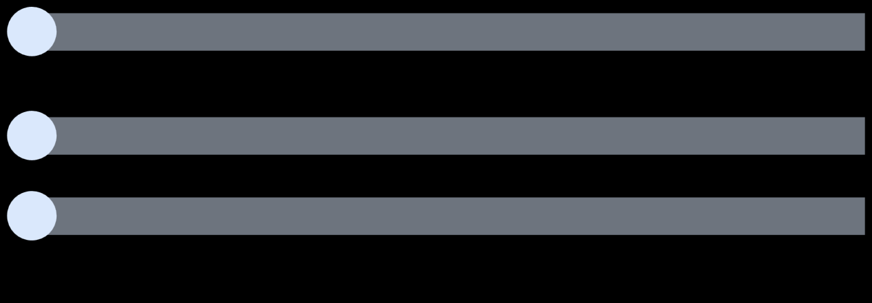

Containers and Docker
Section overview
1
Why use containers?
1.Compare how deployments happen with and without containers
2.Understand the main beneﬁts of using containers
2
Containers and Virtual Machines
1.Compare and highlight the diﬀerences between using containers and VMs for running workloads
3
Docker components
1.Discuss the diﬀerent components from a Docker system
2.Understand how these components interact when running common operations in Docker
Docker

Slide 3
Docker
Why Containers?

Slide 4
the problem (old way)
every server needs the right runtime (Node/Java/Python…), plus exact libraries.
versions drift: “works on my laptop, breaks on prod.”
devs write deploy scripts → ops runs them → missing deps, different OS, patch levels… repeat.
running apps side-by-side is messy (Node 16 vs Node 20, Python 3.8 vs 3.12).
what a container does
packs the app + its exact dependencies into one bundle (an image).
runs the bundle as an isolated container on any machine with Docker/Containerd.
same result on laptop, CI, server, or cloud — no “it works here” drama.

Slide 5

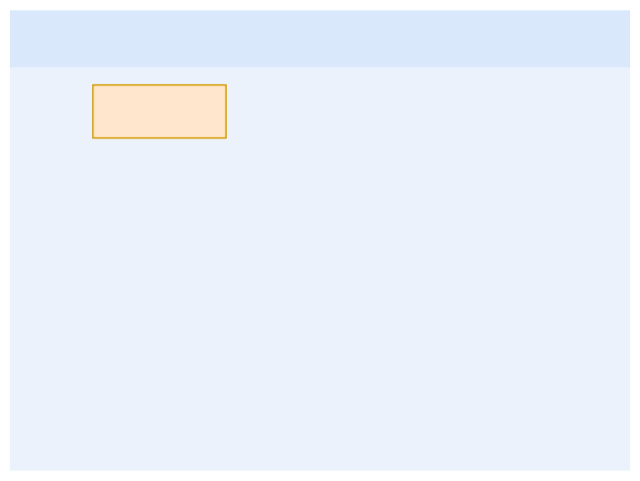

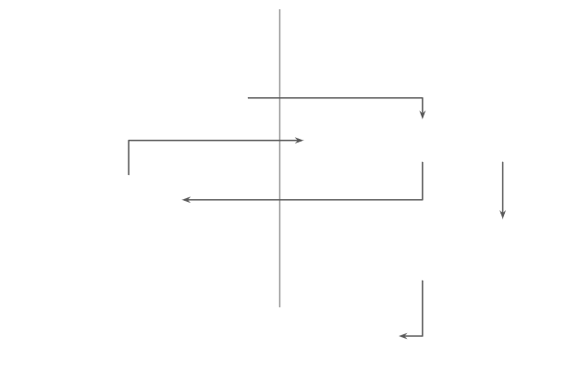









Why Containers?
How did we build and deploy applications, really?
■
What do we need to deploy a NodeJS app?
Devs… and Ops
□ □ □ □
Install NodeJS dependencies Install NodeJS itself Install the app's dependencies Run the application
Devs
Ops
1. Write script to deploy
How about with other programming languages?
2. Script doesn't work
■
3. Adjust script
Eventually…
4. Install dependencies and run script
■ ■
How about with other NodeJS versions? Not to mention managing multiple applications running side by side…
5. Deploy application
Docker

Slide 6

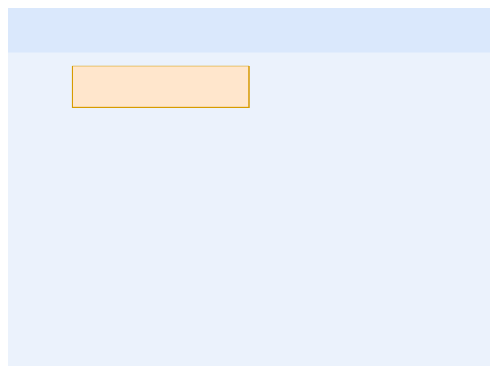


Why Containers?
How do containers come to the rescue?
■
Containers encapsulate all the dependencies and conﬁguration necessary to run whatever application. From the outside, they all look the same and are all run (almost) the same way. This leads to, among others:
Devs… and Ops (Revisited)
Devs
Ops
□Simpliﬁed setup
□ Portability
□Consistent environments
□ Isolation
□ Eﬃciency
1. Write Dockerﬁle
2. Build and push image
3. Provide some information if needed
□
□
Better resource control
Easily scalable applications
4. Deploy application
Docker

Slide 7
Docker
Containers and Virtual Machines

Slide 8
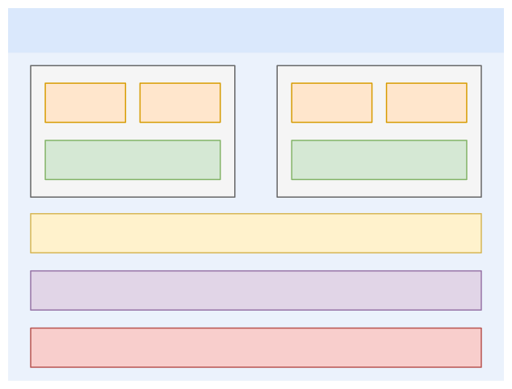
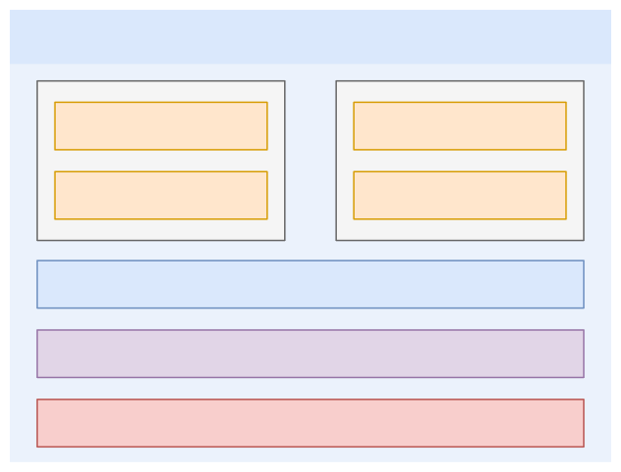
Containers and Virtual Machines
Containers are not the only solution
Virtualization
Containerization
Deps
Code
Deps
Code
Code
Code
Guest OS
Guest OS
Deps
Deps
Hypervisor
Container Engine
Host operating system
Host operating system
Hardware Infrastructure
Hardware Infrastructure
Docker

Slide 9
The core idea
VMs: each app gets a full guest OS on top of a hypervisor. Heavy but very isolated.
Containers: apps share the host OS kernel via a container engine (Docker/containerd). Light and fast.
quick comparison (at a glance)
Aspect | Virtual Machines (VMs) | Containers
What’s inside | Your app + deps + full OS | Your app + deps (no OS)
Starts in | minutes (boot an OS) | seconds (start a process)
Size | GBs (disk image) | MBs–hundreds MB (image layers)
Isolation | Strong (hardware-level via hypervisor) | Process/kernel isolation (namespaces/cgroups)
Density | Fewer per host | Many per host
OS choice per app | Any (Linux, Windows, BSD, etc.) | Must match host kernel family (Linux containers on Linux)
Ideal for | Strong isolation, legacy apps, different OSes, compliance air-gaps | Microservices, web APIs, CI/CD, bursty/scaling workloads

Slide 10

















Containers and Virtual Machines
Containers are not the only solution
Virtualization
Containerization
Docker

Slide 11

Containers and Virtual Machines
Containers are not the only solution
Virtual Machines (VMs)
Strong isolation: Each VM has its own OS, providing complete isolation.
Larger: VMs have a larger footprint due to the guest
OS and virtual hardware.
Less portable: VMs can be tied to speciﬁc hypervisors
and guest OS conﬁgurations.
Docker Containers
Process-level isolation: Containers share the host OS kernel.
Lightweight: Containers have minimal overhead, as they
share the kernel.
Highly portable: Containers are platform-agnostic and
run consistently.
Feature Isol ation
Size/Overhead
Portability
When to use
■
You need strong isolation between diﬀerent environments. You're dealing with legacy applications that might not be easily containerized. You want to replicate a complete system environment for testing or development.
■
You're building modern, cloud-native applications using microservices architecture. You need to scale your applications quickly and eﬃciently. Portability across diﬀerent environments is a top priority.
■
■
■
■
Docker

Slide 12
Docker
Docker Components

Slide 13

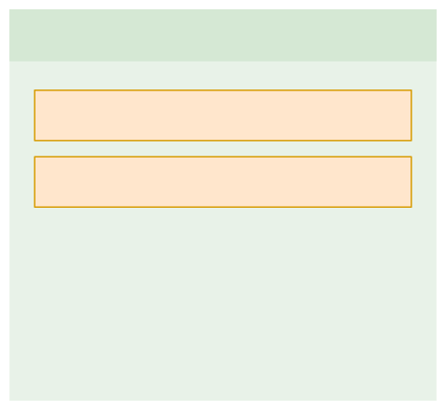

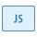


















Docker Components
What are the diﬀerent parts in a Docker-based system?
Docker Client
Docker Host
Image Registry
Docker CLI
REST API
API calls
Docker Daemon
…
Containers
Image cache
Docker

Slide 14
The Components
docker client the thing you use: commands like docker run, docker ps, or any app calling docker’s API.
docker host the machine that actually does the work. inside it:
docker daemon (dockerd): the “manager” that builds images, pulls from registries, creates/runs/stops containers.
rest api: the doorway the client uses to talk to the daemon.
image cache: local shelf of images already downloaded.
containers: the running apps (isolated processes with their own filesystem, network, and settings).
image a read-only blueprint of an app + all its dependencies (like nginx:alpine).
image registry the online library where images live (Docker Hub, GHCR, ECR, etc.).
how a docker run actually flows (in 5 steps)
you type docker run nginx:alpine (client).
client sends the request to the host’s REST API → daemon.
daemon checks local image cache; if missing,
it pulls the image from a registry and stores it in the cache.
daemon creates a container from that image and starts it.

Slide 15


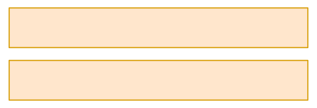
Docker Components
What are the diﬀerent parts in a Docker-based system?
Running a container from an image
Docker Client
Docker Host
Image Registry
Docker CLI
REST API
API calls
Docker Daemon
…
Containers
Image cache
Docker

Slide 16


Docker Components
What are the diﬀerent parts in a Docker-based system?
Running a container from an image
Docker Client
Docker Host
Image Registry
1
Docker CLI
REST API
1.Issue
docker run
in the CLI.
API calls
Docker Daemon
…
Containers
Image cache
Docker

Slide 17

Docker Components
What are the diﬀerent parts in a Docker-based system?
Running a container from an image
Docker Client
Docker Host
Image Registry
2
1.Issue docker run in the CLI. 2.CLI sends a request to the host's
Docker CLI
REST API
API calls
Docker Daemon
…
REST API.
Containers
Image cache
Docker

Slide 18
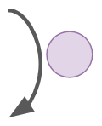
Docker Components
What are the diﬀerent parts in a Docker-based system?
Running a container from an image
Docker Client
Docker Host
Image Registry
1.Issue docker run in the CLI. 2.CLI sends a request to the host's
Docker CLI
REST API
API calls
Docker Daemon
…
REST API.
3.Docker Host checks if the image
3
is present in the local cache.
Containers
Image cache
Docker

Slide 19

Docker Components
What are the diﬀerent parts in a Docker-based system?
Running a container from an image
Docker Client
Docker Host
Image Registry
1.Issue docker run in the CLI. 2.CLI sends a request to the host's
Docker CLI
REST API
4
API calls
Docker Daemon
…
REST API.
3.Docker Host checks if the image
Containers
Image cache
is present in the local cache.
4.If not, it downloads it from the
image registry.
Docker

Slide 20
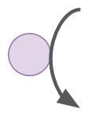
Docker Components
What are the diﬀerent parts in a Docker-based system?
Running a container from an image
Docker Client
Docker Host
Image Registry
1.Issue docker run in the CLI. 2.CLI sends a request to the host's
Docker CLI
REST API
API calls
Docker Daemon
…
REST API.
3.Docker Host checks if the image
5
Containers
Image cache
is present in the local cache.
4.If not, it downloads it from the
image registry.
5.Docker Host instantiates a new
container based on the image.
Docker

Slide 21
Docker
Installing Tools

Slide 22
Docker
Running Containers

Slide 23
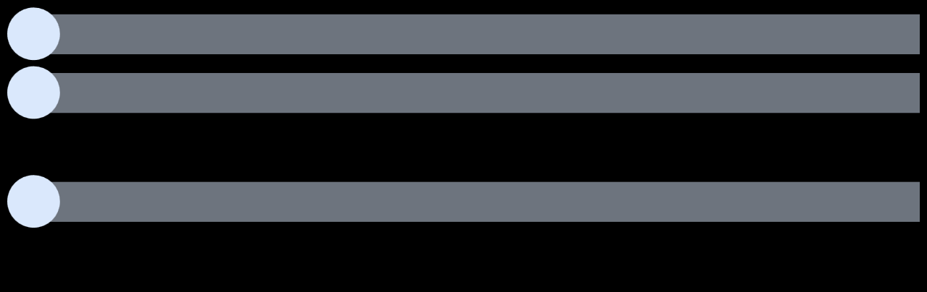

Running Containers
Section overview
1
Run your ﬁrst container
2
Understand the container lifecycle
1.Discuss the diﬀerent states a container can be in
2.Understand which CLI commands result in which states
3
Explore the Docker CLI
1.Demonstrate essential Docker CLI commands for managing containers and images.
2.Explain container behavior and Docker's management of short-lived vs. persistent containers.
3.Demonstrate commands for logging, running commands within containers, and executing shells.
4.Introduce the Docker build process by creating a simple Dockerﬁle and building a custom Docker image.
4
Get help with the CLI
Docker

Slide 24
Pull an image: docker pull nginx
Run a container: docker run nginx
Run in detached mode: docker run -d nginx
List running containers: docker ps
Stop a container: docker stop <container_name>
Kill a container forcefully: docker kill <container_name>
Run with port mapping: docker run -d -p 8080:80 --name webserver nginx
Check response via curl: curl http://localhost:8080
Access web page in a browser: http://localhost:8080

Slide 25
Docker
Container Lifecycle

Slide 26
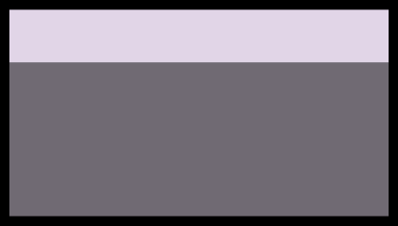
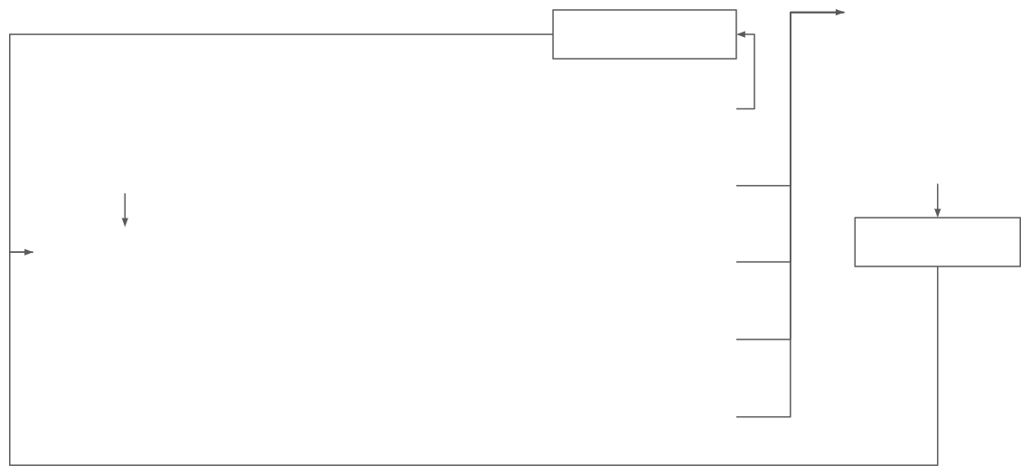





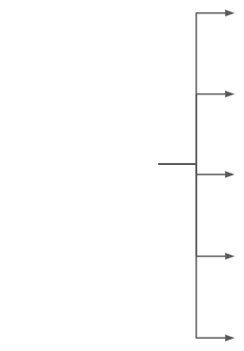







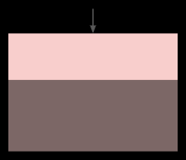


Container Lifecycle
Understand what happens with containers throughout their lifetime
Container stopped
docker unpause <cId>
Container still exists, can be seen with
docker ps -a
docker run <image>
+
docker logs
docker pause <cId>
Container is not
Keep memory
truly stopped
contents
docker create
+
docker
docker inspect
start
docker stop <cId>
Container stops
+
Clear memory
gracefully
contents
Assuming no restart policy in place
Container running
Container is forced to stop with SIGKILL (default)
docker start <cId>
docker rm <cId>
docker kill <cId>
docker logs
Container removed
exit 0
Container exited without an error
docker inspect
Container and its contents are removed, not
docker exec
Container exited with an error
available anymore.
exit <non-zero>
Docker

Slide 27
Here’s the container lifecycle
1) birth
docker run IMAGE = create + start in one step (or do them separately with docker create then docker start)
2) while it’s running
docker logs <cid> – read its output
docker exec -it <cid> sh – open a shell inside
docker inspect <cid> – see config, IP, mounts, etc.
3) ways a running container can “stop”
Pause: docker pause <cid> → freezes the process (CPU stops) but memory stays. Resume with docker unpause <cid>.
Graceful stop: docker stop <cid> → sends SIGTERM (app can clean up); after a timeout, Docker sends SIGKILL. Memory is cleared.
Force stop: docker kill <cid> → immediate SIGKILL (no cleanup).
Process exits:
exit 0 = app finished successfully
exit non-zero = app failed
After any of the above (except pause), the container is in Stopped state.
4) stopped state
It still exists on disk; you’ll see it in docker ps -a.
You can start it again: docker start <cid> → back to Running.
Or remove it: docker rm <cid> → gone.
5) removed
The container is deleted.
The image you used still stays in your local cache (unless you docker rmi IMAGE).
Volumes persist unless you remove with docker rm -v or docker volume rm.
6) (nice to know) restart policies
If you set one, Docker will auto-restart the container after crashes/reboots:
--restart=always
--restart=unless-stopped
--restart=on-failure[:N]

Slide 28
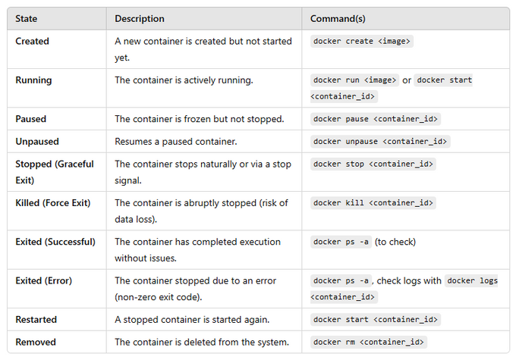
Key Takeaways
docker run is a shortcut for creating and starting a container.
Containers can be paused and unpaused without stopping them.
Containers exit normally (exit code 0) or due to an error (non-zero exit code).
Stopped containers still exist and can be restarted (docker start).
Removing a container (docker rm) permanently deletes it.
Restart policies can automatically restart failed containers (covered later in the course).

Slide 29
Docker CLI
Command | Description | Example Usage
docker images | List all locally stored images | docker images
docker ps -a | Show all containers (running and stopped) | docker ps -a
docker pull <image> | Download an image from Docker Hub | docker pull ubuntu
docker run <image> | Run a container (creates & starts it) | docker run nginx
docker start <container_id> | Restart an existing container | docker start abc123
docker stop <container_id> | Gracefully stop a container | docker stop abc123
docker rm <container_id> | Remove a stopped container | docker rm abc123
docker ps --filter "name=<name>" | Filter containers by name | docker ps --filter "name=web_server"
docker ps -q | Get only container IDs (quiet mode) | docker ps -q
docker stop $(docker ps -q) | Stop all running containers | docker stop $(docker ps -q)
docker rm $(docker ps -aq) | Remove all stopped containers | docker rm $(docker ps -aq)

Slide 30
Docker CLI
Running & Managing Containers
Checking Images & Containers
Command | Description | Options / Explanation
docker run -d -p 80:80 --name web_server nginx | Runs a new Nginx container in detached mode with port mapping | -d (detached mode), -p 80:80 (map host port 80 to container port 80), --name web_server (custom container name)
docker stop <container_name> | Gracefully stops a running container | Allows a proper shutdown, preventing data corruption
docker rm <container_name> | Removes a stopped container | Frees system resources
Command | Description | Options / Explanation
docker images | Lists all locally stored images | Shows only downloaded images, not images available on Docker Hub
docker image rm <image_id> | Removes an image from local storage | If an image is removed and later needed, Docker re-downloads it
docker ps | Shows only running containers | Does not display stopped containers
docker ps -a | Shows all containers (running + stopped) | Useful for inspecting exited containers

Slide 31
Viewing Container Logs
Executing Commands Inside a Running Container
Command | Description | Options / Explanation
docker logs <container_name> | Viewing Container Logs | Useful for debugging without real-time monitoring
docker logs -f <container_name> | Follows container logs live | -f (follow) keeps streaming logs in real time
curl http://localhost | Sends a request to the running Nginx container | Triggers a log entry for GET requests
Command | Description | Options / Explanation
docker exec -it <container_name> sh | Opens an interactive shell inside the container | -it (interactive mode), sh (default shell for Alpine-based images)
docker exec -it <container_name> /bin/bash | Opens an interactive Bash shell | Use Bash if available (e.g., Ubuntu-based containers)
ls | Lists files in the current directory | Standard Linux command
echo "Hello World" | Prints "Hello World" to the terminal | Useful for testing shell access
ls /usr/share/nginx/html | Shows the directory where Nginx serves files | Location of the default index.html
cat /usr/share/nginx/html/index.html | Displays the content of the index.html file | Confirms what is served on the Nginx web server

Slide 32
Creating Custom Docker Images with a Dockerfile
Command | Description | Options / Explanation
vim Dockerfile | Creates a new Dockerfile | You can use any text editor (VS Code, Nano, Vim)
Dockerfile Contents: | Defines the base image and command to execute | FROM ubuntu:latest (Base OS), RUN echo "Hello from my first Docker image" (Prints message)
docker build -t my_first_image . | Builds a custom Docker image | -t (tag name for the image), . (build context = current directory)
docker images | Lists all images, including newly built ones | Confirms if the new image was successfully created
docker run my_first_image | Runs a container from the new custom image | Executes the echo command inside the container
Expected Output: | Hello from my first Docker image | This confirms the custom image was built correctly

Slide 33
Docker
Working with Images

Slide 34
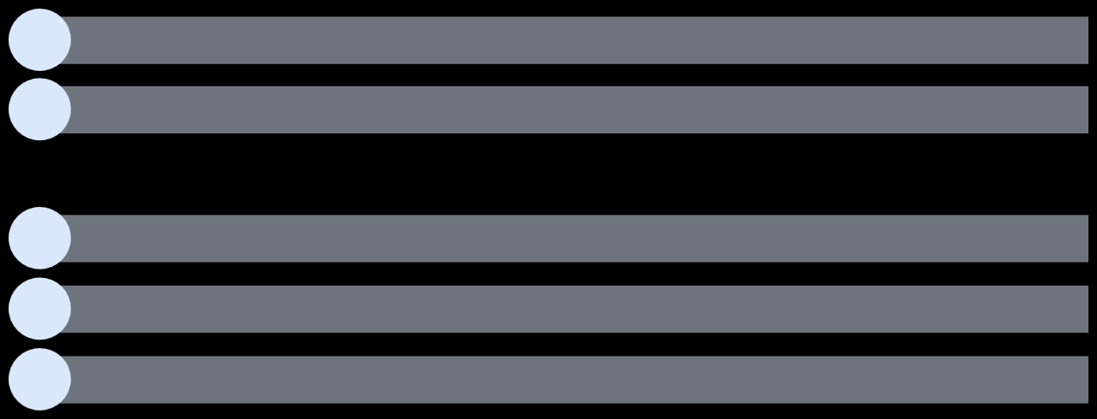
Working with Images
Section overview
1
Understand Docker images and their purpose
2
Explore container registries
1.Understand the purpose of container registries, and the diﬀerent options available
2.Learn how to browse images in Docker Hub
3
Manage images with the CLI
4
Create Dockerﬁles and use them to build images
5
Clarify the diﬀerence between images and containers
Docker

Slide 35
Docker
Docker Images

Slide 36








Docker Images
Understanding the DNA of our containers
Images are a self-contained, read-only template that encapsulates everything needed to run your application:
■The base layer: often a minimal Linux distribution like Alpine, or a more full-ﬂedged one like Ubuntu.
■Runtime Environment: Speciﬁc software (e.g., Python, Node.js) required by your application.
■Libraries & Dependencies: All the external code your application relies on.
■Application Code: Your own source code or compiled binaries.
■Conﬁguration: Settings for your application and its environment.
Conﬁguration
Application code
A Docker image is like a snapshot of your application and its complete runtime environment, frozen in time
and ready to be brought to life as a container. Images can be sourced from multiple locations:
Dependencies
■Docker Hub: This is the oﬃcial Docker image repository, oﬀering a vast collection of images for various
Runtime deps
purposes.
■Private Registries: For organizations or individuals with proprietary software, private registries provide
secure storage for custom images.
Base image
■Building Your Own Images: This is where the real power of Docker shines. By writing Dockerﬁles, you
can create images that perfectly match your application's requirements.
Docker

Slide 37
Docker
Container Registries

Slide 38












Container Registries
Storing and managing Docker images
■
Container registries oﬀer a multitude of beneﬁts:
□ □ □ □
Collaboration: Share your images with teammates, clients, or the wider community. Versioning: Track diﬀerent versions of your images for easy rollback and updates. Security: Private registries provide a secure environment for storing sensitive images. Automation: Automate image building and deployment as part of your CI/CD pipeline.
■
Types of Container Registries:
□
Public Registries: Open to everyone and host a vast collection of images from various sources.
Docker Hub is the most prominent example.
□Private Registries: Used for storing proprietary or sensitive images and oﬀer granular access
control.
Docker

Slide 39
Docker
Dockerﬁle

Slide 40
What is a Dockerfile?
A Dockerfile is a script that defines step-by-step instructions to build a Docker image. These instructions are executed sequentially from top to bottom and are responsible for setting up the dependencies, environment, and configurations required for a containerized application.
The first instruction must always be FROM, which specifies the base image to use.
Each subsequent instruction adds configurations, dependencies, or file modifications.
The order of instructions is important, as each step creates a new image layer.

Slide 41
Structure of a Dockerfile
Instruction | Description | Options / Explanation
FROM <image> | Specifies the base image to use | The first line of every Dockerfile. Example: FROM ubuntu:latest
RUN <command> | Executes a command during the image build process | Example: RUN apt-get update && apt-get install -y curl
COPY <src> <dest> | Copies files from the host machine to the container | Example: COPY app /usr/src/app
ADD <src> <dest> | Similar to COPY but also extracts compressed files | Example: ADD archive.tar.gz /data/
WORKDIR <dir> | Sets the working directory inside the container | Example: WORKDIR /usr/src/app
CMD ["command", "arg1"] | Defines the default command that runs when the container starts | Example: CMD ["node", "app.js"]
ENTRYPOINT ["command", "arg1"] | Sets a command that always executes when the container starts | Works similarly to CMD but is less flexible
EXPOSE <port> | Documents which port the container listens on | Example: EXPOSE 8080
ENV <key>=<value> | Defines environment variables inside the container | Example: ENV NODE_ENV=production

Slide 42
# ==== 0) Prereqs
# Needs: Docker installed and running. Works on Linux/macOS (and WSL2).
set -e
# ==== 1) Make a tiny web app ==========
mkdir -p demo-docker && cd demo-docker
# app code (Flask web server)
cat > app.py <<'PY'
from flask import Flask, jsonify
app = Flask(__name__)
@app.get("/")
def home():
return "Hello from Docker!\n"
@app.get("/health")
def health():
return jsonify(ok=True)
if __name__ == "__main__":
app.run(host="0.0.0.0", port=8000)
PY
# python deps
cat > requirements.txt <<'REQ'
flask==3.0.3
REQ
# ignore junk when building
cat > .dockerignore <<'IGN'
__pycache__/
*.pyc
*.pyo
*.pyd
.venv/
IGN
# ==== 4) Test it ======================
# wait until the health endpoint is ready (few seconds)
echo "Waiting for app to be ready..."
until curl -fsS http://localhost:8000/health >/dev/null; do sleep 1; done
echo "Health OK"
# hit the homepage
echo "GET / =>"
curl -i http://localhost:8000/
# see recent logs
echo -e "\nContainer logs:"
docker logs --tail 20 demo
# optional: execute something inside the running container
docker exec -it demo python -c "print('Inside container OK')"
# ==== 5) Clean up ==========
# stop & remove the container; delete the image (optional)
docker stop demo
docker rm demo
docker rmi demo-flask:1
echo "Done. (Rebuild with: docker build -t demo-flask:1 .)"
# Dockerfile (container recipe)
cat > Dockerfile <<'DOCKER'
FROM python:3.12-slim
# faster, cleaner Python
ENV PYTHONDONTWRITEBYTECODE=1 \
PYTHONUNBUFFERED=1
# install security updates & runtime deps (optional but sensible)
RUN apt-get update -y && apt-get upgrade -y && rm -rf /var/lib/apt/lists/*
WORKDIR /app
# install only what we need, cached by layer
COPY requirements.txt .
RUN pip install --no-cache-dir -r requirements.txt
# add the app
COPY app.py .
EXPOSE 8000
CMD ["python", "app.py"]
DOCKER
# ==== 2) Build the image ======
docker build -t demo-flask:1 .
# ==== 3) Run a container =======
docker run -d --name demo -p 8000:8000 demo-flask:1

Slide 43

Kubernetes
10000-Foot Overview

Slide 44
10000-Foot Overview
Section overview
1
What is Kubernetes? And why use it?
2
Discuss Kubernetes' architecture
1.Control plane vs. data plane
2.Nodes and Kubernetes objects
3
Introduce the Kubernetes CLI: kubectl
1.Diﬀerentiate kubectl and the Kubernetes cluster
2.Understand how kubectl communicates with the cluster
3.Discuss the structure of kubectl commands
Kubernetes

Slide 45
Kubernetes
Managing containers at scale

Slide 46
1) Container scheduling
Docker: you place containers on machines yourself.
Kubernetes: scheduler auto-places pods on the best nodes based on resources & rules.
2) Load balancing
Docker: no built-in, cluster-wide load balancer.
Kubernetes: Services spread traffic across healthy pods.
3) Scaling applications
Docker: manual scaling; you must wire traffic to new instances.
Kubernetes: declarative scaling (replicas) and auto-scaling from metrics (HPA).
4) Self-healing
Docker: if a process dies, you fix it.
Kubernetes: restarts failed containers, reschedules on other nodes, keeps desired state.
5) Service discovery
Docker: no robust, built-in discovery for many services.
Kubernetes: internal DNS—each Service gets a stable name (e.g., orders.default.svc).
6) Configuration & secrets
Docker: ad-hoc env files and flags; gets messy at scale.
Kubernetes: ConfigMaps and Secrets separate config from code and manage it per env.
7) Rollouts & rollbacks
Docker: you script updates.
Kubernetes: rolling updates by default; one command to roll back if needed.
8) Observability
Docker: limited, per-host view.
Kubernetes: unified events, statuses, probes; easy to plug in logging/metrics.
9) Multi-node & resilience
Docker: you build clustering yourself.
Kubernetes: designed for clusters; replaces pods on other nodes when one fails.
10) Policy & security
Docker: basic controls.
Kubernetes: rich policies (RBAC, NetworkPolicies, PodSecurity, resource quotas).

Slide 47


Managing containers at scale
Can't we get by with just Docker?
■
Docker and Docker Compose alone are enough for running individual containers or creating development environments, but they do not meet the requirements of production workloads.
Challenge
Docker
Kubernetes
Container Scheduling
✅ ✅
⭕ ⭕
Manual assignment of containers to servers Time consuming and error-prone
Declarative deﬁnition of criteria for node (server) assignment Handled automatically by Kubernetes based on resource deﬁnitions
Load Balancing
⭕
⭕
⭕
No built-in load balancing
✅ ✅
Services provide built-in load balancing across Pods
Scaling Applications
Lacks automation for horizontal scaling
Requires low-level adjustments for directing load to
newly created containers
Horizontal Pod Autoscaler can scale pods horizontally and
automatically through real-time metrics
⭕
Lacks automation for detecting and restarting
unhealthy workloads
✅
Self-Healing
Health checks and continuous monitoring allow for considerably more robust self-healing mechanisms
Kubernetes

Slide 48
Managing containers at scale
Can't we get by with just Docker?
■
Docker and Docker Compose alone are enough for running individual containers or creating development environments, but they do not meet the requirements of production workloads.
Challenge
Docker
Kubernetes
Service Discovery
⭕
✅
No built-in solution for service discovery at scale
Internal DNS allows for robust service discovery mechanisms through Services
⭕
✅
Conﬁguration maps and secrets allow decoupling and
scaling of application conﬁguration
Conﬁguration Management
Requires low-level conﬁguration and adjustments, and can become cumbersome for larger applications and multiple environments
Kubernetes

Slide 49
Kubernetes
What is Kubernetes?

Slide 50
What it is
Open-source “container orchestrator.” The industry standard for running lots of containers reliably.
Extensible platform. Huge ecosystem of add-ons (networking, storage, security, observability).
The goal (why it exists)
Automation: it handles placement, restarts, rollouts, and recovery for you.
Declarative: you say the desired state (e.g., “run 5 copies”), Kubernetes keeps it that way.
Scalability: add or remove replicas easily; autoscale from real-time metrics.
Resilience: if something dies, it’s replaced; traffic is routed only to healthy instances.
How it thinks (desired-state loop)
you declare the state (YAML/objects).
controllers continuously compare desired vs actual.
they take actions (schedule, start, reschedule, roll back) until it matches.
Core building blocks
Pod: the smallest runnable unit (one or more tightly-coupled containers).
Deployment: manages stateless Pods—replicas, rolling updates, rollbacks.
Service: stable virtual IP + DNS name; load-balances to Pods.
ConfigMap & Secret: app configuration and sensitive data, separate from code.
Ingress / Gateway: routes external HTTP/HTTPS traffic into Services.
PersistentVolume/Claim: attach storage to Pods when state is needed.
Namespace: logical grouping/isolation inside a cluster.
Cluster pieces
Control plane (the brain): API server, scheduler, controller manager, etcd (cluster state).
Worker nodes (the muscles): run Pods via a container runtime (containerd), managed by the kubelet.
What you get out of the box
Scheduling across machines (bin-packing by resources/constraints).
Service discovery & load balancing (built-in DNS, stable service names).
Self-healing (restart, reschedule, replace).
Rolling updates / canaries / rollbacks.
Autoscaling (per workload, cluster-wide with add-ons).
Policies & multi-tenancy (RBAC, NetworkPolicies, quotas).

Slide 51

What is Kubernetes?
Understanding the goal, features, and architecture of Kubernetes
■
Open-source tool, which has become the de facto standard for container orchestration.
□
Kubernetes is designed to be easily extensible, and as a result the K8s ecosystem has grown to thousands of diﬀerent tools.
Goal: address the complexities of running containers in production. As such, the tool is designed around:
■
Automation
Declarative
Scalability
Resilience
Reduces the need for
manual intervention in
deploying and managing
applications.
Declare the ﬁnal, desired
state and let Kubernetes
ﬁgure out how to get there.
Eﬀortlessly scales
applications horizontally to
meet demand.
Ensures that applications
are always available, even in
the face of failures.
■
A Kubernetes cluster has many components, and they are either placed in the control plane or in worker nodes:
□Control plane: it's the brain of the cluster, containing the components responsible for managing the entire system. □Worker nodes: they are the machines where your applications actually run.
Kubernetes

Slide 52
Kubernetes
Kubernetes Architecture

Slide 53



Kubernetes Architecture
Understanding the main components of a Kubernetes Cluster
Kubernetes Cluster
Control Plane (Master Node)
Data Plane
Worker Node
Worker Node
Kubernetes

Slide 54

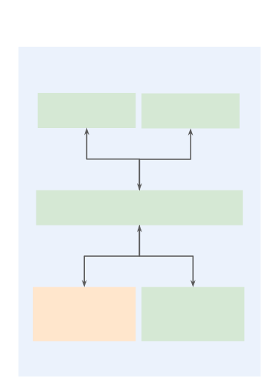

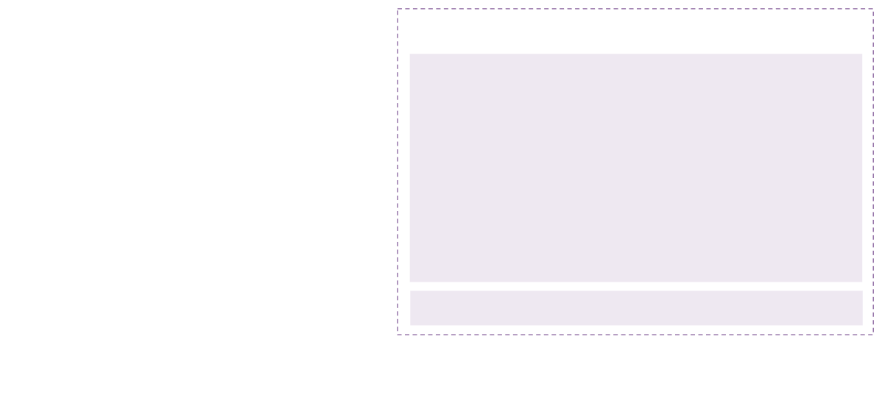
Kubernetes Architecture
Understanding the main components of a Kubernetes Cluster
Kubernetes Cluster
Mandatory
Control Plane (Master Node)
Data Plane
Optional
Etcd
Scheduler
Worker Node
API Server
Cloud Controller
Controller
Manager
Manager
Worker Node
Kubernetes

Slide 55


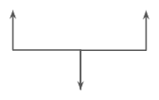

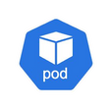
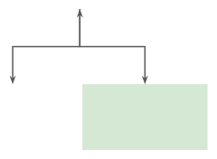
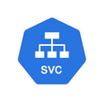

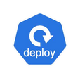
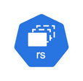
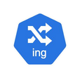

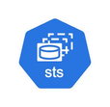


Kubernetes Architecture
Understanding the main components of a Kubernetes Cluster
Kubernetes Cluster
Mandatory
Control Plane (Master Node)
Data Plane
Optional
Etcd
Scheduler
Worker Node
kubelet
container runtime
kube-proxy
API Server
Other K8s objects
...
Cloud Controller
Controller
Manager
Manager
Worker Node
kubelet
kube-proxy
...
Kubernetes

Slide 56
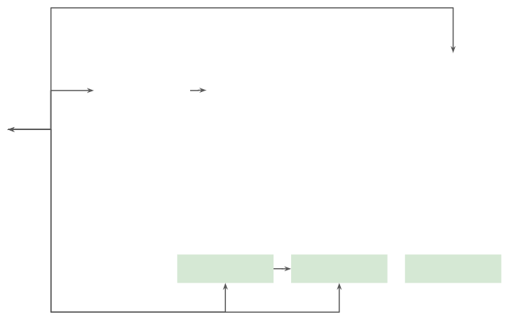

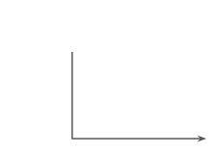
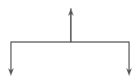


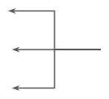




Kubernetes Architecture
Understanding the main components of a Kubernetes Cluster
Kubernetes Cluster
Mandatory
Control Plane (Master Node)
Data Plane
Optional
Etcd
Scheduler
Worker Node
Developer
kubelet
container runtime
kube-proxy
kubectl dashboard etc…
API Server
Other K8s objects
...
Cloud Controller
Controller
Manager
Manager
Worker Node
kubelet
kube-proxy
...
Kubernetes

Slide 57
Kubernetes architecture (big picture)
Cluster = Control Plane + Worker Nodes.
Control Plane = the brain (decides what should run where).
Workers / Data Plane = the muscles (actually run your app containers).
You (or CI) talk to the cluster via kubectl/API → Control Plane → Workers.
Control Plane — what each part does
API Server (must-have): front door for all requests. Every tool talks to this.
etcd (must-have): database storing cluster state (desired + actual).
Scheduler (must-have): chooses the best worker node for each new Pod.
Controller Manager (must-have): background robots that keep reality matching the desired state (ReplicaSet, Job, Node, etc.).
Cloud Controller Manager (optional): talks to AWS/Azure/GCP to create load balancers, attach disks, manage node lifecycles.
Worker Nodes — what runs on every worker
kubelet (must-have): node agent; takes Pod instructions from the API Server and ensures containers are running.
Container Runtime (must-have): actually runs containers (containerd, CRI-O, etc.).
kube-proxy (must-have): sets up networking rules so Services load-balance traffic to Pods.
How a deployment flows (end-to-end)
You apply a manifest to the API Server.
Controllers create/adjust objects (e.g., ReplicaSet wants N pods).
Scheduler assigns each Pod to a worker node.
On that node, kubelet asks the runtime to pull the image and start containers.
kube-proxy/Service make the Pod reachable and load-balanced.
If a Pod dies, controllers notice and the loop repeats (self-healing).

Slide 58
Kubernetes
The Control Plane

Slide 59

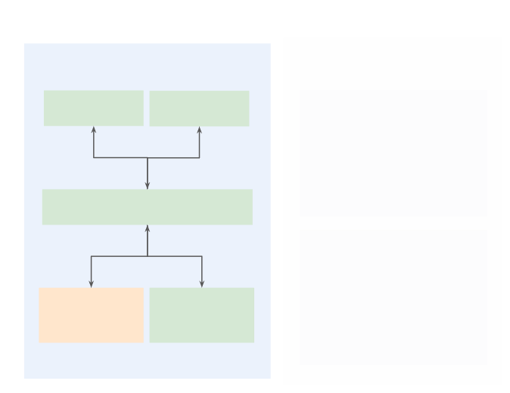

The Control Plane
Taking a closer look at the brains of Kubernetes
Kubernetes Cluster
■
API Server: exposes the Kubernetes API, which is the main entry point for all administrative tasks (kubectl, dashboard, etc.).
Scheduler: responsible for placing pods on the most suitable
nodes. It selects nodes based on resource availability and other
constraints.
Controller Manager: responsible for running controller
processes that handle routine tasks (e.g. ReplicaSet controller,
node controller, job controller, etc.).
Etcd: distributed key-value store that stores all cluster data,
including the conﬁguration and state of the cluster. Acts as the
single source of truth for the cluster's state.
Cloud Controller Manager: enables Kubernetes to interact with
the underlying cloud infrastructure. It handles tasks such as
managing cloud-based load balancers, persistent storage, and
node management.
Control Plane (Master Node)
Data Plane
■
Etcd
Scheduler
Worker Node
■
API Server
■
Worker Node
■
Cloud Controller
Controller
Manager
Manager
Kubernetes

Slide 60
Kubernetes
The Worker Nodes

Slide 61



The Worker Nodes
Taking a closer look at where containers are actually run
Kubernetes Cluster
■
kubelet: agent that runs on each worker node and communicates with the control plane. It ensures that containers are running in the pods as deﬁned by the pod speciﬁcations.
Container Runtime: responsible for running the
containers on each worker node. Kubernetes supports
several runtimes, such as Docker, containerd, or CRI-O.
kube-proxy: manages network rules on each worker
node. It maintains network connectivity and load
Data Plane
Worker Node
■
kubelet
container runtime
kube-proxy
■
balancing for services, ensuring that requests are routed
to the appropriate pods.
Other K8s Objects: higher-level Kubernetes objects such
as ReplicaSets, Deployments, Jobs, Services, StatefulSets,
among others.
Control Plane (Master Node)
Other K8s objects
■
...
Worker Node
kubelet
kube-proxy
...
Kubernetes

Slide 62
Kubernetes
The kubectl CLI

Slide 63
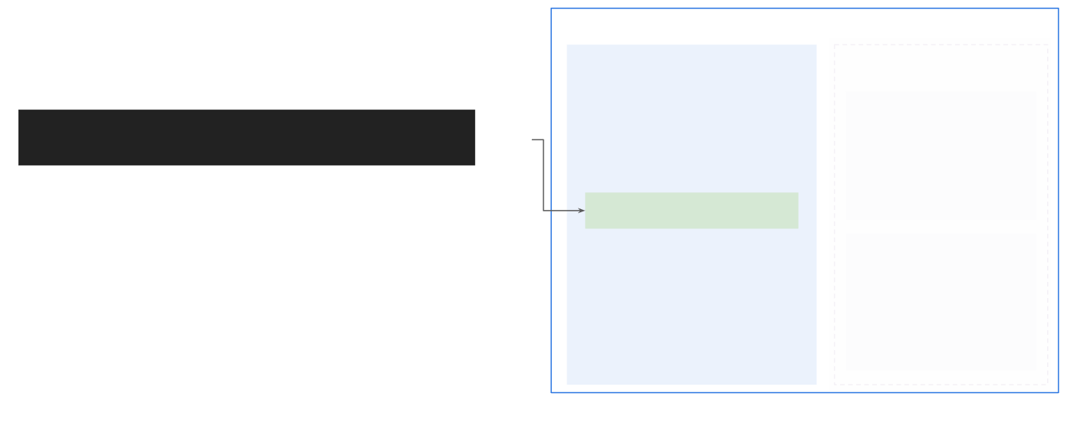
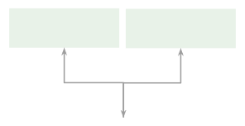
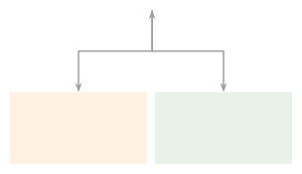
The kubectl CLI
Interacting with Kubernetes clusters via the CLI
Kubernetes Cluster
■
kubectl is the primary command-line utility for interacting with a Kubernetes cluster. It allows you to manage and control Kubernetes resources, such as pods, services, deployments, and more, by sending API requests to the Kubernetes control plane.
Control Plane (Master Node)
Data Plane
Etcd
Scheduler
Worker Node
kubectl [command] [res. type] [name] [flags]
Main types of commands / use-cases
API Server
■
Inspect cluster resources: Commands such as get, describe, and logs can be used to describe the state of individual resources or groups of resources.
Imperative resource management: Commands such as run,
scale, create, and delete can be used to imperatively create,
update, and delete resources.
Declarative resource management: Commands such as apply
and diff can be used to declaratively manage resources.
Worker Node
■
Cloud Controller
Controller
Manager
Manager
■
Kubernetes

Slide 64


Using the Alias for kubectl
Create an alias for the kubectl command line tool in your local
$ alias k=kubectl
environment
$ k version ...
Use the shortcut to refer to
kubectl

Slide 65


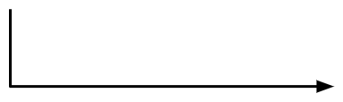

Using Auto-Completion for kubectl
$ kubectl cre<tab>
��
$ kubectl create
source <(kubectl completion bash) # set up autocomplete in bash into the current shell, bash-completion package should be installed first.
echo "source <(kubectl completion bash)" >> ~/.bashrc # add autocomplete permanently to your bash shell.

Slide 66
Kubernetes
Installing K8s Tooling

Slide 67
Kubernetes
Running Containers in K8s

Slide 68
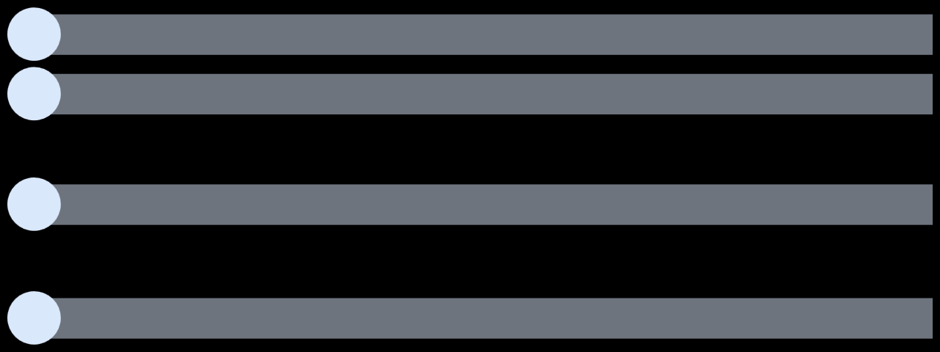
Running Containers in K8s
Section overview
1
Discuss Pods and their role in Kubernetes
2
Manage Pods in Kubernetes
1.Create Pods to run containers
2.Retrieve Pod information and delete Pods
3
Expose Pods via Services
1.Create services to facilitate communication with Pods
2.Understand why services are helpful
4
Understand how to go from Dockerﬁle to Pods
Kubernetes

Slide 69
Kubernetes
Pods

Slide 70
What is a Pod?
The smallest thing Kubernetes runs.
Think of it as a wrapper around one or more containers that must live together.
What a Pod gives you
Shared network: all containers in a Pod share one IP and can talk over localhost (127.0.0.1).
Shared storage (optional): volumes can be mounted by all containers in the Pod.
Shared fate: containers start/stop/restart together; the Pod is scheduled as one unit.
Why more than one container in a Pod?
Use it when containers are tightly coupled and must be co-located:
Sidecar: helper that adds a feature (logging agent, proxy, metrics exporter).
Adapter: transforms files or traffic for the main app.
Init container: runs setup steps before the main container starts.
(If two services can scale independently, they should be separate Pods.)
How Pods behave in the cluster
One Pod = one IP. Other Pods reach it via that IP or a Service name.
All Pods can talk to each other by default (network policies can lock this down).
Ephemeral: Pods can be replaced at any time (node crash, reschedule).
Keep state in Volumes/Databases, not in the container filesystem.
Keeping Pods healthy
Probes: Kubernetes can check if your container is alive/ready.
Liveness → restart if stuck.
Readiness → stop sending traffic until ready.
Resource requests/limits: tell the scheduler how much CPU/RAM you need and cap usage.
Important gotchas
Don’t put unrelated apps in one Pod. A Pod is not a VM; it’s a tight “process group.”
IP is not permanent. Use Services for stable access.
Logs/Temp files vanish with the Pod. Use central logging and volumes.

Slide 71

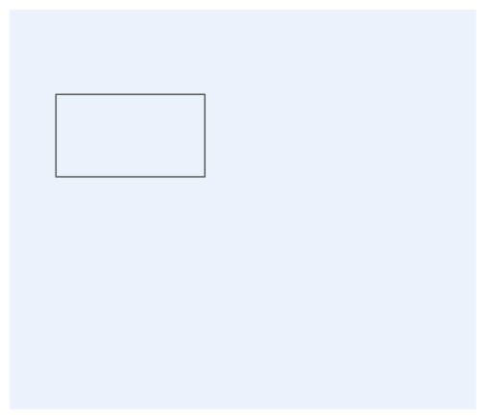
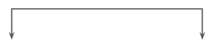

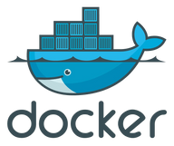
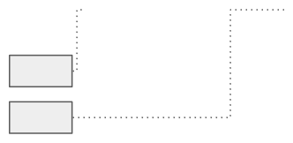





Pods
Meet the smallest and simplest unit that you create to run containers.
■
Pods represent a single instance of a running process in your cluster. They:
Pod
□ □ □
Encapsulate one or more containers. Allow containers to share storage and network resources. Provides multiple options to conﬁgure how containers are run (ports,
environment variables, volumes, security conﬁguration, among others).
localhost
container 1
container 2
Pods provide a higher level of abstraction than working directly with
containers, allowing multiple containers to work together if necessary.
80
■
□Containers running in the same Pod can communicate with each other via
8080
localhost.
They can also read/write to the same volumes.
□
pod directory
persistent vols
■ ■
Pods can all communicate with each other by default in Kubernetes.
We can set health probes in each container so that they are restarted or stop
receiving traﬃc if considered unhealthy.
cloud storage
Kubernetes

Slide 72
Kubernetes
Pod lifecycle

Slide 73
The phases (what you’ll see)
Pending
Pod accepted by the API but not running yet.
Waiting for a node (scheduler), pulling images, creating volumes.
Common sub-states: Scheduling, ContainerCreating, ImagePullBackOff.
Running
Pod is on a node and at least one container is started (or starting).
Readiness/Liveness probes decide whether it should receive traffic or be restarted.
Succeeded
All containers exited with code 0 and won’t restart (typical for Jobs/batch).
Pod is done; kept for history until cleaned up.
Failed
All containers exited, and at least one failed (non-zero).
Pod won’t restart (unless a controller creates a replacement, e.g., Job retry).
Unknown
Control plane can’t reach the node to know the status (network/node issue).

Slide 74
What drives transitions
Scheduler picks a node → Pending → Running.
Image pulls / volume mounts happen during Pending.
Container exit codes drive Running → Succeeded/Failed.
Probes (liveness/readiness) can trigger restarts or remove the Pod from traffic.
Restart policy (Always, OnFailure, Never) controls whether containers inside the Pod are restarted by kubelet.
Common “why is it stuck?” hints
Pending: no free resources, node selectors/taints don’t match, PVC not bound.
ContainerCreating: slow image pull, missing secret, volume attach delay.
CrashLoopBackOff: app starts then crashes repeatedly (bad config, port, env).
ImagePullBackOff: bad image name, tag, registry auth.
Unknown: node down or network partition.
Controllers matter
Deployment/ReplicaSet: if a Pod dies, a new Pod is created to keep the desired count.
Job/CronJob: repeats or retries until Succeeded (or hits backoff limits).
Standalone Pod: once Failed/Succeeded, it stays that way.
Lifecycle extras (useful to mention)
Init containers: run to completion before main containers.
PreStop/termination grace: Pods get time to shut down cleanly.
Eviction/Preemption: Pods can be removed or moved if a node is under pressure or a higher-priority Pod needs the spot.

Slide 75

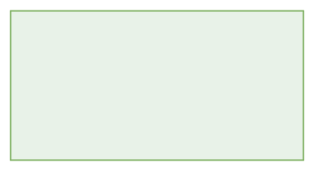




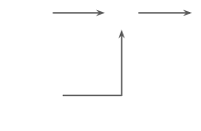

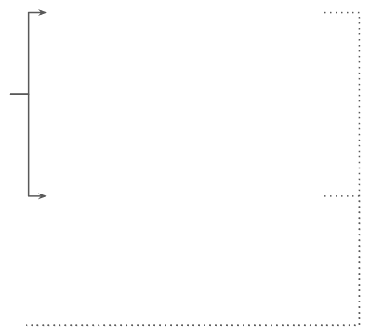







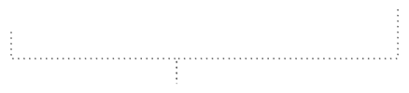


Pod lifecycle
Understand the diﬀerent phases of a Pod's lifecycle
Create Pod
Succeeded
All containers in the Pod have terminated successfully and will not be restarted.
Pending
One or more containers are not ready to run.
Running
All containers have been created and at least one is still running, or in the process of starting or restarting.
Devs
Pod to be scheduled
Container images will
Failed
All containers in the Pod have terminated, and at least one container has terminated in failure (non-zero exit code).
…
in Node
be downloaded
ContainerCreating
Unknown
The Pod's status could not be obtained, either due to a communication error with the Node running the Pod or due to some other issue.
Kubernetes

Slide 76
Kubernetes Pod Lifecycle
A pod in Kubernetes moves through multiple phases from creation to termination. These states determine whether a pod is scheduled, running, or stopped.
Phase | Description | Additional Information
Pending | The pod is created but not yet running. | It is waiting for a node assignment or image download.
ContainerCreating | The container images are being pulled and started. | This is a sub-phase of Pending.
Running | The pod is active, and at least one container is running. | If multiple containers exist, one must be running for the pod to be considered "Running".
Succeeded | All containers have exited successfully. | This is common for batch jobs that complete their tasks.
Failed | At least one container has terminated with an error. | Indicates a failure in execution.
Unknown | Kubernetes cannot determine the pod state. | Often due to communication issues with the node.

Slide 77
How Kubernetes Handles Container Failures
If a container crashes or exits unexpectedly, Kubernetes evaluates its restart policy.
Restart Policy | Behavior
Always | The container is restarted regardless of the exit code.
OnFailure | The container is restarted only if it fails (non-zero exit code).
Never | The container is not restarted, even if it fails.
If no restart policy is set, Kubernetes defaults to Always.
The OnFailure policy applies only to batch jobs or one-time scripts.

Slide 78
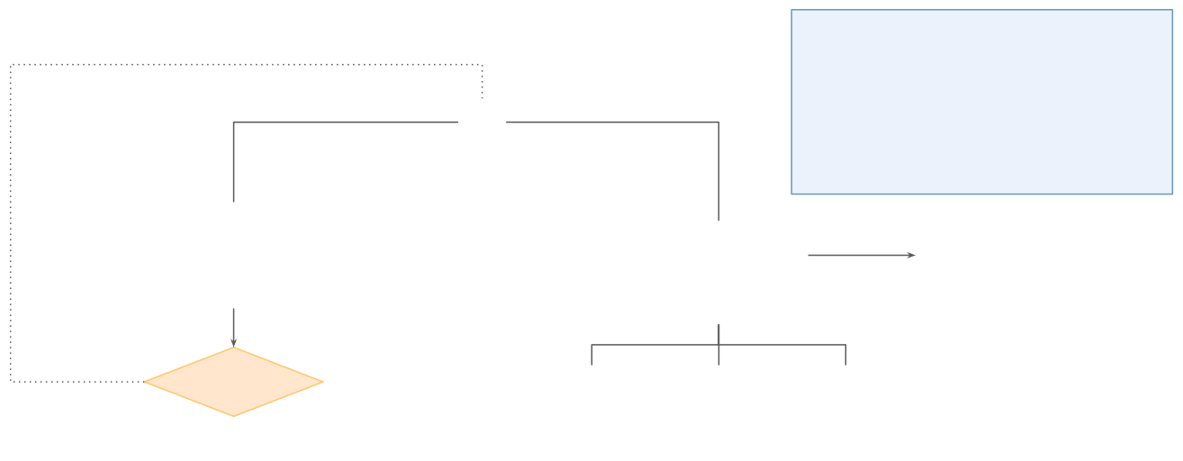






Pod lifecycle
Understand how Pods handle container errors
Helpful debugging commands
kubectl describe pod <pod-name> kubectl logs <pod-name> kubectl events pod <pod-name>
Adding the .-watch ﬂag can be helpful to stream updates in the terminal.
Reset exponential backoﬀ count
Restart container
Wait for exponential backoﬀ
CrashLoopBackOff
Yes
No
Container remains exited with error code
Container creating or
Container
running
crashes
Restart policy applies?
No
Always
OnFailure
Never
Has recent restarts?
Kubernetes

Slide 79
What happens when a container crashes
The kubelet notices the container exited with an error.
If the Pod’s restartPolicy allows it, Kubernetes tries to restart the container.
Each failed restart increases a backoff delay (wait longer each time) → you’ll see CrashLoopBackOff.
Backoff resets after the container runs successfully for a while.
How restartPolicy changes behavior
Always (typical for Deployments):
Restart on any exit (error or clean).
Designed for long-running services.
OnFailure (typical for Jobs):
Restart only if the container exits non-zero.
If it exits 0, it’s considered done.
Never:
Never restart. Pod keeps the exit code as its final state.
What keeps trying again?
A kubelet restarts containers inside the existing Pod according to restartPolicy.
Higher-level controllers (Deployment, Job) may create new Pods if the Pod fails or completes, to keep desired state.
Why CrashLoopBackOff happens
App starts → immediately crashes → Kubernetes restarts → crash again…
To avoid thrashing, it waits exponentially longer between attempts (seconds → minutes).
When the loop finally stops
For Deployments (Always): it keeps retrying indefinitely (with backoff) while the Pod exists.
For Jobs (OnFailure): retries until reaching the job’s backoff limit.
With Never: it stops after the first failure.

Slide 80
Exponential Backoff & CrashLoopBackOff
When a container repeatedly crashes, Kubernetes increases the delay before restarting it, preventing endless restart loops.
This mechanism is called Exponential Backoff and follows this pattern:
First restart: Instant
Next restarts: Delays increase (few seconds → 1 min → 2 mins → max 5 mins)
If repeated failures continue, the pod enters CrashLoopBackOff status.
The CrashLoopBackOff message indicates:
Kubernetes is delaying the restart due to multiple failures.
The application might be misconfigured or crashing immediately after startup.
You need to debug using logs or pod descriptions.
Resetting Exponential Backoff Count
If a container stops crashing and remains stable, Kubernetes:
Monitors it for a few minutes.
Resets the restart count to zero.
If the container crashes again later, Kubernetes restarts it immediately, starting the cycle fresh.

Slide 81
Debugging Pod Failures & Restart Issues
To troubleshoot pod crashes, Kubernetes provides several useful commands:
Command | Description
kubectl describe pod <pod_name> | Shows detailed information, including event history & errors.
kubectl logs <pod_name> | Retrieves logs from the container.
kubectl logs -f <pod_name> | Follows logs in real-time (similar to tail -f).
kubectl get events | Displays cluster-wide events, useful for identifying scheduling issues.
kubectl get pods --watch | Continuously watches the pod status in real-time.

Slide 82
Creating and Managing Pods with kubectl
This lecture introduces how to create, manage, and inspect Kubernetes pods using the kubectl CLI tool. It covers basic pod creation, setting the Kubernetes context, and verifying pod status.
Command | Description | Options / Explanation
kubectl version | Checks if Kubernetes is running and retrieves client & server versions. | Confirms cluster accessibility.
kubectl config current-context | Displays the current active Kubernetes context. | Ensures you are interacting with the correct cluster.
kubectl config set-context minikube | Sets the context to use Minikube as the Kubernetes cluster. | Use if the context is incorrectly set.
Verifying Kubernetes Cluster & Context
Before creating pods, ensure Kubernetes is running and correctly configured.
The context determines which cluster kubectl interacts with.
If working with multiple clusters, always verify the correct context is selected to avoid accidental modifications.

Slide 83
Creating a Pod using kubectl run
The kubectl run command is the primary way to create pods.
Command | Description | Options / Explanation
kubectl run nginx-pod --image=nginx:1.27.0 | Creates a pod with a single Nginx container (version 1.27.0). | --image=nginx:1.27.0 specifies the container image.
kubectl get pods | Lists all running pods and their statuses. | Shows columns: NAME, READY, STATUS, RESTARTS, AGE.
READY: 1/1 means one container is running and ready.
STATUS: Running confirms the pod is active.
RESTARTS: 0 indicates no failures.

Slide 84
Understanding the kubectl run Command
kubectl run <pod-name> --image=<container-image>:<tag>
<pod-name> → Specifies the pod’s name.
--image=<container-image>:<tag> → Defines the container image.
Ex: kubectl run nginx-pod --image=nginx:1.27.0
kubectl run --help
This provides usage examples and all available options.

Slide 85
Exploring Pod Inspection, Communication, and Management with kubectl
Command | Description | Options / Explanation
kubectl get pods | Lists all running pods and their basic status. | Shows NAME, READY, STATUS, RESTARTS, AGE.
kubectl describe pod <pod_name> | Provides detailed information about a specific pod. | Includes Node assignment, IP address, Status, Conditions, and Events.
The kubectl describe output includes:
Namespace where the pod is created.
Node where it is running.
Start time of the pod.
Pod IP address (internal to the cluster).
Container image details for debugging.
Conditions & Events showing pod scheduling and health status.

Slide 86
Communicating with a Pod Internally
Kubernetes assigns an internal IP to each pod, but this IP is not accessible externally. It can only be used within the cluster.
Command | Description | Options / Explanation
kubectl get pod <pod_name> -o wide | Shows additional details, including the pod’s internal IP address. | Useful for internal communication.
curl <pod_ip> (from another pod) | Tests direct communication with the pod’s IP address. | Works only inside the cluster.
Running curl <pod_ip> from outside the cluster will fail because the pod IP is private.
To test communication, we must create another pod inside the cluster.

Slide 87
Creating an Interactive Shell Inside a Pod
To interact with a pod’s container, we can start an interactive shell session.
Command | Description | Options / Explanation
kubectl run alpine --image=alpine:3.20 -it -- sh | Creates an interactive pod with Alpine Linux. | -it allows interaction, sh opens a shell.
apk add curl | Installs curl inside the Alpine container. | Alpine uses apk instead of apt/yum.
Using Pod Names for Communication:
Unlike Docker, Kubernetes does not allow pod-to-pod communication using names by default.
Instead, we must use internal IP addresses or configure Kubernetes Services (covered later).
After entering the container shell, we can test communication using:
curl <nginx_pod_ip>
If successful, we receive an HTML response from Nginx.

Slide 88
Retrieving Logs:
Use kubectl logs <pod_name> to check container output and errors.
Follow logs live with: kubectl logs -f <pod_name>.
Deleting Pods:
kubectl delete pod <pod_name> removes a pod normally.
If needed, force deletion using --force --grace-period=0.

Slide 89
Exposing Kubernetes Pods Using Services (kubectl expose)
This lecture covers how to expose Kubernetes pods using a Service, enabling stable network communication between containers. It also explains how to delete services and clean up resources.
1. Why Use a Kubernetes Service?
By default, pods in Kubernetes only have dynamic IPs that change upon restarts. This makes it difficult to establish persistent communication between different pods.
A Kubernetes Service provides:
✅ A stable IP address for reaching a pod.
✅ A DNS name to access the pod instead of using IPs.
✅ Load balancing for multiple pods.
Listing Existing Pods
Before creating a Service, ensure your pods are running.
Command Description
kubectl get pods Lists all running pods and their status.
If an Nginx pod is running, it can be exposed through a Service.

Slide 90
Creating a Service Using kubectl expose
The kubectl expose command creates a Service for an existing pod.
Command | Description | Options / Explanation
kubectl expose pod nginx --type=NodePort --port=80 | Creates a Service named nginx that exposes the nginx pod. | --type=NodePort makes the Service accessible within the cluster.
kubectl get services | Lists all services and their Cluster IPs. | Displays columns: NAME, TYPE, CLUSTER-IP, PORT(S), AGE.

Slide 91
Understanding Service Types
Accessing the Pod via the Service
After creating a Service, use its Cluster IP for communication between pods.
Service Type | Behavior
ClusterIP (default) | Exposes a pod internally (accessible only inside the cluster).
NodePort | Exposes a pod on a high-range port (30000-32767) on all cluster nodes.
LoadBalancer | Provides an external IP (used in cloud environments).
Command | Description
kubectl describe service nginx | Displays the Service details, including its Cluster IP.
kubectl run alpine --image=alpine:3.20 -it -- sh | Starts an interactive shell in a new pod.
apk add curl | Installs curl in Alpine (for making HTTP requests).
curl <cluster_ip> | Sends a request to the nginx Service.
A ClusterIP Service assigns a stable IP that does not change even when the pod restarts.
A NodePort Service allows external access via <node_ip>:<node_port>.
✅ The response confirms that the Nginx service is accessible.

Slide 92
Using DNS Names Instead of IP Addresses
Deleting a Service & Cleaning Up Pods
Instead of using the Cluster IP, we can communicate using the Service name.
Command | Description
kubectl delete service nginx | Deletes the Service, removing its Cluster IP.
Command | Description
curl nginx | Accesses the pod using the Service name.
Command | Description
kubectl delete pod alpine | Deletes the Alpine pod.
kubectl delete pod nginx | Deletes the Nginx pod.
kubectl get pods | Verifies that no pods are running.
✅ The Service automatically resolves pod IP changes, making it a more reliable method for inter-pod communication.

Slide 93
Kubernetes Objects

Slide 94
The core four (and how they nest)
Namespace A folder in the cluster. Separates teams/envs (dev, test, prod), names don’t clash.
Deployment The manager for stateless apps. You say “keep 3 copies of this Pod and roll out updates safely.” (Handles rollouts, rollbacks, and scaling.)
ReplicaSet The counter that ensures the right number of Pods exist. Deployments create/replace ReplicaSets during updates.
Pod The actual workload unit. One IP. One or more tightly-coupled containers that share network/storage.
Relationship: Namespace ⟶ Deployment ⟶ ReplicaSet ⟶ Pods.

Slide 95

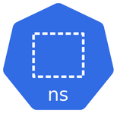
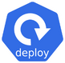


Kubernetes Objects
Provides a way to create logical partitions within a cluster
Manage Pod’s lifecycle & provide advanced capabilities for application management
Namespaces
Deployments
Ensure continuous pod availability
by automatically replacing failed
pods with new ones
R e plic aSe t s
Smallest installable units of
computing that can be created
and managed in K8s
Pods

Slide 96
Namespaces

Slide 97
what a namespace is
A folder inside a Kubernetes cluster.
Lets multiple teams/apps share one cluster without stepping on each other’s names.
why they matter
Organization: group all objects for an app/env (e.g., cloudmart-dev, cloudmart-prod).
Isolation (logical): limit who can see/change things with RBAC; pair with NetworkPolicies to restrict traffic.
Quotas & limits: cap CPU/RAM/objects per team using ResourceQuota + LimitRange.
Safer ops: delete/inspect at the namespace level instead of the whole cluster.
default namespaces (created by Kubernetes)
default – where things go if you don’t specify a namespace.
kube-system – core cluster components.
kube-public – readable by everyone (e.g., cluster info).
kube-node-lease – heartbeats from nodes.
what namespaces do not do (important!)
Not a hard security boundary by themselves. You still need RBAC, NetworkPolicies, and image/security policies.
They don’t split compute; scheduling is still cluster-wide (quotas help control usage).
good patterns
One namespace per environment or team (e.g., orders-dev, orders-stg, orders-prod).
Attach ResourceQuota and LimitRange to each namespace.
Use labels/annotations for ownership, cost center, and cleanup automation.
Keep platform stuff in dedicated namespaces (e.g., monitoring, logging).

Slide 98





Namespaces
Default Namespaces
Resource Isolation
Creates four default namespaces
▪ default
▪ kube- node- l ease
▪ kube- public
▪ kube- system
to manage cluster resources
Isolate resources in a cluster, preventing interference between users or teams
to manage cluster resources
Resource Organization
Resource Quotas
Helps in organizing and managing resources specific to application or environment
Enforce limits on resource usage to avoid excessive consumption by any single team

Slide 99
---
apiVersion: v1
kind: Namespace
metadata:
name: testns
---
apiVersion: v1
kind: ResourceQuota
metadata:
name: testnsquota
namespace: testns
spec:
hard:
pods: "1"
requests.memory: "1Gi"
requests.cpu: "1"
# If you are specifying requests and limits on quotas you have to define them in the POD sepc also
---
apiVersion: v1
kind: Pod
metadata:
name: testnspod
namespace: testns
spec:
containers:
- name: testnscon
image: httpd:latest
resources:
requests:
memory: "100Mi"
cpu: ".2"
apiVersion: v1
kind: Namespace
metadata:
name: jaitif
apiVersion: v1
kind: ResourceQuota
metadata:
name: quotatest
namespace: jaitif
spec:
hard:
pods: "1"

Slide 100
# List namespaces
kubectl get namespaces
# Verify ResourceQuota
kubectl get resourcequota -n testns
# Describe ResourceQuota to check limits
kubectl describe resourcequota testnsquota -n testns
# List pods in the namespace
kubectl get pods -n testns
# Describe the pod to check resource requests
kubectl describe pod testnspod -n testns
Command to Apply an Extra Pod (Should Fail)
cat <<EOF | kubectl apply -f -
---
apiVersion: v1
kind: Pod
metadata:
name: extratestpod
namespace: testns
spec:
containers:
- name: extratestcon
image: httpd:latest
EOF
cat <<EOF | kubectl apply -f -
---
apiVersion: v1
kind: Pod
metadata:
name: highmem-pod
namespace: testns
spec:
containers:
- name: highmem-container
image: httpd:latest
resources:
requests:
memory: "2Gi" # Exceeding the quota
EOF
Command to Apply a Pod Requesting More Memory (Should Fail)

Slide 101
Command to Apply a Pod Requesting More CPU (Should Fail)
cat <<EOF | kubectl apply -f -
---
apiVersion: v1
kind: Pod
metadata:
name: highcpu-pod
namespace: testns
spec:
containers:
- name: highcpu-container
image: httpd:latest
resources:
requests:
cpu: "2" # Exceeding the quota
EOF
kubectl describe resourcequota testnsquota -n testns

Slide 102
ReplicaSets

Slide 103
what is a ReplicaSet (RS)?
A controller that keeps a fixed number of identical Pods running.
You tell it: “keep N Pods matching this label selector.” It creates more if there are too few, deletes extras if there are too many.
how it works (mentally)
Define desired count (replicas) + Pod template + label selector.
RS watches the cluster for Pods with those labels.
If a Pod dies, RS replaces it (self-healing).
If you change replicas, RS scales up/down.
benefits
High availability: failed Pods are recreated automatically.
Scalability: change a number to add/remove capacity.
Consistency: all Pods come from the same template.
where it fits with Deployments
Deployment = higher-level manager that creates and swaps ReplicaSets for rolling updates and rollbacks.
Best practice: use Deployment for stateless apps.
Use a standalone ReplicaSet only when you need RS behavior without rollouts (rare).
key concepts & gotchas
Label selector is king: it decides which Pods the RS “owns.” If labels don’t match, RS won’t adopt them.
Selector is immutable: you can’t change it after creation (you’d make a new RS).
Pod IPs change: expose Pods via a Service, not by Pod IP.
Template changes: with a plain RS, edits replace Pods immediately but no rolling update strategy—that’s why Deployments are preferred.

Slide 104




ReplicaSets

Slide 105





How ReplicaSets Works?
Define ReplicaSet
Monitor running Pods
Effortless
Object
Scaling

Slide 106




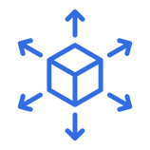

Benefits of ReplicaSets
High Availability
Scalability
Self-healing

Slide 107
apiVersion: apps/v1
kind: ReplicaSet
metadata:
name: myapp-replicaset
labels:
app: myapp
spec:
template:
metadata:
name: myapp-pod
labels:
app: myapp
spec:
containers:
- name: httpd-container
image: httpd
replicas: 1
selector:
matchLabels:
app: myapp
apiVersion: apps/v1
kind: ReplicaSet
metadata:
name: myapp-replicaset
labels:
app: myapp
spec:
template:
metadata:
name: myapp-pod
labels:
app: myapp
spec:
containers:
- name: httpd-container
image: httpd
replicas: 3
selector:
matchLabels:
app: myapp

Slide 108


ReplicaSets
Ensure that a certain number of pods is running at any given time
■
So far, we ran pods manually and individually. If a pod breaks or enters into an unhealthy state, we need to manually intervene.
ReplicaSets address the issue of replacing exited or unhealthy pods and
making sure that a stable number of identical pods are running at any
point in time.
apiVersion: apps/v1 kind: ReplicaSet metadata:
■
name: nginx-replicaset labels:
app: nginx
□Ensures high availability and fault tolerance by automatically
spec:
replicas: 3 selector:
replacing failed or terminated pods.
ReplicaSets work by identifying pods via selectors, and continuously
checking whether the number of running pods matches the desired
number of pods speciﬁed in the conﬁguration.
ReplicaSets will recreate pods automatically based on the template
section in their spec.
matchLabels: app: nginx
■
template:
metadata: labels:
■
app: nginx
spec:
containers:
- name: nginx
image: nginx:1.27.0
Kubernetes

Slide 109





ReplicaSets
Ensure that a certain number of pods is running at any given time
apiVersion: apps/v1 kind: ReplicaSet metadata:
nginx-replicaset
name: nginx-replicaset labels:
Continuous monitoring
replicas: 3
template
app: nginx
spec:
replicas: 3 selector:
matchLabels: app: nginx
template:
metadata: labels:
app: nginx
nginx
pod
nginx
pod
nginx
pod
spec:
containers:
- name: nginx
image: nginx:1.27.0
Kubernetes

Slide 110




ReplicaSets
Ensure that a certain number of pods is running at any given time
apiVersion: apps/v1 kind: ReplicaSet metadata:
nginx-replicaset
name: nginx-replicaset labels:
Continuous monitoring
replicas: 3
template
app: nginx
spec:
replicas: 3 selector:
matchLabels: app: nginx
template:
metadata: labels:
app: nginx
nginx
pod
nginx
pod
nginx
pod
spec:
containers:
- name: nginx
image: nginx:1.27.0
Kubernetes

Slide 111

ReplicaSets
Ensure that a certain number of pods is running at any given time
apiVersion: apps/v1 kind: ReplicaSet metadata:
nginx-replicaset
name: nginx-replicaset labels:
Continuous monitoring
replicas: 3
template
app: nginx
spec:
replicas: 3 selector:
matchLabels: app: nginx
template:
metadata: labels:
app: nginx
nginx
pod
nginx
pod
nginx
pod
spec:
containers:
- name: nginx
image: nginx:1.27.0
Kubernetes

Slide 112
Creating a Replica Set in Kubernetes
# What We Are Doing:
# 1. Clean up the Kubernetes cluster to remove any existing resources.
# 2. Create a new YAML file to define a ReplicaSet.
# 3. Apply the configuration using `kubectl apply`.
# 4. Verify the ReplicaSet and its managed pods.
# 5. Test Kubernetes' self-healing mechanism by deleting a pod.

Slide 113
# Step 1: Clean Up Existing Resources (if any)
kubectl delete all --all
# Step 2: Create a YAML File for the Replica Set
cat <<EOF > nginx-rs-replicaset.yaml
apiVersion: apps/v1
kind: ReplicaSet
metadata:
name: nginx-replica-set
spec:
replicas: 3
selector:
matchLabels:
app: nginx
template:
metadata:
labels:
app: nginx
spec:
containers:
- name: nginx
image: nginx:1.27.0
ports:
- containerPort: 80
EOF

Slide 114
# Step 3: Apply the Replica Set Configuration
kubectl apply -f nginx-rs-replicaset.yaml
# Step 4: Verify that the Replica Set and Pods are Running
kubectl get rs
kubectl get pods
# Step 5: Test Auto-Recovery by Deleting a Pod
POD_NAME=$(kubectl get pods -l app=nginx -o jsonpath='{.items[0].metadata.name}')
kubectl delete pod $POD_NAME
# Step 6: Recheck Pods to Confirm Auto-Recovery
kubectl get pods
# Step 7: Clean Up (Optional)
kubectl delete -f nginx-rs-replicaset.yaml

Slide 115
Creating a Kubernetes Deployment
# What We Are Doing:
# 1. Create a deployment YAML file.
# 2. Define API version, metadata, labels, and spec.
# 3. Specify replicas and the deployment strategy.
# 4. Apply the deployment using kubectl.
# 5. Verify deployment and pod status.

Slide 116
Kubernetes
Deployments

Slide 117


Deployments
Manage and update applications at scale
apiVersion: apps/v1 kind: Deployment metadata: name: nginx-deployment labels:
■
ReplicaSets oﬀer a great way to ensure a pre-deﬁned number of pods are running at any given time. However, they do not provide all the needed functionality for managing applications at scale.
Deployments oﬀer a higher level of abstraction on top of ReplicaSets, and
add the following features:
■
app: nginx
□Rolling updates: Gradually replace old pods with new ones without
spec: replicas: 3 selector:
downtime, ensuring the application remains available.
matchLabels: app: nginx
□Rollbacks: roll back to a previous version in case something goes
wrong during an update. This feature is crucial for maintaining
application stability and quickly recovering from errors.
template:
metadata: labels:
□Declarative updates of replicas over time.
□History and revision control: keep track of the history of all changes
app: nginx
spec:
made, allowing you to view and revert to previous versions.
containers: ...
□Advanced rollouts: limit risk by leveraging controlled rollouts of new
strategy:
type: RollingUpdate rollingUpdate: ...
versions, ensuring that updates are applied gradually and safely.
Kubernetes

Slide 118




Deployments
Manage and update applications at scale
apiVersion: apps/v1 kind: Deployment metadata: name: nginx-deployment labels:
nginx-deployment
replicas: 3
template
app: nginx
spec: replicas: 3 selector:
matchLabels: app: nginx
nginx-replicaset-01
template:
metadata: labels:
app: nginx
nginx
pod
nginx
pod
nginx
pod
spec:
containers:
- ...
strategy:
type: RollingUpdate
Kubernetes

Slide 119

Deployments
Manage and update applications at scale
apiVersion: apps/v1 kind: Deployment metadata: name: nginx-deployment labels:
nginx-deployment
replicas: 3
template
replicas: 3
new
app: nginx
template
spec: replicas: 3 selector:
matchLabels: app: nginx
nginx-replicaset-01
nginx-replicaset-02
template:
metadata: labels:
app: nginx
nginx
pod
nginx
pod
nginx
pod
spec:
containers:
- ...
strategy:
type: RollingUpdate
Kubernetes

Slide 120


Deployments
Manage and update applications at scale
apiVersion: apps/v1 kind: Deployment metadata: name: nginx-deployment labels:
nginx-deployment
replicas: 3
template
replicas: 3
new
app: nginx
template
spec: replicas: 3 selector:
matchLabels: app: nginx
nginx-replicaset-01
nginx-replicaset-02
template:
metadata: labels:
app: nginx
nginx
pod
nginx
pod
nginx
pod v2
spec:
containers:
- ...
strategy:
type: RollingUpdate
Kubernetes

Slide 121
Deployments
Manage and update applications at scale
apiVersion: apps/v1 kind: Deployment metadata: name: nginx-deployment labels:
nginx-deployment
replicas: 3
template
replicas: 3
new
app: nginx
template
spec: replicas: 3 selector:
matchLabels: app: nginx
nginx-replicaset-01
nginx-replicaset-02
template:
metadata: labels:
app: nginx
nginx
pod
nginx
pod v2
nginx
pod v2
spec:
containers:
- ...
strategy:
type: RollingUpdate
Kubernetes

Slide 122
Deployments
Manage and update applications at scale
apiVersion: apps/v1 kind: Deployment metadata: name: nginx-deployment labels:
nginx-deployment
replicas: 3
template
replicas: 3
new
app: nginx
template
spec: replicas: 3 selector:
matchLabels: app: nginx
nginx-replicaset-01
nginx-replicaset-02
template:
metadata: labels:
app: nginx
nginx
pod v2
nginx
pod v2
nginx
pod v2
spec:
containers:
- ...
strategy:
type: RollingUpdate
Kubernetes

Slide 123

Deployments
Manage and update applications at scale
apiVersion: apps/v1 kind: Deployment metadata: name: nginx-deployment labels:
nginx-deployment
replicas: 3
new
app: nginx
template
spec: replicas: 3 selector:
matchLabels: app: nginx
nginx-replicaset-02
template:
metadata: labels:
app: nginx
nginx
pod v2
nginx
pod v2
nginx
pod v2
spec:
containers:
- ...
strategy:
type: RollingUpdate
Kubernetes

Slide 124
Deployments
Manage and update applications at scale
apiVersion: apps/v1 kind: Deployment metadata: name: nginx-deployment labels:
nginx-deployment
app: nginx
spec: replicas: 3 selector:
matchLabels: app: nginx
nginx-replicaset-01
nginx-replicaset-02
template:
metadata: labels:
app: nginx
nginx
pod
nginx
pod
nginx
pod
nginx
pod v2
nginx
pod v2
nginx
pod v2
spec:
containers: ...
strategy:
type: RollingUpdate rollingUpdate: ...
Kubernetes

Slide 125
# Step 1: Create the Deployment YAML File
cat <<EOF > nginx-deployment.yaml
apiVersion: apps/v1
kind: Deployment
metadata:
name: nginx-deployment
labels:
app: nginx
spec:
replicas: 5
selector:
matchLabels:
app: nginx
template:
metadata:
labels:
app: nginx
spec:
containers:
- name: nginx
image: nginx:1.27.0
ports:
- containerPort: 80
strategy:
type: RollingUpdate
EOF
# Step 2: Apply the Deployment
kubectl apply -f nginx-deployment.yaml
# Step 3: Check Deployment Status
kubectl get deploy
# Step 4: Describe Deployment
kubectl describe deployment nginx-deployment
# Step 5: List the Pods Created by the Deployment
kubectl get pods
# Step 6: View Configuration of a Specific Pod
kubectl get pod $(kubectl get pods -l app=nginx -o jsonpath='{.items[0].metadata.name}') -o yaml
# Step 7: Cleanup (Optional)
kubectl delete -f nginx-deployment.yaml

Slide 126
Updating Pod Templates in Kubernetes
# What We Are Doing:
# 1. Open and modify the deployment YAML file.
# 2. Change the image from `nginx:1.27.0` to `nginx:1.27.0-alpine`.
# 3. Dry-run to check changes before applying.
# 4. Apply the update using kubectl.
# 5. Monitor pods and replica sets for rolling update progress.
# 6. Verify the updated image version.

Slide 127
# Step 1: Modify the Deployment YAML File
cat <<EOF > nginx-deployment.yaml
apiVersion: apps/v1
kind: Deployment
metadata:
name: nginx-deployment
labels:
app: nginx
spec:
replicas: 5
selector:
matchLabels:
app: nginx
template:
metadata:
labels:
app: nginx
spec:
containers:
- name: nginx
image: nginx:1.27.0-alpine
ports:
- containerPort: 80
strategy:
type: RollingUpdate
EOF
# Step 2: Check What Will Change Before Applying
kubectl apply --dry-run=client -f nginx-deployment.yaml
# Step 3: Monitor Current Pods and Replica Sets
kubectl get pods --watch &
kubectl get rs --watch &
# Step 4: Apply the Update
kubectl apply -f nginx-deployment.yaml
# Step 5: Monitor the Rolling Update Progress
kubectl rollout status deployment nginx-deployment
# Step 6: Describe the Deployment to Verify Changes
kubectl describe deploy nginx-deployment
# Step 7: Confirm the Image Update in the Running Pods
kubectl get pods
kubectl describe pod $(kubectl get pods -l app=nginx -o jsonpath='{.items[0].metadata.name}') | grep Image
# Step 8: Cleanup (Optional)
kubectl delete -f nginx-deployment.yaml

Slide 128
Exploring Rollouts in Kubernetes
# What We Are Doing:
# 1. Verify deployment status.
# 2. Check rollout history.
# 3. Undo rollouts if necessary.
# 4. View revision details.
# 5. Add annotations for tracking changes.
# 6. Apply and verify changes.

Slide 129
# Step 5: Modify Deployment YAML to Add an Annotation
cat <<EOF > nginx-deployment.yaml
apiVersion: apps/v1
kind: Deployment
metadata:
name: nginx-deployment
labels:
app: nginx
annotations:
kubernetes.io/change-cause: "Update nginx to tag 1.27.0-alpine"
spec:
replicas: 5
selector:
matchLabels:
app: nginx
template:
metadata:
labels:
app: nginx
spec:
containers:
- name: nginx
image: nginx:1.27.0-alpine
ports:
- containerPort: 80
strategy:
type: RollingUpdate
EOF
# Step 1: Verify Deployment Status
kubectl get deploy
# Step 2: Check Rollout History
kubectl rollout history deployment/nginx-deployment
# Step 3: Undo a Rollout (Rollback to Previous Version)
kubectl rollout undo deployment/nginx-deployment
# Step 4: View Details of a Specific Revision
kubectl rollout history deployment/nginx-deployment --revision=2
# Step 6: Apply the Deployment with the Change Cause
kubectl apply -f nginx-deployment.yaml
# Step 7: Annotate the Deployment Post-Rollout (Alternative CI/CD Approach)
kubectl annotate deployment/nginx-deployment kubernetes.io/change-cause="Update nginx to tag 1.27.1-alpine"
# Step 8: Verify Annotations
kubectl describe deployment/nginx-deployment
# Optional Cleanup
kubectl delete -f nginx-deployment.yaml

Slide 130
Scaling Deployments in Kubernetes
# What We Are Doing:
# 1. Check current deployment status.
# 2. Scale deployment replicas up or down.
# 3. Verify the changes.
# 4. Understand that `kubectl scale` is temporary.
# 5. (Optional) Reset replicas for troubleshooting.

Slide 131
# Step 1: Get Current Deployments
kubectl get deploy
# Step 2: Scale Deployment to 3 Replicas
kubectl scale deployment nginx --replicas=3
# Step 3: Verify the Scaling
kubectl get deploy
# Step 4: Apply the Original Configuration (Optional)
kubectl apply -f nginx-deployment.yaml
# Step 5: Scale Down to Zero (For Recovery Purposes)
kubectl scale deployment nginx --replicas=0
# Step 6: Scale Back to Desired Number
kubectl scale deployment nginx --replicas=5
# Optional Cleanup
kubectl delete deployment nginx

Slide 132
Understanding Failed Rollouts in Kubernetes
# What We Are Doing:
# 1. Deploy an invalid configuration (incorrect image tag).
# 2. Investigate the deployment and pod errors.
# 3. Roll back to the previous stable version if needed.
# 4. Fix the invalid configuration and reapply.
# 5. Verify the deployment.

Slide 133
apiVersion: apps/v1
kind: Deployment
metadata:
name: nginx
labels:
app: nginx
spec:
replicas: 3
selector:
matchLabels:
app: nginx
template:
metadata:
labels:
app: nginx
spec:
containers:
- name: nginx
image: nginx:invalid-tag # Intentionally incorrect tag
ports:
- containerPort: 80

Slide 134
# Step 1: Create an Invalid Deployment (Incorrect Image Tag)
kubectl apply -f nginx-invalid-deployment.yaml
# Step 2: Check Deployment Status
kubectl describe deployment nginx
# Step 3: Investigate Pod Errors
kubectl get pods # Look for ImagePullBackOff status
kubectl describe pod <pod-name>
# Step 4: Identify the Issue (Check Image Pull Failures)
kubectl logs <pod-name>
# Step 5: Roll Back Deployment to Last Working Version (if needed)
kubectl rollout undo deployment/nginx
# Step 6: Fix the Invalid Configuration in YAML and Reapply
kubectl apply -f nginx-deployment.yaml
# Step 7: Verify the Deployment and Ensure Pods Are Running
kubectl get pods
kubectl rollout status deployment/nginx
# Optional Cleanup
kubectl delete deployment nginx

Slide 135
Labels & Selectors

Slide 136
Labels & Selectors
Provides a way to categorize & target resources within a cluster
Labels categorize resources in Kubernetes with identifying tags
Selectors filter resources based on their assigned labels

Slide 137



Benefits of Labels & Selectors
Categorization
/Organization
Selection
Automation

Slide 138
Labels are key-value pairs attached to Kubernetes objects (e.g., Pods, Services, Deployments). They help organize, group, and select resources.
Selectors are filters used to query and select Kubernetes resources based on their labels.
📌 Why Use Labels & Selectors? ✔ Organize resources logically.
✔ Select groups of Pods for a Service, Deployment, or NetworkPolicy.
✔ Enable dynamic management of workloads.
Feature | Explanation
Labels | Metadata (key-value pairs) assigned to objects.
Selectors | Used to query and filter objects based on labels.
Immutable? | Labels can be added/modified but not removed once set.
Use Cases | - Grouping resources - Attaching Pods to Services - Identifying environments (prod, dev, test)

Slide 139




Labels and Selectors
Identify and group resources meaningfully
■
Labels are key-value pairs attached to Kubernetes objects (e.g., pods, nodes, services). They provide metadata that helps identify and organize these objects.
Labels allow Kubernetes users to categorize and organize resources, enabling
sophisticated grouping and selection mechanisms. Labels are not unique,
and multiple objects can have the same label.
Selectors are expressions used to ﬁlter Kubernetes objects based on their
labels. Selectors allow users and Kubernetes components to target speciﬁc
objects that match certain criteria.
apiVersion: v1 kind: Pod metadata: name: api-server
apiVersion: v1 kind: Service metadata: ... spec:
■
labels:
selector:
app: color-api tier: backend
app: color-api tier: backend
■
spec: ...
labels:
labels:
labels:
labels:
labels:
:
app environment:
color-api dev frontend stable
:
app environment:
color-api dev backend stable
:
app environment:
color-api dev backend canary
:
app environment:
ecomm dev backend stable
:
app environment:
ecomm prod backend stable
tier
:
tier
:
tier
:
tier
:
tier
:
release:
release:
release:
release:
release:
Kubernetes

Slide 140
cat <<EOF | kubectl apply -f -
apiVersion: apps/v1
kind: Deployment
metadata:
name: label-demo
labels:
app: web
spec:
replicas: 3
selector:
matchLabels:
app: web
template:
metadata:
labels:
app: web
tier: frontend
spec:
containers:
- name: nginx
image: nginx:latest
EOF
# 1️⃣ Show all pods with labels
kubectl get pods --show-labels
# 2️⃣ Filter pods based on label "tier=frontend"
kubectl get pods -l tier=frontend
# 3️⃣ Add a new label "env=production" to the first pod
POD_NAME=$(kubectl get pods -l app=web -o jsonpath='{.items[0].metadata.name}')
kubectl label pod $POD_NAME env=production
# 4️⃣ Verify label was added
kubectl get pods --show-labels
# 5️⃣ Remove the label "env" from the pod
kubectl label pod $POD_NAME env-
# 6️⃣ Show updated labels
kubectl get pods --show-labels
# 7️⃣ Delete all pods with label "tier=frontend"
kubectl delete pods -l tier=frontend

Slide 141
Inbuilt (System) Labels in Kubernetes
In Kubernetes, inbuilt labels are automatically assigned by the system to resources (like pods, nodes, etc.). These labels provide metadata that helps Kubernetes manage and schedule workloads effectively.
kubectl get nodes --show-labels

Slide 142
Kubernetes
Annotations

Slide 143


Annotations
Add useful information and conﬁguration to resources
■
Annotations are key-value pairs attached to Kubernetes objects, just like labels. Unlike labels, annotations are not supposed to store identifying metadata, and they are often used by tools or the Kubernetes system itself.
Common use-cases:
apiVersion: networking.k8s.io/v1 kind: Ingress metadata: name: my-ingress annotations:
■
□
Tool-speciﬁc metadata and conﬁguration: external tools (monitoring
systems, logging agents) leverage annotations to attach custom data to
resources (conﬁgurations, metrics collection endpoints, etc.)
Conﬁguration for ingress controllers: used to conﬁgure ingress
controllers (traﬃc routing, SSL termination, security settings). For
example, you can deﬁne path rewrites or custom load balancing rules via
annotations.
nginx.ingress.kubernetes.io/rewrite-target: / nginx.ingress.kubernetes.io/ssl-redirect: "true" nginx.ingress.kubernetes.io/force-ssl-redirect: "true" nginx.ingress.kubernetes.io/proxy-body-size: 10m
□
spec: ...
□Storing build and version information: annotations can store metadata
Preﬁx
Name
such as build timestamps, version numbers, or Git commit hashes.
■
Must be a DNS subdomain
■ ■
Less than 63 characters Alphanumeric, dots, underscores and dashes
□Runtime conﬁguration for operators: Kubernetes operators or
controllers can use annotations to customize runtime behavior for
speciﬁc resources.
Kubernetes

Slide 144
# 1️⃣ Create a Pod with Annotations
cat <<EOF | kubectl apply -f -
apiVersion: v1
kind: Pod
metadata:
name: annotation-demo
annotations:
build-version: "1.2.3"
owner: "dev-team"
description: "This pod is used for annotation demo"
spec:
containers:
- name: nginx
image: nginx:latest
EOF
# 2️⃣ Retrieve Annotations for the Pod
kubectl get pod annotation-demo -o jsonpath='{.metadata.annotations}'
# 3️⃣ Add a New Annotation
kubectl annotate pod annotation-demo env=production
# 4️⃣ Verify the New Annotation
kubectl get pod annotation-demo -o jsonpath='{.metadata.annotations}'
# 5️⃣ Remove an Annotation (Example: Remove 'description' annotation)
kubectl annotate pod annotation-demo description-
# 6️⃣ Show Final Annotations After Removal
kubectl get pod annotation-demo -o jsonpath='{.metadata.annotations}'
# 7️⃣ Clean Up (Optional)
kubectl delete pod annotation-demo

Slide 145
Kubernetes Networking

Slide 146
Services

Slide 147
why Services exist
Pod IPs change whenever Pods are recreated or scaled.
A Service gives a stable virtual IP + DNS name and load-balances traffic to the right Pods.
how it works (mentally)
You define a Service with a label selector (e.g., app=web).
Kubernetes builds an Endpoints/EndpointSlice list of matching Pod IPs.
kube-proxy programs node networking so traffic to the Service IP is spread across those Pods.
Only Ready Pods receive traffic (readiness probes matter).
common Service types
ClusterIP (default): internal-only, reachable from inside the cluster. Use this for service-to-service calls.
NodePort: exposes the Service on a fixed port on every node (for simple external access or with your own LB).
LoadBalancer: asks the cloud to create an external load balancer and forwards to the Service (typical for prod ingress points).
Headless (clusterIP: None): no virtual IP; DNS returns individual Pod IPs (useful for stateful apps, direct discovery).
ExternalName: DNS alias to an external host (no proxying).
DNS you get
Service gets a name like web.default.svc.cluster.local.
Clients inside the same namespace can just use web (K8s DNS resolves it).
traffic behavior options
SessionAffinity: stick a client to the same Pod by source IP (optional).
TargetPort/Port: Service port can differ from Pod’s container port.
when to use what
Service ↔ Service (internal): ClusterIP.
Expose externally (simple/DIY): NodePort (or behind your own LB).
Expose externally (cloud): LoadBalancer (often fronted by Ingress/Gateway for HTTP routing).
Databases, queues needing direct pod identity: Headless Service.
Gotchas
If labels don’t match, the Service has no endpoints (traffic black hole).
Readiness probe failures remove Pods from endpoints—check probes first.
For sticky sessions, enable sessionAffinity or move stickiness to the app/LB.
Services are L4 (TCP/UDP). For HTTP routing, use Ingress/Gateway on top.

Slide 148






Services
192.168.0.33
Service
192.168.0.22
192.168.0.48
192.168.0.55

Slide 149

Services
Service

Slide 150


Services
10. 104.10 .20
Service
10. 96.0.0 /12 DNS Name
✓ ✓ ✓
ClusterIP NodePort
LoadBalanc er

Slide 151
Multiple Pods :
The blue hexagons represent Pods, which could be replicas of your application. These Pods each have their own IP address, but those IPs are short-lived (ephemeral).
Service Object :
The Service is assigned a single, stable virtual IP address (e.g., 10.104.10.20) within the cluster’s IP range (like 10.96.0.0/12).
Internally, Kubernetes routes traffic from this Service IP to the appropriate Pods (using label selectors or other mechanisms).
This IP address does not change, even if the underlying Pods are added, removed, or replaced.
DNS Name:
Services are also given a DNS name within the cluster (e.g., my-service.my-namespace.svc.cluster.local), allowing applications to refer to the Service by name rather than by IP address.
Service Types:
ClusterIP: The default type. Exposes the Service on an internal IP that is only reachable within the cluster.
NodePort: Exposes the Service on a static port on each Node’s IP address, making it accessible externally (e.g., NodeIP:NodePort).
LoadBalancer: Integrates with a cloud provider to provision an external load balancer. Assigns a publicly accessible IP (or hostname) to route traffic into the cluster.

Slide 152
what a Service does
Gives your app a stable IP + DNS name inside the cluster.
Load-balances traffic across all matching Pods.
how it picks Pods
You set a label selector (e.g., app: myapp).
Kubernetes finds Pods with matching labels and builds an endpoint list.
Only Ready Pods are included, so broken ones don’t get traffic.
why labels matter
Labels are just tags on Pods (e.g., app: myapp, env: prod).
The Service only forwards to Pods whose labels match the selector.
If labels don’t match → no endpoints → traffic goes nowhere.
what clients see
One stable ClusterIP/DNS name (the Service).
Behind it, traffic is spread across the selected Pods automatically.

Slide 153







Services
labels:
app: myapp
Service IP /
labels:
Services can
perform Internal
load balancing
Cluster IP
app: myapp
Service
labels:
app: myapp
selector:
app: myapp
labels:
env: prod

Slide 154
Benefits of Service Objects

Slide 155
Decoupling
Clients call a stable name/IP (the Service), not individual Pod IPs.
Pods can be recreated, moved, or updated without breaking callers.
Teams can evolve/roll out backends independently from consumers.
Scalability
Traffic is load-balanced across all matching Pods.
You can scale replicas up/down and the Service automatically includes/excludes them.
Works the same for internal calls (ClusterIP) and external entry points (via LB/Ingress).
Stability
Only Ready Pods receive traffic, improving uptime.
If a Pod dies, the Service routes around failures; new Pods are picked up automatically.
Provides predictable addressing (DNS name) across environments.

Slide 156


Benefits of Service Objects
Decoupling
Scalability
Stability

Slide 157
ClusterIP

Slide 158
what it is
The default Kubernetes Service type.
Creates a virtual IP (ClusterIP) that’s reachable only inside the cluster.
communication
Other Pods call it via DNS name (e.g., orders.default.svc).
Traffic is load-balanced across the selected, Ready Pods.
Great for service-to-service calls (API → DB, web → auth, etc.).
security
Not exposed externally—reduces attack surface.
Combine with RBAC + NetworkPolicies to restrict who inside the cluster can talk to it.
limitations
No direct external access. You’ll need Ingress/Gateway or a different Service type (NodePort/LoadBalancer) to reach it from outside.
If labels don’t match, the Service has no endpoints (black hole).
Health depends on readiness probes—unready Pods won’t receive traffic.
when to use
Internal microservices, databases, caches, message brokers—anything meant for in-cluster consumers only.

Slide 159






ClusterIP
Expose applications exclusively to other pods within the same cluster for internal communication
▪
Communication
Security
Limitations

Slide 160
ClusterIP is the default Service type that exposes your application on an internal IP only accessible within the cluster.
Imperative Approach
Create a Deployment:
kubectl create deployment nginx-deployment --image=nginx:latest
kubectl expose deployment nginx-deployment --port=80 --target-port=80 --name=nginx-clusterip
kubectl get svc nginx-clusterip
Test the Service (from within the cluster):
kubectl run curlpod --rm -it --image=curlimages/curl -- /bin/sh
# Inside the container, run:
curl http://nginx-clusterip

Slide 161
apiVersion: apps/v1
kind: Deployment
metadata:
name: nginx-deployment
spec:
replicas: 2
selector:
matchLabels:
app: nginx
template:
metadata:
labels:
app: nginx
spec:
containers:
- name: nginx
image: nginx:latest
ports:
- containerPort: 80
---
apiVersion: v1
kind: Service
metadata:
name: nginx-clusterip
spec:
selector:
app: nginx
ports:
- protocol: TCP
port: 80
targetPort: 80
type: ClusterIP
Declarative Approach
kubectl apply -f clusterip.yaml
kubectl get svc nginx-clusterip

Slide 162
NodePort Service

Slide 163
what it is
A Service type that exposes your app on the same static port on every node.
Default port range: 30000–32767.
You reach the app at: <any-node-IP>:<nodePort>.
how traffic flows
Client hits a node on the nodePort → kube-proxy forwards to the Service → load-balances to one of the matching Pods (on any node).
when it’s useful
Quick external access for dev/test labs.
Bare-metal clusters without a cloud Load Balancer (often combined behind your own external LB or HAProxy).
Simple, small setups where you control firewall rules.
benefits
No cloud LB required.
Works from any node IP, gives a single outside entry point (IP + port).
Still respects readiness: only Ready Pods get traffic.
limitations / gotchas
Port management: limited to the 30000–32767 range; each NodePort must be unique cluster-wide.
Firewall/Networking: you must open the port on every node and handle DNS yourself.
Not ideal for internet-facing prod by itself (no TLS termination, no L7 routing, no auto public IP).
Node stickiness: clients connect to a particular node first; if that node is unreachable, they need another node IP.
Source IP may be altered depending on proxy mode (matters for IP-based auth).
good patterns
Put a real Load Balancer or Ingress/Gateway in front of a NodePort Service on each node.
Use for internal tools or temporary demos; prefer LoadBalancer or Ingress for production HTTP/S traffic.

Slide 164

NodePort
▪ ▪
Expose application on a static port across all nodes in the cluster Default port range is 30000 – 32767
30000 - 32767
NodePort Benef it s
✓ ✓
Simple External Access No Load Balancer Required

Slide 165
NodePort exposes your Service on each Node’s IP at a static port (within the range 30000–32767), which can be accessed externally.
Imperative Approach
Expose the Deployment as a NodePort Service:
kubectl expose deployment nginx-deployment --port=80 --target-port=80 --type=NodePort --name=nginx-nodeport
kubectl get svc nginx-nodeport
curl http://<NODE-IP>:31234

Slide 166
Declarative Approach
Create a file named nodeport.yaml with the following content:
apiVersion: v1
kind: Service
metadata:
name: nginx-nodeport
spec:
selector:
app: nginx
ports:
- protocol: TCP
port: 80
targetPort: 80
# Optionally, specify a fixed nodePort; if omitted, Kubernetes assigns one automatically.
nodePort: 30080
type: NodePort
kubectl apply -f nodeport.yaml
kubectl get svc nginx-nodeport
curl http://<NODE-IP>:30080

Slide 167
LoadBalancer Service

Slide 168





Load Balancer
▪ ▪
Leverages external or cloud provider-specific load balancers to distribute incoming traffic across pods Highly available & scalable solution for exposing application to the public internet
Cloud Provider
External IP Address
Traffic
Integration
Distribution

Slide 169
what it is
A Service that asks the cloud provider to create a real external load balancer (ELB/ALB on AWS, LB on GCP/Azure, etc.).
You get a public/external IP (and sometimes DNS) that forwards traffic to the Service, which then load-balances to Pods.
how traffic flows
Internet → Cloud LB (L4/L7) → Service → Ready Pods across nodes. Health checks keep bad Pods out of rotation.
why it’s great
One public entry point with built-in high availability.
Automatic wiring: public IP, health checks, and node routing are set up for you.
Scales as you add/remove Pods or nodes; Service endpoints update automatically.
common use
Exposing APIs and apps to the internet.
Pair with Ingress/Gateway for HTTP routing, TLS, and virtual hosts (LoadBalancer fronts the Ingress controller).

Slide 170
Minikube:
kubectl create deploy web --image=nginx:stable
kubectl expose deploy web --type=LoadBalancer --port=80 --target-port=80
sudo minikube tunnel
kubectl get svc web
# Open in browser or:
curl http://<EXTERNAL-IP>/
# Press Ctrl+C in the tunnel terminal
# or explicitly:
sudo minikube tunnel --cleanup

Slide 171
LoadBalancer provisions an external load balancer (supported by your cloud provider) and assigns an external IP to your Service.
Imperative Approach
Expose the Deployment as a LoadBalancer Service
kubectl expose deployment nginx-deployment --port=80 --target-port=80 --type=LoadBalancer --name=nginx-loadbalancer
kubectl get svc nginx-loadbalancer
Test the Service:
Once the external IP is ready, test with:
curl http://a1b2c3d4e5f6.us-west-2.elb.amazonaws.com
If you're using a local environment like Minikube, you can simulate a LoadBalancer using:
minikube tunnel

Slide 172
Declarative Approach
Create a file named loadbalancer.yaml with the following content:
apiVersion: v1
kind: Service
metadata:
name: nginx-loadbalancer
spec:
selector:
app: nginx
ports:
- protocol: TCP
port: 80
targetPort: 80
type: LoadBalancer
kubectl apply -f loadbalancer.yaml
kubectl get svc nginx-loadbalancer
curl http://<EXTERNAL-IP>

Slide 173


Slide 174
Kubernetes Manifest Files

Slide 175


Slide 176


Slide 177


Slide 178



Slide 179


Slide 180

Understanding Kubernetes API Ecosystem
The Kubernetes API Ecosystem: A Structured Playground for Container Orchestration
▪ ▪
Serves as central nervous system for any internal & external communication within or outside a cluster Offers a programmatic interface for controlling & managing every aspect of a cluster

Slide 181
Big picture
Everything goes through the API server. Creating Pods, scaling Deployments, wiring Services—all are API calls.
This API-first design makes Kubernetes easy to extend and integrate with other tools.
Kubernetes objects (how things are modeled)
Object = a resource in the cluster (Pod, Deployment, Service…).
Each object has:
kind (what it is)
apiVersion (which API group/version)
metadata (name, namespace, labels)
spec (what you want—desired state)
status (what’s really happening—observed state)
Common objects
Pod: smallest runnable unit (one/more containers).
Deployment: manages Pods via ReplicaSets; supports rollouts/rollbacks.
Service: stable network name/IP for a set of Pods.
ConfigMap/Secret: app configuration (plain/sensitive).
PersistentVolume / PersistentVolumeClaim: storage abstraction.
API groups & versions (how it evolves)
Core/v1: Pods, Services, ConfigMaps…
apps/v1: Deployments, StatefulSets, DaemonSets…
batch/v1: Jobs, CronJobs
networking.k8s.io/v1: Ingress, NetworkPolicy…
Versioning lets Kubernetes change safely without breaking you.
Controllers & reconciliation (how it keeps promises)
Controllers watch the API for changes, compare desired vs actual, and fix differences.
Example: Deployment controller ensures the requested number of Pods is always running.

Slide 182
Update Strategies & Rollback

Slide 183
What it is
A Deployment update mode where Kubernetes deletes all existing Pods first, then creates the new Pods.
Opposite of RollingUpdate (which overlaps old and new to avoid downtime).
how it behaves (timeline)
Scale current ReplicaSet to 0 (all old Pods are terminated).
Create new ReplicaSet from the updated template.
Start new Pods; app becomes available only after they’re Ready.
When to use it
Old and new versions cannot run at the same time (e.g., DB schema conflicts, exclusive ports, singleton jobs).
You can tolerate a brief downtime during deploys.
Simpler environments where availability isn’t critical.
Pros
Simple & predictable rollout.
Avoids version skew or cross-version traffic mix.
Frees resources before starting new Pods (helpful on tight nodes).
Cons
Downtime while new Pods start.
If new Pods fail to come up, your service stays down until fixed.
No gradual canarying or traffic shifting.
Good practices
Use readiness & liveness probes so traffic only flows when the new Pods are healthy.
Announce maintenance windows if user-facing.
For stateful systems, pair with backups/migrations and tested rollback steps.

Slide 184

Recreate Strategy
Deployment Configuration
Image version Number of replicas Other parameters
R e plic aSe t
✓ ✓
Imperative Declarative
Pods

Slide 185
The Recreate strategy is one of the update strategies available for Kubernetes Deployments. With this strategy, Kubernetes will terminate all existing Pods before starting the new ones during an update. This approach contrasts with the default RollingUpdate strategy, which gradually replaces Pods, ensuring that some instances of the application remain available during the update.
Key Points about Recreate Strategy
Behavior:
When an update is triggered, the Recreate strategy shuts down all existing Pods first and then creates new Pods using the updated configuration.
Use Cases:
When your application cannot tolerate running two different versions simultaneously.
When you need to ensure a clean start for the new version.
When there are resource constraints and you prefer not to run multiple versions concurrently.
Considerations:
There is a downtime window as the old Pods are terminated before new ones start.
It is simpler than a rolling update since you are not coordinating the overlap of old and new Pods.

Slide 186






Recreate Strategy
Deployments
Old ReplicaSet
New ReplicaSet
Pods
Pods

Slide 187

Recreate Strategy
Benefits
✓ ✓ ✓
Deployments are generally faster to implement Update process happens swiftly Rapid delivery of features or fixes
Drawback
✓
Downtime

Slide 188
Imperative Approach
Create an Initial Deployment
Create a Deployment using the default RollingUpdate strategy:
kubectl create deployment nginx-deployment --image=nginx:1.14.2 --replicas=3
Use kubectl patch to change the update strategy to Recreate:
kubectl patch deployment nginx-deployment --patch '{"spec": {"strategy": {"type": "Recreate"}}}'
Update the image to a new version. With the Recreate strategy, all Pods will be terminated before new ones are created:
kubectl set image deployment/nginx-deployment nginx=nginx:1.16.1
Watch the rollout status:
kubectl rollout status deployment/nginx-deployment
kubectl get pods -w

Slide 189
Declarative Approach
Create a YAML Manifest with Recreate Strategy
Save the following content as nginx-recreate.yaml:
# Updated nginx-recreate.yaml snippet
apiVersion: apps/v1
kind: Deployment
metadata:
name: nginx-deployment
spec:
replicas: 3
strategy:
type: Recreate
selector:
matchLabels:
app: nginx
template:
metadata:
labels:
app: nginx
spec:
containers:
- name: nginx
image: nginx:1.16.1
ports:
- containerPort: 80
apiVersion: apps/v1
kind: Deployment
metadata:
name: nginx-deployment
spec:
replicas: 3
strategy:
type: Recreate
selector:
matchLabels:
app: nginx
template:
metadata:
labels:
app: nginx
spec:
containers:
- name: nginx
image: nginx:1.14.2
ports:
- containerPort: 80
kubectl apply -f nginx-recreate.yaml
kubectl rollout status deployment/nginx-deployment

Slide 190
Rolling Update

Slide 191



Rolling Update Strategy
Old ReplicaSet
New ReplicaSet
Pods
Pods
✓
maxUnavailable setting
✓ ✓
maxSurge setting Health checks

Slide 192





Rolling Update Strategy
Deployments
Old ReplicaSet
New ReplicaSet
Pods
Pods
✓
maxUnavailable setting
✓
maxSurge setting

Slide 193
Rolling Update Strategy
Benefits
✓
Minimize service disruption
Drawback
✓
Gradual Update Process

Slide 194
The Rolling Update strategy is the default update mechanism in Kubernetes for Deployments. It allows you to update your application with minimal downtime by gradually replacing the old Pods with new ones. During a rolling update, Kubernetes creates new Pods using the updated configuration and terminates the old Pods incrementally while ensuring that a defined minimum number of Pods remains available.
Key Points About Rolling Update Strategy
Gradual Update:
New Pods are started before the old ones are terminated, ensuring that some instances of your application remain available at all times.
Control Over Update Process:
You can specify parameters like maxUnavailable (the maximum number of Pods that can be unavailable during the update) and maxSurge (the maximum number of extra Pods that can be created) to fine-tune the rollout.
Default Strategy:
When you create a Deployment without specifying an update strategy, Kubernetes uses RollingUpdate by default.

Slide 195
Create a YAML Manifest with RollingUpdate Strategy
Create a file named nginx-rollingupdate.yaml with the following content. Even though RollingUpdate is the default, you can explicitly define it along with maxUnavailable and maxSurge:
# Updated nginx-rollingupdate.yaml snippet
apiVersion: apps/v1
kind: Deployment
metadata:
name: nginx-deployment
spec:
replicas: 3
strategy:
type: RollingUpdate
rollingUpdate:
maxUnavailable: 1
maxSurge: 1
selector:
matchLabels:
app: nginx
template:
metadata:
labels:
app: nginx
spec:
containers:
- name: nginx
image: nginx:1.16.1
ports:
- containerPort: 80
apiVersion: apps/v1
kind: Deployment
metadata:
name: nginx-deployment
spec:
replicas: 3
strategy:
type: RollingUpdate
rollingUpdate:
maxUnavailable: 1
maxSurge: 1
selector:
matchLabels:
app: nginx
template:
metadata:
labels:
app: nginx
spec:
containers:
- name: nginx
image: nginx:1.14.2
ports:
- containerPort: 80
maxUnavailable: 1
During the update, at most 1 Pod can be taken down.
This guarantees that at least 2 Pods are always running.
maxSurge: 1
During the update, up to 1 extra Pod (beyond the desired count of 3) can be created.
This means you might see 4 Pods running at one point, ensuring the new version is available faster.
These settings help ensure minimal downtime during a rolling update.
kubectl apply -f nginx-rollingupdate.yaml
kubectl rollout status deployment/nginx-deployment

Slide 196
Choosing the Right Strategy

Slide 197

Choosing the Right Strategy
Recreate Strategy
Rolling Update Strategy
Suitable for applications that can
Ideal for applications that need
tolerate downtime
continuous availability during updates

Slide 198
Rollback

Slide 199

Rollback
▪
Process of reverting application deployment to previous version
Rollback
Undo current rollout &
Undo current rollout & rollback to
rollback to last deployment version
specific revision by specifying its
revision number

Slide 200
Rollback in Kubernetes refers to reverting a Deployment to a previous stable state if an update causes issues. Here’s a concise explanation along with imperative and declarative demonstration steps.
Update Deployment (e.g., problematic update):
kubectl set image deployment/nginx-deployment nginx=nginx:1.18.0
kubectl rollout status deployment/nginx-deployment
kubectl rollout undo deployment/nginx-deployment
kubectl rollout status deployment/nginx-deployment
kubectl get deployment nginx-deployment -o yaml | grep image:
To roll back to a specific revision number, you can use the kubectl rollout undo command with the --to-revision flag.
kubectl rollout history deployment/nginx-deployment
Rollback to a Specific Revision:
kubectl rollout undo deployment/nginx-deployment --to-revision=2
kubectl rollout status deployment/nginx-deployment
kubectl rollout history deployment/nginx-deployment

Slide 201
Kubernetes Cluster Maintenance

Slide 202


















Scaling out a Cluster
Step 1: Provision New Worker Nodes
K8s Cluster
ver: x.y
ver: x.y
ver: x.y
ver: x.y
kubelet x.y.z kubeadm x.y.z kubectl x.y.z
kubelet x.y.z kubeadm x.y.z kubectl x.y.z
kubelet x.y.z kubeadm x.y.z kubectl x.y.z
kubelet x.y.z kubeadm x.y.z kubectl x.y.z
ver: y.z
ver: y.z
ver: y.z
ver: y.z
P rer eq u isi tes mas ter node
P rer eq u isi tes
P rer eq u isi tes worker two
P rer eq u isi tes
worker one
worker thr ee

Slide 203



Scaling out a Cluster
Step 2: Generate a New Join Token
▪ ▪
K8s token expires after 24 hours To add a new worker node, we need to generate a new token
kubeadm token create --print-join-command
ver: x.y
kubeadm join <master-node-ip>:6443 --token <token> --discovery-token-ca-
cert-hash sha256:<hash>
kubelet x.y.z kubeadm x.y.z kubectl x.y.z
ver: y.z
P rer eq u isi tes

Slide 204














Scaling out a Cluster
K8s Cluster
K8s Cluster
ver: x.y
ver: x.y
ver: x.y
ver: x.y
kubelet x.y.z kubeadm x.y.z kubectl x.y.z
kubelet x.y.z kubeadm x.y.z kubectl x.y.z
kubelet x.y.z
kubeadm x.y.z kubectl x.y.z
kubelet x.y.z
kubeadm x.y.z kubectl x.y.z
ver: y.z
ver: y.z
ver: y.z
ver: y.z
P rer eq u isi tes mas ter node
P rer eq u isi tes
P rer eq u isi tes
P rer eq u isi tes
worker one
worker two
worker thr ee
kubectl get nodes

Slide 205
Cordon & Uncordon

Slide 206

Cordon & Uncordon
▪
Managing node availability in a Kubernetes cluster is key for planned maintenance or upgrades
Cordon
Uncordon

Slide 207

















Cordon
▪
Cordoning a Kubernetes node stops new pods from being scheduled, allowing maintenance without disrupting current workloads
K8s Cluster
Marking workertwo
Unschedulable
ku b el et kubeadm kubectl
ku b el et kubeadm kubectl
ku b el et kubeadm kubectl
ku b el et
kubeadm kubectl
mas ter node
worker one
worker two
worker three
kubectl cordon workertwo

Slide 208

Uncordon
After maintenance, uncordoning the node makes it schedulable again, allowing new pods to be scheduled
▪
K8s Cluster
Marking workertwo
schedulable
ku b el et kubeadm kubectl
ku b el et kubeadm kubectl
ku b el et kubeadm kubectl
ku b el et
kubeadm kubectl
mas ter node
worker one
worker two
workerthree
kubectl uncordon workertwo

Slide 209
Draining in Kubernetes

Slide 210

Draining in Kubernetes
▪ ▪
Cordon stops new pods from being scheduled but it doesn’t evict existing ones Draining offers a mechanism to gracefully evicts existing pods for smooth maintenance or upgrades
kubectl drain <node-name>
▪
kubectl drain cannot evict pods managed by DaemonSets
--ignore-daemonsets=true

Slide 211











Draining in Kubernetes
kubectl drain workertwo --ignore-daemonsets=true
K8s Cluster
Marking workertwo
Unschedulable
Pods eviction
ku b el et
ku b el et
ku b el et
ku b el et kubeadm kubectl
kubeadm kubectl
kubeadm kubectl
kubeadm kubectl
mas ter node
worker one
worker two
worker thr ee

Slide 212
Create a pod and verify its scheduling on a worker node.
Cordon the node (mark it unschedulable).
Try deploying another pod (it should not be scheduled on the cordoned node).
Drain the node (evict running pods).
Uncordon the node (bring it back to normal operation).
Deploy a new pod and check if it gets scheduled again.
kubectl get nodes
We’ll create a simple Nginx pod and force it to be scheduled on worker-node-1.
cat <<EOF | kubectl apply -f -
apiVersion: v1
kind: Pod
metadata:
name: test-pod
spec:
nodeSelector:
kubernetes.io/hostname: worker-node-1
containers:
- name: nginx
image: nginx
ports:
- containerPort: 80
EOF
kubectl get pods -o wide

Slide 213
Cordon the Node (Mark it Unschedulable)
Now, we will prevent new pods from being scheduled on worker-node-1:
kubectl cordon worker-node-1
kubectl get nodes
worker-node-1 Ready,SchedulingDisabled worker 1d v1.26.0
Try Deploying Another Pod
Let’s create another pod to see if it gets scheduled on worker-node-1
cat <<EOF | kubectl apply -f -
apiVersion: v1
kind: Pod
metadata:
name: test-pod-2
spec:
nodeSelector:
kubernetes.io/hostname: worker-node-1
containers:
- name: nginx
image: nginx
ports:
- containerPort: 80
EOF
kubectl get pods
Since the node is cordoned, test-pod-2 is in the Pending state and won’t be scheduled.

Slide 214
Drain the Node (Evict Pods)
Now, let’s drain worker-node-1 to move all running workloads away from it.
kubectl drain worker-node-1 --ignore-daemonsets --delete-local-data --force
--ignore-daemonsets: Ensures daemonset pods (e.g., logging or monitoring) are not evicted.
--delete-local-data: Forces the deletion of pods using local storage.
--force: Ensures pods without controllers (e.g., standalone pods) are also evicted.
kubectl get pods -o wide
NAME READY STATUS RESTARTS AGE NODE
test-pod 0/1 Terminating 0 6m worker-node-1
test-pod-2 0/1 Pending 0 1m <none>
test-pod is being terminated.
test-pod-2 is still pending because the node is unschedulable.
Uncordon the Node (Bring it Back Online)
Once maintenance is complete, bring worker-node-1 back into service:
kubectl uncordon worker-node-1
✔ Cordon prevents new workloads from scheduling.
✔ Drain safely removes existing workloads.
✔ Uncordon restores scheduling to the node.
✔ Testing with a pod confirms behavior at each step.
Using this process, you can perform maintenance safely in Kubernetes while ensuring minimal disruption to workloads.
Deploy Another Pod and Verify Scheduling
kubectl delete pod test-pod-2
kubectl apply -f test-pod-2.yaml

Slide 215
Scaling in a Cluster

Slide 216



Scaling in a Cluster
K8s Cluster
ver: x.y
ver: x.y
ver: x.y
ver: x.y
kubelet x.y.z kubeadm x.y.z kubectl x.y.z
kubelet x.y.z kubeadm x.y.z kubectl x.y.z
kubelet x.y.z
kubeadm x.y.z kubectl x.y.z
kubelet x.y.z
kubeadm x.y.z kubectl x.y.z
ver: y.z
ver: y.z
ver: y.z
ver: y.z
P rer eq u isi tes mas ter node
P rer eq u isi tes
P rer eq u isi tes
P rer eq u isi tes worker thr ee
worker one
worker two

Slide 217











Scaling in a Cluster
K8s Cluster
ver: x.y
ver: x.y
ver: x.y
kubelet x.y.z kubeadm x.y.z
kubectl x.y.z
kubelet x.y.z kubeadm x.y.z
kubectl x.y.z
kubelet x.y.z kubeadm x.y.z kubectl x.y.z
ver: y.z
ver: y.z
ver: y.z
P rer eq u isi tes mas ter node
P rer eq u isi tes
P rer eq u isi tes
worker one
worker two

Slide 218

Scaling in a Cluster
Step 1: Drain a node (run below command from your master node)
kubectl drain <node-name> --ignore-daemonsets=true
Step 2: Reset a node (run below command from your worker node)
kubeadm reset
Step 3: Delete a node (run below command from your master node)
kubectl delete node <nodename>

Slide 219
Useful Kubernetes Objects
DaemonSet Jobs & CronJob Static Pods ConfigMaps & Secrets

Slide 220
DaemonSet

Slide 221






DaemonSet
▪
DaemonSet in Kubernetes ensures a specified pod runs on every node in the cluster, making it ideal for system-level tasks like log collection, monitoring, or networking
X Pod
X Pod
X Pod
X Pod
X Pod
masternode
worker one
worker two
worker thr ee
workerfour

Slide 222







DaemonSet
▪
DaemonSet in Kubernetes ensures a specified pod runs on every node in the cluster, making it ideal for system-level tasks like log collection, monitoring, or networking
Key Features
Uniform Deployment
Automatic
Node Affinity/Selectors
Scalability
Resource
Updates
Efficiency

Slide 223






DaemonSet
Logging
Monitoring
Net wo rk in g
Security

Slide 224
A DaemonSet ensures that a copy of a Pod is automatically deployed on all (or specific) nodes in a Kubernetes cluster. It is commonly used for running cluster-wide system services such as log collection, monitoring, networking, and security tools.
Feature | Explanation
Ensures 1 Pod per Node | A DaemonSet ensures that a specific Pod runs on every node in the cluster.
Automatic Pod Scheduling | When a new node joins the cluster, a DaemonSet Pod is automatically created on it.
Pod Lifecycle Management | If a node is removed, the corresponding DaemonSet Pod is also removed.
Runs on All Nodes (or Select Nodes) | By default, runs on all nodes, but can be restricted using node selectors or taints and tolerations.
Common Use Cases | - Log collection (e.g., Fluentd, Filebeat) - Monitoring (e.g., Prometheus node exporter) - Networking (e.g., CNI plugins like Calico, Cilium)

Slide 225
Create a DaemonSet that runs an nginx container on all nodes.
Check how Pods are deployed across nodes.
Test behavior when new nodes are added or removed.
Apply node-specific scheduling.
Demonstrate cordon, drain, and uncordon with DaemonSets.
cat <<EOF | kubectl apply -f -
apiVersion: apps/v1
kind: DaemonSet
metadata:
name: nginx-daemonset
labels:
app: nginx
spec:
selector:
matchLabels:
name: nginx
template:
metadata:
labels:
name: nginx
spec:
containers:
- name: nginx
image: nginx:latest
ports:
- containerPort: 80
EOF
kubectl get nodes
We will deploy an Nginx DaemonSet that ensures an Nginx pod runs on every node.
kubectl get daemonsets

Slide 226
Restrict DaemonSet to Specific Nodes
DaemonSets can be restricted to specific nodes using node selectors.
Modify the existing DaemonSet:
kubectl patch daemonset nginx-daemonset --type='json' -p='[
{"op": "add", "path": "/spec/template/spec/nodeSelector", "value": {"kubernetes.io/hostname": "worker-node-1"}}
]'
How DaemonSets Behave with Cordon, Drain, and Uncordon
DaemonSets do not get evicted when a node is drained unless you force it.
Cordon the Node
kubectl cordon worker-node-1
Now, new Pods cannot be scheduled on worker-node-1, but existing DaemonSet Pods keep running.
Drain the Node
kubectl drain worker-node-1 --ignore-daemonsets --delete-local-data --force
DaemonSet Pods remain because they are ignored by default during drain.
Uncordon the Node
✔ DaemonSets ensure 1 Pod per node.
✔ Automatically schedules Pods on new nodes.
✔ DaemonSet Pods are NOT evicted by default during drain.
✔ Can be restricted to specific nodes using node selectors.
✔ Ideal for system services (logging, monitoring, networking).
kubectl uncordon worker-node-1
Now, the node is schedulable again, and new Pods can be assigned.

Slide 227
Jobs

Slide 228



Jobs
▪ ▪
In Kubernetes, Jobs manage batch processing tasks by ensuring a set number of pods complete their work, ideal for one-time or finite tasks Typically used for tasks like data processing, backups, or sending emails
Remove “X Pod” after the
task is completed
X Pod

Slide 229
Jobs
▪ ▪
In Kubernetes, Jobs manage batch processing tasks by ensuring a set number of pods complete their work, ideal for one-time or finite tasks Typically used for tasks like data processing, backups, or sending emails
Key Features
Finite Execution
Pod
Parallelism
Completion
Managemen
Tracking

Slide 230

Jobs
✓ ✓ ✓
Simple Jobs Parallel Jobs with a Fixed Completion Count Parallel Jobs with a Work Queue (Non-Parallel Jobs)
Types of
Jobs

Slide 231





Jobs
Data Processing
Database Migrations
Use Cases
Scheduled
Maintenance
Event-Driven
Tasks

Slide 232
A Job in Kubernetes is used for running batch or one-time tasks. Unlike Deployments or DaemonSets, Jobs run Pods to completion and ensure the task finishes successfully. Jobs are often used for data processing, database migrations, and scheduled tasks.
Feature | Explanation
Run-to-Completion | Jobs run a Pod, complete execution, and exit when finished.
Automatic Retry on Failure | If a Job’s Pod fails, Kubernetes will automatically restart it based on restartPolicy.
Parallel Execution | Jobs can run multiple Pods in parallel to speed up execution (controlled via completions and parallelism).
Pod Re-Creation | If a Pod is deleted before completion, Kubernetes will recreate it.
Common Use Cases | - Database migrations - Batch data processing - Scheduled tasks (when used with CronJobs)

Slide 233
Create a simple Job that runs a task and exits.
Test automatic re-creation on failure.
Demonstrate a Job with parallel execution.
Apply cordon, drain, and uncordon to see Job behavior.
Delete a Job and verify its behavior.
Create a Simple Job
We will create a Job that runs an echo command and then exits.
Verify the Job Execution
Check if the Job is running
cat <<EOF | kubectl apply -f -
apiVersion: batch/v1
kind: Job
metadata:
name: simple-job
spec:
template:
spec:
containers:
- name: job-container
image: busybox
command: ["echo", "Hello from Kubernetes Job!"]
restartPolicy: Never
EOF
kubectl get jobs
kubectl get pods -o wide
kubectl logs simple-job-xyz

Slide 234
Test Job Failure Handling
Modify the Job to force a failure (simulate a crash).
cat <<EOF | kubectl apply -f -
apiVersion: batch/v1
kind: Job
metadata:
name: fail-job
spec:
template:
spec:
containers:
- name: job-container
image: busybox
command: ["exit", "1"] # This will fail
restartPolicy: Never
EOF
kubectl get jobs
kubectl get pods -o wide

Slide 235
Create a Parallel Job
We can run multiple Pods in parallel by setting completions and parallelism.
cat <<EOF | kubectl apply -f -
apiVersion: batch/v1
kind: Job
metadata:
name: parallel-job
spec:
completions: 3
parallelism: 2
template:
spec:
containers:
- name: job-container
image: busybox
command: ["echo", "Running Parallel Job"]
restartPolicy: Never
EOF
kubectl get jobs
completions: 3
The Job will run 3 Pods sequentially (if parallelism is not set).
The Job is finished only when all 3 Pods complete successfully.
parallelism: 2
A maximum of 2 Pods will run simultaneously.
If completions: 3, Kubernetes will run:
2 Pods first, wait for them to complete.
Then 1 more Pod to reach the total of 3 completions.
Delete a Job
Since Jobs create Pods that do not restart, deleting a Job removes all associated Pods.
kubectl delete job parallel-job

Slide 236
CronJob

Slide 237


CronJob
▪ ▪
CronJob in Kubernetes schedules recurring tasks at specified intervals, similar to Unix cron, for regular operations like backups and report generation Ideal for regularly scheduled tasks like backups, report generation, or periodic data processing
Monday - 9:00 AM Tuesday - 9:00 AM Wednesday - 9:00 AM
Schedule and Remove “X Pod” after the task is completed to run
periodically at fixed times
X Pod
w or ke ro ne

Slide 238
A CronJob in Kubernetes is used to schedule Jobs to run at specific times (similar to Linux cron). It is useful for recurring tasks, such as backups, report generation, or log rotation.
Feature | Explanation
Automated Scheduling | Runs Jobs at specified intervals using a cron schedule.
Handles Failures | Failed Jobs can be retried automatically.
Time-Based Execution | Uses standard cron syntax to define schedules.
Pod Lifecycle Management | Creates a new Pod per scheduled Job and deletes old ones based on history settings.
Parallel Execution Support | Can run multiple Jobs at the same time.
Common Use Cases | - Automated backups - Data processing - Log rotation - Database cleanups

Slide 239
Create a simple CronJob that runs every minute.
Check scheduled Jobs and their execution.
Demonstrate automatic retries on failure.
Test parallel execution with concurrency policy.
Use completions and parallelism in CronJobs.
Apply cordon, drain, and uncordon to test behavior.
Delete a CronJob and verify cleanup.
cat <<EOF | kubectl apply -f -
apiVersion: batch/v1
kind: CronJob
metadata:
name: simple-cronjob
spec:
schedule: "*/1 * * * *" # Runs every minute
jobTemplate:
spec:
template:
spec:
containers:
- name: cron-container
image: busybox
command: ["echo", "Hello from Kubernetes CronJob!"]
restartPolicy: Never
EOF
Create a Simple CronJob
We will create a CronJob that runs every minute (*/1 * * * *) and prints "Hello from Kubernetes CronJob!".

Slide 240
kubectl get cronjobs
kubectl get jobs
kubectl get pods -o wide
kubectl logs simple-cronjob-xyz-abc12

Slide 241
ConfigMaps

Slide 242
A ConfigMap in Kubernetes is used to store configuration data separately from application code. This allows decoupling of application logic from its configuration, making deployments more flexible and portable
Feature | Explanation
Decouples Configuration | Stores non-sensitive key-value pairs for applications.
Can Be Mounted as Files | ConfigMaps can be mounted as volumes inside Pods.
Can Be Used as Environment Variables | Allows injecting config values as env variables in containers.
Easier Config Updates | Allows modifying application behavior without changing container images.
Not for Sensitive Data | Use Secrets instead for passwords, API keys, and sensitive info.
Common Use Cases | - Application settings (e.g., URLs, timeouts) - Feature flags - Database connection details

Slide 243



ConfigMaps
ConfigMaps in Kubernetes store configuration data as key-value pairs, allowing you to manage and update configurations independently from container images
▪
Configuration Files/
configmaps
Environment Variables

Slide 244
ConfigMaps
ConfigMaps in Kubernetes store configuration data as key-value pairs, allowing you to manage and update configurations independently from container images
▪
Key Features
Centralized
Dynamic Updates
Versatile Data
Seamless
Management
Sources
Integration

Slide 245
We will:
Create a ConfigMap using both imperative and declarative approaches.
Use a ConfigMap in a Pod as environment variables.
Use a ConfigMap as a mounted volume inside a Pod.
Modify a ConfigMap and test dynamic updates.
Apply cordon, drain, and uncordon to test behavior.
Delete a ConfigMap and verify its impact.
Step 2: Create a ConfigMap
Method 1: Imperative Approach
Create a ConfigMap from CLI:
kubectl create configmap my-config --from-literal=APP_MODE=production --from-literal=APP_VERSION=v1.0
kubectl get configmaps
kubectl describe configmap my-config

Slide 246
Method 2: Declarative Approach
Create a ConfigMap using a YAML file:
Use ConfigMap as Environment Variables
Now, we will inject ConfigMap values into a Pod as environment variables.
cat <<EOF | kubectl apply -f -
apiVersion: v1
kind: Pod
metadata:
name: env-pod
spec:
containers:
- name: busybox
image: busybox
command: ["sh", "-c", "echo APP_MODE=$APP_MODE && echo APP_VERSION=$APP_VERSION && sleep 3600"]
envFrom:
- configMapRef:
name: my-config
EOF
cat <<EOF | kubectl apply -f -
apiVersion: v1
kind: ConfigMap
metadata:
name: my-config
data:
APP_MODE: "production"
APP_VERSION: "v1.0"
EOF
kubectl get configmaps
kubectl get pods -o wide
kubectl logs env-pod

Slide 247
Use ConfigMap as a Mounted Volume
Modify the ConfigMap to add multiple configuration values:
cat <<EOF | kubectl apply -f -
apiVersion: v1
kind: ConfigMap
metadata:
name: config-volume
data:
app.properties: |
APP_MODE=production
APP_VERSION=v1.0
EOF
cat <<EOF | kubectl apply -f -
apiVersion: v1
kind: Pod
metadata:
name: volume-pod
spec:
containers:
- name: busybox
image: busybox
command: ["sleep", "3600"]
volumeMounts:
- name: config-volume
mountPath: "/etc/config"
volumes:
- name: config-volume
configMap:
name: config-volume
EOF
kubectl get pods -o wide
kubectl exec -it volume-pod -- ls /etc/config
kubectl exec -it volume-pod -- cat /etc/config/app.properties

Slide 248
Modify ConfigMap and Test Dynamic Updates
Edit the ConfigMap:
Delete a ConfigMap
Deleting a ConfigMap will affect only new Pods that try to use it. Existing Pods using mounted ConfigMaps will retain their previous values.
kubectl edit configmap config-volume
Modify:
kubectl delete configmap my-config
data:
app.properties: |
APP_MODE=development
APP_VERSION=v2.0
kubectl get configmaps
kubectl exec -it volume-pod -- cat /etc/config/app.properties
🚀 The update is reflected instantly without restarting the Pod!
✔ ConfigMaps store non-sensitive configurations.
✔ Can be used as environment variables or mounted as files.
✔ Changes are dynamically reflected in mounted volumes.
✔ Draining a node can cause Pods to be rescheduled with new ConfigMap values.
✔ Deleting a ConfigMap affects only new Pods.

Slide 249
Secrets

Slide 250
A Secret in Kubernetes is a secure way to store sensitive information such as passwords, API keys, SSH keys, or TLS certificates. Unlike ConfigMaps, Secrets are stored in a base64-encoded format and are not visible in plain text when using kubectl describe.
Feature | Explanation
Stores Sensitive Data Securely | Secrets store confidential information like passwords and API keys.
Base64 Encoded | Secret values are encoded in base64, preventing casual visibility.
Can Be Used as Env Variables | Applications can access Secrets through environment variables.
Can Be Mounted as Volumes | Secrets can be mounted inside Pods as files for secure access.
Access Control | Kubernetes RBAC (Role-Based Access Control) can restrict access to Secrets.
Common Use Cases | - Storing database credentials - API keys for third-party services - TLS certificates - SSH private keys

Slide 251
Types of Secrets
Type | Description | Use Case
Opaque | Default type, used for arbitrary key-value pairs. | API keys, passwords, generic secrets.
TLS (kubernetes.io/tls) | Stores a TLS certificate and key. | HTTPS/TLS encryption.
Docker Registry (kubernetes.io/dockerconfigjson) | Stores credentials for private container registries. | Pulling images from private registries.
BasicAuth (kubernetes.io/basic-auth) | Stores a username and password. | Web service authentication.
SSH Key (kubernetes.io/ssh-auth) | Stores an SSH private key. | Secure SSH authentication.
Service Account Token (kubernetes.io/service-account-token) | Used for API authentication. | Accessing the Kubernetes API securely.

Slide 252
We will:
Create a Secret using both imperative and declarative approaches.
Use a Secret as environment variables in a Pod.
Use a Secret as a mounted volume.
Test modification of a Secret.
Delete a Secret and verify its impact.
Create a Secret
Method 1: Imperative Approach
Create a Secret from CLI using --from-literal
kubectl create secret generic my-secret --from-literal=DB_USER=admin --from-literal=DB_PASSWORD=SuperSecret123
kubectl get secrets
kubectl describe secret my-secret

Slide 253
Declarative Approach
Create a Secret using a YAML file:
Use a Secret as Environment Variables
Now, we will inject Secret values into a Pod as environment variables.
cat <<EOF | kubectl apply -f -
apiVersion: v1
kind: Pod
metadata:
name: secret-env-pod
spec:
containers:
- name: busybox
image: busybox
command: ["sh", "-c", "echo DB_USER=\$DB_USER && echo DB_PASSWORD=\$DB_PASSWORD && sleep 3600"]
env:
- name: DB_USER
valueFrom:
secretKeyRef:
name: my-secret
key: DB_USER
- name: DB_PASSWORD
valueFrom:
secretKeyRef:
name: my-secret
key: DB_PASSWORD
EOF
cat <<EOF | kubectl apply -f -
apiVersion: v1
kind: Secret
metadata:
name: my-secret
type: Opaque
data:
DB_USER: $(echo -n "admin" | base64)
DB_PASSWORD: $(echo -n "SuperSecret123" | base64)
EOF
kubectl get secrets
kubectl get pods
kubectl logs secret-env-pod
🚀 The application successfully retrieves secret values as environment variables!

Slide 254
Use a Secret as a Mounted Volume
Modify the Secret to store multiple credentials in a single file:
Now, create a Pod that mounts this Secret as a file:
cat <<EOF | kubectl apply -f -
apiVersion: v1
kind: Pod
metadata:
name: secret-volume-pod
spec:
containers:
- name: busybox
image: busybox
command: ["sleep", "3600"]
volumeMounts:
- name: secret-volume
mountPath: "/etc/secret"
volumes:
- name: secret-volume
secret:
secretName: secret-volume
EOF
cat <<EOF | kubectl apply -f -
apiVersion: v1
kind: Secret
metadata:
name: secret-volume
type: Opaque
data:
db-config: $(echo -e "DB_USER=admin\nDB_PASSWORD=SuperSecret123" | base64)
EOF
kubectl get pods
kubectl exec -it secret-volume-pod -- ls /etc/secret
Expected Output:
db-config
kubectl exec -it secret-volume-pod -- cat /etc/secret/db-config
Expected Output:
DB_USER=admin
DB_PASSWORD=SuperSecret123

Slide 255
Modify a Secret and Test Updates
Edit the Secret:
kubectl edit secret secret-volume
Modify:
data:
db-config: $(echo -e "DB_USER=newadmin\nDB_PASSWORD=NewSecret456" | base64)
kubectl exec -it secret-volume-pod -- cat /etc/secret/db-config
Delete a Secret
Deleting a Secret affects only new Pods that try to use it. Existing Pods will retain their previous values.
kubectl delete secret my-secret
✔ Secrets store sensitive data securely.
✔ Base64-encoded values prevent casual visibility.
✔ Can be injected as environment variables or mounted as files.
✔ Modifying a Secret updates mounted values instantly.
✔ Deleting a Secret affects only new Pods.

Slide 256
Advanced Pod Tasks

Slide 257
Init Containers

Slide 258



Init Containers
▪
Init containers are specialized containers that run before application containers in a Pod to perform setupscripts or utilities not included in the application image
Key characteristics:
✓ ✓ ✓
Run to Completion Sequential Execution Failure Handling
init containers
application containers
i ni t- con-1
i ni t- con-2
app- con-1
app- con-2

Slide 259
An Init Container is a specialized container that runs before the main application containers in a Pod. It is used for preparing the environment before the application starts, such as setting up configurations, waiting for dependencies, or performing database migrations.
Feature | Explanation
Runs Before Application Containers | Ensures pre-setup tasks are completed before the main application starts.
Sequential Execution | Multiple Init Containers execute in the order they are defined.
Prepares Application Environment | Useful for setting up files, waiting for services, or downloading dependencies.
Must Complete Successfully | A Pod does not start until all Init Containers have completed successfully.
Uses Different Images | Init Containers can use different container images than the main application.
Common Use Cases | - Waiting for database readiness - Configuring application settings - Fetching secrets before the app starts

Slide 260
We will:
Create a Pod with an Init Container that prepares the environment.
Verify Init Container execution.
Modify an Init Container and observe behavior.
Delete and recreate the Pod to see Init Containers in action.
Create a Pod with an Init Container
The following Pod uses an Init Container to simulate a pre-start task (sleep for 10 seconds to mimic a service dependency check). After it completes, the main application (Nginx) starts.
cat <<EOF | kubectl apply -f -
apiVersion: v1
kind: Pod
metadata:
name: init-container-pod
spec:
initContainers:
- name: init-setup
image: busybox
command: ["sh", "-c", "echo Initializing... && sleep 10"]
containers:
- name: nginx
image: nginx
ports:
- containerPort: 80
EOF
kubectl get pods
Init:0/1 means the Init Container is still running.
Once it completes, the main application (nginx) will start.
kubectl describe pod init-container-pod

Slide 261
Modify an Init Container
Let's modify the Init Container to simulate a failure.
cat <<EOF | kubectl apply -f -
apiVersion: v1
kind: Pod
metadata:
name: failing-init-container-pod
spec:
initContainers:
- name: failing-init
image: busybox
command: ["sh", "-c", "echo Failing Init Container... && exit 1"]
containers:
- name: nginx
image: nginx
ports:
- containerPort: 80
EOF
kubectl get pods
🚨 The Pod does not start because the Init Container failed.
kubectl logs failing-init-container-pod -c failing-init

Slide 262
Use an Init Container to Prepare a Volume
Init Containers can write files that the main container uses. The following example:
The Init Container writes a config file inside a shared volume.
The main application reads the file and prints the contents.
cat <<EOF | kubectl apply -f -
apiVersion: v1
kind: Pod
metadata:
name: init-volume-pod
spec:
volumes:
- name: shared-data
emptyDir: {}
initContainers:
- name: write-config
image: busybox
command: ["sh", "-c", "echo 'APP_MODE=production' > /config/app.env"]
volumeMounts:
- name: shared-data
mountPath: /config
containers:
- name: nginx
image: busybox
command: ["sh", "-c", "cat /config/app.env && sleep 3600"]
volumeMounts:
- name: shared-data
mountPath: /config
EOF
kubectl logs init-volume-pod
APP_MODE=production
✔ Init Containers run before main application containers.
✔ They execute sequentially and must complete before the main app starts.
✔ Used for preparing configurations, waiting for dependencies, or setting up files.
✔ Failures prevent the Pod from starting (Init:CrashLoop).
✔ Deleting a Pod restarts Init Containers from scratch.

Slide 263
Multicontainer Pod

Slide 264
A Multi-Container Pod is a Kubernetes Pod that runs multiple containers within the same Pod. These containers share resources like networking, storage, and memory but operate as separate processes. This setup is useful for building tightly coupled applications that need to communicate efficiently.
Feature | Explanation
Shared Network | All containers in a Pod share the same network namespace (localhost communication).
Shared Storage | Containers can mount shared volumes to exchange data.
Tightly Coupled Components | Useful when multiple processes need to work closely together within the same lifecycle.
Single Scheduling Unit | The entire Pod (with all containers) is scheduled as a single unit on a node.
Lifecycle Synchronization | If a Pod is restarted, all its containers are restarted together.
Common Use Cases | - Logging sidecars - Proxies and security agents - Data processors - Helper utilities

Slide 265
Types of Multi-Container Pods
There are three primary patterns for designing Multi-Container Pods:
Pattern | Description | Use Case
Sidecar | A helper container runs alongside the main application container. | Logging, monitoring, proxies.
Adapter | A lightweight container modifies or processes data from the main container. | Log parsing, data transformation.
Ambassador | Acts as a proxy container to handle communication inside or outside the Pod. | API gateways, network proxies.

Slide 266
We will:
Create a Multi-Container Pod with a Sidecar for logging.
Create an Adapter pattern Pod for transforming logs.
Create an Ambassador pattern Pod for proxying network traffic.
Verify inter-container communication.
Delete and recreate Pods to see interactions.
Sidecar Pattern: Logging Sidecar
Scenario:
Main container runs an application (Nginx).
Sidecar container collects logs and prints them.
cat <<EOF | kubectl apply -f -
apiVersion: v1
kind: Pod
metadata:
name: sidecar-pod
spec:
volumes:
- name: log-volume
emptyDir: {}
containers:
- name: app-container
image: nginx
volumeMounts:
- name: log-volume
mountPath: /var/log/nginx
- name: logging-sidecar
image: busybox
command: ["sh", "-c", "while true; do cat /var/log/nginx/access.log; sleep 5; done"]
volumeMounts:
- name: log-volume
mountPath: /var/log/nginx
EOF
How It Works:
The Nginx container writes logs to /var/log/nginx/.
The Sidecar container reads these logs and prints them.
kubectl logs sidecar-pod -c logging-sidecar
🚀 The Sidecar continuously prints logs from the main container!
Force Nginx to Generate Logs
Manually send a request to Nginx from another Pod or the same Pod:
kubectl exec -it sidecar-pod -c app-container -- curl localhost

Slide 267
Adapter Pattern: Log Transformer
Scenario:
Main container generates logs.
Adapter container reads logs, modifies them, and saves them in uppercase format.
cat <<EOF | kubectl apply -f -
apiVersion: v1
kind: Pod
metadata:
name: adapter-pod
spec:
volumes:
- name: log-volume
emptyDir: {}
containers:
- name: app-container
image: busybox
command: ["sh", "-c", "echo 'error: something went wrong' > /log/output.log; sleep 3600"]
volumeMounts:
- name: log-volume
mountPath: /log
- name: log-adapter
image: busybox
command: ["sh", "-c", "while true; do cat /log/output.log | tr a-z A-Z > /log/processed.log; sleep 5; done"]
volumeMounts:
- name: log-volume
mountPath: /log
EOF
How It Works:
Main container writes logs to /log/output.log.
Adapter container reads logs and converts them to uppercase in /log/processed.log.
kubectl exec adapter-pod -c log-adapter -- cat /log/processed.log
🚀 The Adapter modifies log data dynamically!

Slide 268
Ambassador Pattern: Network Proxy
Scenario:
Main container connects to a mock database (app-container).
Ambassador container acts as a proxy for handling database communication.
cat <<EOF | kubectl apply -f -
apiVersion: v1
kind: Pod
metadata:
name: ambassador-pod
spec:
containers:
- name: app-container
image: busybox
command: ["sh", "-c", "while true; do wget -qO- http://localhost:8080; sleep 5; done"]
- name: network-proxy
image: python:3.9
command: ["sh", "-c", "echo 'Database connected!' > index.html && python3 -m http.server 8080"]
EOF
kubectl logs ambassador-pod -c network-proxy
kubectl exec ambassador-pod -c app-container -- wget -qO- http://localhost:8080

Slide 269
Resource Limits & Requests

Slide 270
Resource Limits & Requests in Kubernetes allow you to control the amount of CPU and memory (RAM) allocated to a container. These settings ensure that containers get the resources they need while preventing excessive resource usage.
Feature | Explanation
Resource Requests | Defines the minimum CPU and memory a container needs.
Resource Limits | Defines the maximum CPU and memory a container can use.
Ensures Fair Resource Allocation | Prevents a single container from consuming all available resources.
Affects Scheduling | Kubernetes schedules Pods based on Requests, ensuring enough resources are available.
Prevents Resource Starvation | Protects critical workloads by capping excessive resource usage.
Common Use Cases | - Ensuring fair CPU/memory allocation - Preventing Pods from crashing nodes - Managing workloads efficiently

Slide 271
Understanding Requests and Limits
Term | Definition | Example
CPU Request | The minimum CPU required for the container to be scheduled. | cpu: "500m" (500 millicores = 0.5 CPU core).
Memory Request | The minimum RAM required for the container to be scheduled. | memory: "256Mi" (256 Megabytes).
CPU Limit | The maximum CPU the container can use. | cpu: "1" (1 full CPU core).
Memory Limit | The maximum RAM the container can use. | memory: "512Mi" (512 Megabytes).

Slide 272
We will:
Create a Pod with CPU & Memory Requests and Limits.
Test CPU consumption with a stress test.
Observe memory usage and out-of-memory kills (OOM).
Modify Requests & Limits and redeploy.
Delete and verify behavior.
cat <<EOF | kubectl apply -f -
apiVersion: v1
kind: Pod
metadata:
name: resource-limited-pod
spec:
containers:
- name: busybox
image: busybox
command: ["sh", "-c", "while true; do echo Running...; sleep 5; done"]
resources:
requests:
cpu: "500m" # Request 0.5 CPU core
memory: "256Mi" # Request 256Mi RAM
limits:
cpu: "1" # Max 1 CPU core
memory: "512Mi" # Max 512Mi RAM
EOF
Create a Pod with Resource Requests & Limits
The following Pod:
Requests 0.5 CPU and 256Mi RAM.
Limits CPU to 1 core and RAM to 512Mi.
kubectl get pods
kubectl describe pod resource-limited-pod
🚀 Pod is running with defined resource limits!

Slide 273
Test CPU Consumption
We will simulate high CPU usage inside the Pod to test resource limits.
kubectl exec -it resource-limited-pod -- sh
Run a CPU-intensive task:
yes > /dev/null &
Monitor CPU Usage: Open another terminal and run:
kubectl top pod resource-limited-pod
Test Memory Limits
Allocate Memory:
Inside the Pod:
dd if=/dev/zero of=/dev/shm/test bs=1M count=600
Modify Resource Requests & Limits
Edit the Pod to increase CPU and memory limits:

Slide 274
Kubernetes Liveness, Readiness & Startup Probes

Slide 275



Liveness, Readiness and Startup Probes
Continuously monitor container health
Startup Probe
Container
created
■
Probes are periodic health checks performed by Kubernetes to determine the status of a container. They allow Kubernetes to manage the lifecycle of containers by checking if they are healthy and ready to serve traﬃc.
Types of probes:
No
Proceed with liveness and readiness
■
Has startup
probe?
Yes
probes
□
Startup Probe: Ensures that a container has started successfully. If the startup
probe fails, Kubernetes will kill the container and try to restart it.
Liveness Probe: Checks if the container is still running. If the liveness probe
fails, Kubernetes will restart the container. Keeps executing throughout the
container lifecycle.
□
Execute
probe
□Readiness Probe: Checks if the container is ready to accept traﬃc. If the
Yes
Pass?
No
readiness probe fails, the container will be removed from the list of endpoints
that receive traﬃc. Keeps executing throughout the container lifecycle.
No
Yes
Restart
container
Fail threshold
exceeded?
Kubernetes

Slide 276
Startup Probe 🕒
Purpose: Ensures that an application has fully started before running Liveness and Readiness probes.
Process:
A container is created.
If a Startup Probe is defined, it runs the probe.
If the probe fails:
Kubernetes checks if the failure threshold is exceeded.
If exceeded, Kubernetes restarts the container.
If the probe passes, Kubernetes starts using Liveness & Readiness probes.
📌 Use Case:
For slow-starting applications (e.g., Java Spring Boot apps, large ML models).
Prevents premature restarts caused by Liveness checks.

Slide 277



Liveness, Readiness and Startup Probes
Continuously monitor container health
Liveness Probe
■
Probes are periodic health checks performed by Kubernetes to determine the status of a container. They allow Kubernetes to manage the lifecycle of containers by checking if they are healthy and ready to serve traﬃc.
Types of probes:
Container
running
■
□
Startup Probe: Ensures that a container has started successfully. If the startup
probe fails, Kubernetes will kill the container and try to restart it.
Liveness Probe: Checks if the container is still running. If the liveness probe
fails, Kubernetes will restart the container. Keeps executing throughout the
container lifecycle.
□
Execute
probe
Pass?
Yes
□Readiness Probe: Checks if the container is ready to accept traﬃc. If the
No
readiness probe fails, the container will be removed from the list of endpoints
that receive traﬃc. Keeps executing throughout the container lifecycle.
No
Yes
Restart
container
Fail threshold
exceeded?
Kubernetes

Slide 278

Liveness Probe
Key Parameters
Time to wait after container start before the first probe
initialDelaySeconds
Interval between successive probes
periodSeconds
Time to wait for a probe to complete before timing out
timeoutSeconds
Consecutive successes required to consider the probe successful after failure
successThreshold
Consecutive failures required to mark the container as failed and kill it
failureThreshold

Slide 279
Liveness Probe 🔄
Purpose: Checks whether the application is still alive (not stuck or crashed).
Process:
Kubernetes executes the probe at regular intervals.
If the probe passes, the container keeps running.
If the probe fails:
Kubernetes checks if the failure threshold is exceeded.
If exceeded, Kubernetes restarts the container.
📌 Use Case:
Detects application crashes, deadlocks, or infinite loops.
Ensures self-healing by automatically restarting broken containers.

Slide 280



Liveness, Readiness and Startup Probes
Continuously monitor container health
Readiness Probe
■
Probes are periodic health checks performed by Kubernetes to determine the status of a container. They allow Kubernetes to manage the lifecycle of containers by checking if they are healthy and ready to serve traﬃc.
Types of probes:
Container
running
■
□
Startup Probe: Ensures that a container has started successfully. If the startup
probe fails, Kubernetes will kill the container and try to restart it.
Liveness Probe: Checks if the container is still running. If the liveness probe
fails, Kubernetes will restart the container. Keeps executing throughout the
container lifecycle.
□
Execute
probe
Pass?
Yes
□Readiness Probe: Checks if the container is ready to accept traﬃc. If the
No
readiness probe fails, the container will be removed from the list of endpoints
that receive traﬃc. Keeps executing throughout the container lifecycle.
No
Yes
Receives no traﬃc from
service
Fail threshold
exceeded?
Kubernetes

Slide 281
Readiness Probe 🚦
Purpose: Determines if a container is ready to receive traffic.
Process:
Kubernetes executes the probe at regular intervals.
If the probe passes, the Pod remains in the Service load balancer.
If the probe fails:
Kubernetes checks if the failure threshold is exceeded.
If exceeded, the Pod stops receiving traffic but is NOT restarted.
📌 Use Case:
For apps that require initialization (e.g., database connections).
Removes unhealthy Pods from load balancers without restarting them.

Slide 282
We will:
Create a Pod with Liveness, Readiness, and Startup Probes.
Test failure conditions and observe behavior.
Modify the probes and see how the application behaves.
Delete and recreate the Pod to test probe execution.
Create a Pod with Liveness, Readiness, and Startup Probes
The following Pod:
Uses Liveness Probe to restart if the health check fails.
Uses Readiness Probe to delay traffic routing until it's ready.
Uses Startup Probe to wait before running Liveness checks.

Slide 283
cat <<EOF | kubectl apply -f -
apiVersion: v1
kind: Pod
metadata:
name: probe-demo
spec:
containers:
- name: my-app
image: busybox
command: ["/bin/sh", "-c", "sleep 30 && touch /tmp/ready && sleep 30 && rm -f /tmp/ready && sleep 600"]
# Liveness Probe (checks if the app is alive)
livenessProbe:
exec:
command: ["cat", "/tmp/ready"]
initialDelaySeconds: 10
periodSeconds: 5
failureThreshold: 3
# Readiness Probe (checks if the app is ready to receive traffic)
readinessProbe:
exec:
command: ["cat", "/tmp/ready"]
initialDelaySeconds: 5
periodSeconds: 3
failureThreshold: 2
# Startup Probe (used for slow-starting applications)
startupProbe:
exec:
command: ["cat", "/tmp/ready"]
initialDelaySeconds: 10
periodSeconds: 5
failureThreshold: 10
EOF
Time | Event
0-30s | Pod is not ready (Startup Probe running).
30s | /tmp/ready is created → Readiness Probe passes, Pod becomes Ready.
60s | /tmp/ready is deleted → Liveness Probe fails.
75s | Kubernetes restarts the container due to Liveness failure.
120s | New container starts, the process repeats.

Slide 284
Here’s a detailed explanation of each Kubernetes Probe Parameter:
Parameter | Definition
initialDelaySeconds | Time to wait after the container starts before the first probe runs. Prevents premature failures during startup.
periodSeconds | Time between successive probe executions. Defines how often the probe runs.
timeoutSeconds | Time to wait for a probe to complete before timing out. If the probe does not return success within this time, it is marked as failed.
successThreshold | Consecutive successful probe executions required to consider the probe healthy again after a failure.
failureThreshold | Consecutive failed probe executions required before marking the container as failed and taking action (restarting for Liveness, removing from traffic for Readiness).

Slide 285
apiVersion: v1
kind: Pod
metadata:
name: probe-example
spec:
containers:
- name: my-app
image: busybox
command: ["/bin/sh", "-c", "sleep 30 && touch /tmp/ready && sleep 60 && rm -f /tmp/ready && sleep 600"]
# Liveness Probe (Ensures the app is running)
livenessProbe:
exec:
command: ["cat", "/tmp/ready"]
initialDelaySeconds: 10 # Wait 10s after container starts before the first probe
periodSeconds: 5 # Run the probe every 5 seconds
timeoutSeconds: 2 # If no response in 2 seconds, consider it failed
successThreshold: 1 # 1 success is enough to mark as healthy
failureThreshold: 3 # 3 consecutive failures will restart the container
# Readiness Probe (Ensures the app is ready to receive traffic)
readinessProbe:
exec:
command: ["cat", "/tmp/ready"]
initialDelaySeconds: 5 # Wait 5s before first probe
periodSeconds: 3 # Run every 3 seconds
timeoutSeconds: 1 # Probe timeout is 1 second
successThreshold: 2 # Need 2 consecutive successes to be marked ready
failureThreshold: 2 # 2 failures will mark the container as not ready
# Startup Probe (For slow-starting apps)
startupProbe:
exec:
command: ["cat", "/tmp/ready"]
initialDelaySeconds: 10 # Delay before the first probe runs
periodSeconds: 5 # Check every 5 seconds
timeoutSeconds: 2 # Timeout after 2 seconds if unresponsive
successThreshold: 1 # 1 success is enough to proceed
failureThreshold: 10 # Allow 10 failures before considering the startup failed
Scenario | Effect
initialDelaySeconds = 10 | First probe starts 10 seconds after the container starts.
periodSeconds = 5 | Probes are executed every 5 seconds after the initial delay.
timeoutSeconds = 2 | If the probe does not respond within 2 seconds, it is marked as failed.
successThreshold = 2 | If the container previously failed, it must succeed twice consecutively to be considered healthy again.
failureThreshold = 3 | If the probe fails 3 times in a row, the container is restarted (Liveness) or removed from traffic (Readiness).

Slide 286
Kubernetes Node Scheduling Techniques

Slide 287
nodeName

Slide 288
Kubernetes provides multiple ways to control where Pods run inside a cluster. The Node Scheduler decides the placement of Pods based on node constraints, affinity rules, taints, and tolerations.
Node Schedulers in Kubernetes
How Scheduling Works
The Kubernetes Scheduler is responsible for assigning Pods to Nodes.
It considers resource availability, constraints, and affinity rules.
By default, the scheduler automatically places Pods where resources are available.
When to Override Scheduling?
When you want to pin a Pod to a specific Node.
When you want to spread Pods across different Nodes.
When some Nodes are dedicated for specific workloads.

Slide 289
Assigning Pods to Specific Nodes
nodeName (Direct Node Assignment)
Assigns a Pod directly to a specific Node.
If the Node is unavailable, the Pod stays in Pending state.
cat <<EOF | kubectl apply -f -
apiVersion: v1
kind: Pod
metadata:
name: specific-node-pod
spec:
nodeName: worker-node-1
containers:
- name: nginx
image: nginx
EOF
🔹 Use Case: Pinning a Pod to a specific node for debugging or special workloads.

Slide 290
nodeSelector (Simple Key-Value Match)
Assigns a Pod to a Node that matches a specific label.
Nodes must have labels defined.
kubectl label nodes worker-node-1 environment=production
cat <<EOF | kubectl apply -f -
apiVersion: v1
kind: Pod
metadata:
name: node-selector-pod
spec:
nodeSelector:
environment: production
containers:
- name: nginx
image: nginx
EOF
🔹 Use Case: Assigning workloads to Nodes based on labels (e.g., gpu=true, storage=ssd).

Slide 291
Node Affinity & Anti-Affinity
Node Affinity & Anti-Affinity allow Kubernetes to control where a Pod is scheduled based on Node labels and conditions.
What is Node Affinity & Anti-Affinity?
Feature | Description
Node Affinity | Defines rules to schedule Pods on specific Nodes based on labels.
Node Anti-Affinity | Defines rules to avoid scheduling Pods on certain Nodes.
Example Use Cases:
✔ Running Pods on Nodes with SSD storage or GPUs.
✔ Ensuring database Pods do not run on testing Nodes.
✔ Spreading workloads only on specific groups of Nodes.

Slide 292
Types of Node Affinity & Anti-Affinity
Type | Description | Effect
requiredDuringSchedulingIgnoredDuringExecution | Mandatory: Pod must be scheduled on matching Nodes. | If no matching Node is found, the Pod stays Pending.
preferredDuringSchedulingIgnoredDuringExecution | Preferred: Kubernetes tries to place the Pod on matching Nodes. | If no matching Node is found, the Pod is still scheduled elsewhere.
requiredDuringSchedulingRequiredDuringExecution | Mandatory: If a Node label changes, the Pod is evicted. | Ensures strict compliance with affinity rules.

Slide 293
We will:
Label Nodes for scheduling.
Use Node Affinity to pin Pods to Nodes.
Use Node Anti-Affinity to prevent scheduling on certain Nodes.
Modify rules and test behavior.
kubectl label nodes worker-node-1 storage=ssd
kubectl get nodes --show-labels

Slide 294
Required Node Affinity (Strict Scheduling)
Deploy a Pod that must be scheduled on worker-node-1:
cat <<EOF | kubectl apply -f -
apiVersion: v1
kind: Pod
metadata:
name: node-affinity-pod
spec:
affinity:
nodeAffinity:
requiredDuringSchedulingIgnoredDuringExecution:
nodeSelectorTerms:
- matchExpressions:
- key: storage
operator: In
values:
- ssd
containers:
- name: nginx
image: nginx
EOF
🚀 The Pod is scheduled on worker-node-1 because it matches the label (storage=ssd)!

Slide 295
Preferred Node Affinity (Soft Scheduling)
Now, let’s deploy a Pod that prefers worker-node-1 but will run elsewhere if necessary.
cat <<EOF | kubectl apply -f -
apiVersion: v1
kind: Pod
metadata:
name: preferred-node-affinity-pod
spec:
affinity:
nodeAffinity:
preferredDuringSchedulingIgnoredDuringExecution:
- weight: 1
preference:
matchExpressions:
- key: storage
operator: In
values:
- ssd
containers:
- name: nginx
image: nginx
EOF
🚀 If worker-node-1 had no space, Kubernetes scheduled it on worker-node-2!

Slide 296
Required Node Anti-Affinity (Avoid Specific Nodes)
Now, let’s prevent a Pod from running on worker-node-1.
cat <<EOF | kubectl apply -f -
apiVersion: v1
kind: Pod
metadata:
name: node-anti-affinity-pod
spec:
affinity:
nodeAffinity:
requiredDuringSchedulingIgnoredDuringExecution:
nodeSelectorTerms:
- matchExpressions:
- key: storage
operator: NotIn
values:
- ssd
containers:
- name: nginx
image: nginx
EOF
🚀 The Pod avoids worker-node-1 because of the anti-affinity rule.
kubectl label node worker-node-1 storage=standard --overwrite
🚨 If the Pod had the requiredDuringSchedulingRequiredDuringExecution rule, it would be evicted!

Slide 297
Inter-Pod Affinity & Anti-Affinity

Slide 298
Inter-Pod Affinity and Anti-Affinity allow Kubernetes to control how Pods are scheduled relative to each other. They help group related workloads together or distribute workloads for high availability.
Feature | Description
Pod Affinity | Ensures that Pods run on the same Node or in close proximity.
Pod Anti-Affinity | Ensures that Pods avoid running on the same Node to improve redundancy.
🔹 Example Use Cases:
✔ Running frontend & backend together on the same Node for low latency.
✔ Ensuring database replicas do not run on the same Node to prevent failures.
✔ Distributing microservices across multiple Nodes.

Slide 299
Types of Inter-Pod Affinity & Anti-Affinity
Kubernetes supports two levels of affinity rules:
Type | Description | Effect
requiredDuringSchedulingIgnoredDuringExecution | Strict rule: Pod must be scheduled based on the affinity rule. | If no matching Node is found, the Pod stays Pending.
preferredDuringSchedulingIgnoredDuringExecution | Soft rule: Kubernetes tries to place the Pod based on the affinity rule. | If no matching Node is found, the Pod is scheduled elsewhere.

Slide 300
We will:
Label Nodes for scheduling.
Use Pod Affinity to group related Pods together.
Use Pod Anti-Affinity to spread Pods across different Nodes.
Modify rules and test behavior.
kubectl label nodes worker-node-1 zone=us-west
kubectl get nodes --show-labels

Slide 301
Pod Affinity (Pods Prefer to be Together)
Ensures that related Pods (e.g., frontend & backend) run on the same Node.
cat <<EOF | kubectl apply -f -
apiVersion: v1
kind: Pod
metadata:
name: frontend-pod
labels:
app: frontend
spec:
containers:
- name: nginx
image: nginx
---
apiVersion: v1
kind: Pod
metadata:
name: backend-pod
spec:
affinity:
podAffinity:
requiredDuringSchedulingIgnoredDuringExecution:
labelSelector:
matchLabels:
app: frontend
topologyKey: "kubernetes.io/hostname"
containers:
- name: nginx
image: nginx
EOF
How It Works
The backend Pod requires the frontend Pod to be on the same Node.
Kubernetes schedules them together if possible.
🚀 Both Pods are scheduled on worker-node-1 as expected!

Slide 302
Pod Anti-Affinity (Pods Should be on Different Nodes)
Ensures that multiple replicas of the same Pod do not run on the same Node.
Helps distribute workloads for high availability.
cat <<EOF | kubectl apply -f -
apiVersion: apps/v1
kind: Deployment
metadata:
name: database-deployment
spec:
replicas: 3
selector:
matchLabels:
app: database
template:
metadata:
labels:
app: database
spec:
affinity:
podAntiAffinity:
requiredDuringSchedulingIgnoredDuringExecution:
- labelSelector:
matchLabels:
app: database
topologyKey: "kubernetes.io/hostname"
containers:
- name: postgres
image: postgres
EOF
Expected Outcome
Database Pods will be distributed across different Nodes.
This ensures HA (High Availability) by preventing all replicas from being on the same Node.
🚀 Database replicas are spread across different Nodes for fault tolerance!
✔ Deployments use Affinity & Anti-Affinity for automatic Pod scheduling.
✔ Pod Affinity keeps related Pods together (e.g., frontend & backend).
✔ Pod Anti-Affinity distributes Pods for high availability (e.g., database replicas).
✔ Scaling does not break Affinity/Anti-Affinity rules.
✔ Modifying Affinity preferences can change Pod placement dynamically.

Slide 303
Taints & Tolerations

Slide 304
Taints and Tolerations allow Kubernetes to control which Pods can be scheduled on which Nodes by marking Nodes as "unavailable" to specific workloads unless they have a Toleration.
Feature | Description
Taints (Node Level) | Prevents Pods from being scheduled unless they have a matching Toleration.
Tolerations (Pod Level) | Allows specific Pods to override a Node’s Taint and get scheduled.

Slide 305
Taint Effects (Scheduling Behavior)
Taint Effect | Description
NoSchedule | Strict rule: New Pods without a matching Toleration will not be scheduled on the Node.
PreferNoSchedule | Soft rule: Kubernetes will try to avoid scheduling Pods on the Node, but may still do so if necessary.
NoExecute | Strictest rule: Existing Pods will be evicted if they do not have a Toleration.

Slide 306
We will:
Taint a Node to prevent normal workloads from being scheduled.
Deploy a normal Pod and observe its failure.
Deploy a Tolerant Pod and verify it runs successfully.
Modify Taints dynamically and test behavior.
Add a Taint to a Node
To prevent Pods from scheduling on worker-node-1, apply a Taint:
kubectl taint nodes worker-node-1 key=value:NoSchedule
🚀 Now, worker-node-1 will reject all Pods unless they have a matching Toleration!
kubectl describe node worker-node-1 | grep Taints
Deploy a Normal Pod (Without Toleration)
This Pod does not have a Toleration, so it should fail to schedule on worker-node-1.
cat <<EOF | kubectl apply -f -
apiVersion: v1
kind: Pod
metadata:
name: normal-pod
spec:
containers:
- name: nginx
image: nginx
EOF
kubectl describe pod normal-pod
🚨 The Pod is stuck in Pending because of the Node Taint!

Slide 307
Deploy a Pod with a Matching Toleration
Now, let's deploy a Pod that can tolerate the Node Taint.
cat <<EOF | kubectl apply -f -
apiVersion: v1
kind: Pod
metadata:
name: tolerant-pod
spec:
tolerations:
- key: "key"
operator: "Equal"
value: "value"
effect: "NoSchedule"
containers:
- name: nginx
image: nginx
EOF
🚀 The Tolerant Pod successfully bypasses the Taint and runs on worker-node-1!

Slide 308
Use NoExecute to Evict Running Pods
Now, let's modify the Taint so that existing Pods get evicted if they don't have a Toleration.
kubectl taint nodes worker-node-1 key=value:NoExecute --overwrite
🚨 The normal Pod gets evicted because it doesn't tolerate NoExecute!
Remove a Taint
To remove the Taint from the Node:
kubectl taint nodes worker-node-1 key=value:NoSchedule-
🚀 Now, normal Pods can be scheduled on worker-node-1 again!

Slide 309
Command | Description
kubectl taint nodes <node> key=value:NoSchedule | Prevents new Pods from running on the Node unless they tolerate the Taint.
kubectl taint nodes <node> key=value:PreferNoSchedule | Soft rule: Avoids scheduling Pods here unless necessary.
kubectl taint nodes <node> key=value:NoExecute | Evicts existing Pods unless they tolerate the Taint.
kubectl describe node <node> | View Node Taints.
kubectl taint nodes <node> key=value:NoSchedule- | Removes a Taint from a Node.
✔ Taints prevent unwanted Pods from running on a Node.
✔ Tolerations allow specific Pods to override Taints.
✔ NoSchedule prevents new Pods from being scheduled.
✔ PreferNoSchedule avoids scheduling Pods unless necessary.
✔ NoExecute immediately evicts existing Pods that do not tolerate the Taint.
✔ Removing a Taint makes the Node available for normal workloads again.

Slide 310
Kubernetes
Storage and Persistence

Slide 311
Kubernetes
Introduction to Volumes

Slide 312
Kubernetes Volumes provide persistent storage for Pods, ensuring that data survives container restarts. Unlike container storage, which is ephemeral, Kubernetes Volumes allow data sharing between containers within a Pod or across multiple Pods.
Feature | Description
Persistent Storage | Ensures data is not lost when a container restarts.
Multiple Volume Types | Supports local storage, cloud storage, and distributed storage.
Pod-Scoped Volumes | Volumes are defined at the Pod level, not per container.
Data Sharing | Enables data sharing between multiple containers in the same Pod.
Supports Persistent Volumes | Allows long-term storage beyond Pod lifetimes.

Slide 313
Types of Kubernetes Volumes
Volume Type | Description | Use Case
emptyDir | Temporary storage that is deleted when the Pod is deleted. | Caching, scratch space.
hostPath | Uses a directory on the Node’s filesystem. | Logs, debug tools.
configMap/Secret | Stores configuration data as a file. | Application settings, passwords.
Persistent Volume (PV & PVC) | Persistent storage managed separately from the Pod lifecycle. | Databases, logs.
nfs, csi, awsEBS, azureDisk | Cloud-based or external network storage. | Cloud storage solutions.

Slide 314

Introduction to Volumes
Persist and share data in Kubernetes
Diﬀerent types of Volumes
When to use Ephemeral storage within the Pod. Follows the lifecycle of the Pod: when the Pod is terminated, its
contents are also deleted.
Durable storage within a speciﬁc node. Requires setting node aﬃnity to correctly schedule Pods on
the correct nodes. Preferred over hostPath
Durable storage backed by multiple technologies (e.g., cloud storage). Can be statically or
dynamically provisioned.
Inject conﬁguration data into Pods, without having to hard-code the data into the Pod deﬁnition.
Volume Type
emptyDir
local*
Persistent Volume
ConfigMap
Secret
Inject sensitive data into Pods, without having to hard-code the data into the Pod deﬁnition.
*
hostPath
may introduce many security vulnerabilities and is currently discouraged.
Kubernetes

Slide 315
Kubernetes
EmptyDir and Local

Slide 316


EmptyDir and Local
Pod- and Node-level Storage
■
emptyDir
volumes are ephemeral and deﬁned at the Pod level.
□ □ □ □ □
The volume is created when the Pod is assigned to a node. The volume is initially empty. All containers in the Pod can read and write the same ﬁles in the emptyDir volume. Containers might mount the volume in diﬀerent paths. When a Pod is removed from a node, the data in the emptyDir is deleted permanently.
Data follows the Pod's lifecycle
■
local
volumes are persistent and deﬁned at the Node level.
□
kube-scheduler knows how to assign Pods to Nodes based on the aﬃnity constraints deﬁned in the
PersistentVolume
□
□
Setting a
conﬁguration.
is mandatory when using local volumes.
PersistentVolume nodeAffinity
Data follows the Node's lifecycle
PersistentVolume
Like other
s, it requires creating PersistentVolumeClaims so that Pods can use
the storage.
Only supports static provisioning.
□
Kubernetes

Slide 317
Use emptyDir for Data Sharing Between Containers
emptyDir is a temporary directory shared between containers in a Pod.
cat <<EOF | kubectl apply -f -
apiVersion: v1
kind: Pod
metadata:
name: shared-volume-pod
spec:
volumes:
- name: shared-data
emptyDir: {}
containers:
- name: writer
image: busybox
command: ["sh", "-c", "echo 'Hello from Writer!' > /data/message && sleep 3600"]
volumeMounts:
- name: shared-data
mountPath: /data
- name: reader
image: busybox
command: ["sh", "-c", "cat /data/message && sleep 3600"]
volumeMounts:
- name: shared-data
mountPath: /data
EOF
kubectl logs shared-volume-pod -c reader

Slide 318
Use hostPath to Store Logs on a Node
hostPath mounts a Node directory inside the Pod.
cat <<EOF | kubectl apply -f -
apiVersion: v1
kind: Pod
metadata:
name: hostpath-volume-pod
spec:
volumes:
- name: host-logs
hostPath:
path: /var/log/nginx
type: DirectoryOrCreate
containers:
- name: nginx
image: nginx
volumeMounts:
- name: host-logs
mountPath: /var/log/nginx
EOF
kubectl exec -it hostpath-volume-pod -- ls /var/log/nginx
🚀 Now, logs persist on the Node’s filesystem even if the Pod is deleted!

Slide 319
Kubernetes
Persistent Volume Claims

Slide 320
Kubernetes StorageClass, PV, and PVC enable dynamic and persistent storage management. These components allow Kubernetes to provision storage dynamically, manage data persistence, and integrate with cloud-based storage solutions.
Concept | Description
StorageClass (SC) | Defines different storage types (e.g., SSD, HDD, Cloud Disks).
PersistentVolume (PV) | A physical storage unit available for use by Kubernetes.
PersistentVolumeClaim (PVC) | A request for storage by a Pod, which gets bound to a PV.
🔹 Example Use Cases:
✔ Running databases (MySQL, PostgreSQL) with persistent storage.
✔ Storing logs, backups, and files beyond Pod lifetimes.
✔ Using cloud-based block storage (AWS EBS, Azure Disk, GCP Persistent Disks).

Slide 321








Persistent Volume Claims
Claim durable storage for usage in Pods
■
A PersistentVolumeClaim is what actually reserves a PV (when using static provisioning) or creates and reserves a PV (when using dynamic provisioning).
Claims are bound to a single PersistentVolume, and a PersistentVolume can
have at most one claim bound to it.
Best-eﬀort match based on access mode and size requests. It might not be fulﬁlled depending on
Provisions storage dynamically when PVCs are created. If the backend supports what's requested,
■
what's available.
it will always be fulﬁlled.
□
We can set speciﬁc criteria in a claim, so that only PVs that match these criteria
are considered for binds.
Be mindful of the possibility for extra unused capacity!
Reclamation policies can be Retain, Delete, or Recycle (deprecated).
Static provisioning
Dynamic provisioning
□
□
■
Access modes:
□
ReadWriteOnce: the volume can be mounted as read-write by a single node, and can be used by any number of Pods within that node.
ReadOnlyMany: the volume can be mounted as read-only by many nodes.
ReadWriteMany: the volume can be mounted as read-write by many nodes.
ReadWriteOncePod: the volume can be mounted as read-write by a single Pod.
□
□
□
Kubernetes

Slide 322
How PV, PVC, and StorageClass Work Together
StorageClass defines how storage is provisioned dynamically.
PersistentVolume (PV) provides actual storage space.
PersistentVolumeClaim (PVC) allows Pods to request storage.
Reclaim Policy | Effect
Retain | PV is not deleted after PVC removal (manual cleanup required).
Recycle | PV is wiped and reused.
Delete | PV is deleted automatically with PVC.
✔ StorageClass enables dynamic storage provisioning.
✔ PV is the actual storage resource, PVC is the request for storage.
✔ PVC binds to a PV based on storageClassName.
✔ Data persists across Pod restarts when using PVs/PVCs.
✔ Reclaim Policies (Retain, Recycle, Delete) define PV behavior after PVC deletion.

Slide 323
Kubernetes Deployment with PVC for Dynamic Storage Provisioning
cat <<EOF | kubectl apply -f -
apiVersion: apps/v1
kind: Deployment
metadata:
name: dynamic-storage-deployment
spec:
replicas: 2
selector:
matchLabels:
app: nginx
template:
metadata:
labels:
app: nginx
spec:
volumes:
- name: storage-volume
persistentVolumeClaim:
claimName: dynamic-pvc
containers:
- name: nginx
image: nginx
volumeMounts:
- name: storage-volume
mountPath: /usr/share/nginx/html
---
apiVersion: v1
kind: PersistentVolumeClaim
metadata:
name: dynamic-pvc
spec:
storageClassName: standard # This triggers dynamic provisioning
accessModes:
- ReadWriteOnce
resources:
requests:
storage: 500Mi
EOF
kubectl get storageclass
🚀 Kubernetes will automatically create a PV and bind it to the PVC without manual intervention!
kubectl get pvc
kubectl get pv
🚀 A new PV was automatically created and bound to the PVC!

Slide 324
Steps to Dynamically Provision Storage on Cloud
Check available StorageClasses in the cloud Kubernetes cluster.
Use the cloud provider’s default StorageClass for automatic provisioning.
Deploy an application that dynamically provisions storage via Persistent Volume Claims (PVCs).
Verify that the cloud storage was automatically created and attached.
Step 1: Check Available StorageClasses in the Cloud
Before defining your PVC, check the available StorageClasses in your cloud environment.
kubectl get storageclass
Example Output for AWS, Azure, and GCP:
NAME PROVISIONER RECLAIMPOLICY VOLUMEBINDINGMODE
gp2 (default) kubernetes.io/aws-ebs Delete WaitForFirstConsumer
standard (default) kubernetes.io/gce-pd Delete WaitForFirstConsumer
default (default) kubernetes.io/azure-disk Delete WaitForFirstConsumer
🚀 The default StorageClass (gp2, standard, default) will automatically create Persistent Volumes (PVs).

Slide 325
Step 2: Deploy a Dynamic Storage Provisioning Application
💡 This Deployment dynamically provisions storage via PVC, using the default StorageClass of the cloud provider.
cat <<EOF | kubectl apply -f -
apiVersion: apps/v1
kind: Deployment
metadata:
name: cloud-storage-deployment
spec:
replicas: 2
selector:
matchLabels:
app: nginx
template:
metadata:
labels:
app: nginx
spec:
volumes:
- name: storage-volume
persistentVolumeClaim:
claimName: cloud-dynamic-pvc
containers:
- name: nginx
image: nginx
volumeMounts:
- name: storage-volume
mountPath: /usr/share/nginx/html
---
apiVersion: v1
kind: PersistentVolumeClaim
metadata:
name: cloud-dynamic-pvc
spec:
storageClassName: gp2 # AWS (use "standard" for GCP or "default" for Azure)
accessModes:
- ReadWriteOnce
resources:
requests:
storage: 5Gi
EOF
📌 This YAML will:
Create a PVC (cloud-dynamic-pvc) using the default cloud StorageClass.
Dynamically provision a Persistent Volume (PV) in the cloud (EBS, Azure Disk, or GCE PD).
Deploy Nginx Pods, automatically mounting the dynamically provisioned storage.
Step 3: Verify Storage Provisioning
✅ Check if the PVC is successfully created and bound:

Slide 326
Kubernetes
StatefulSets

Slide 327









StatefulSets
Manage stateful applications more eﬀectively
■
StatefulSets maintain stable identities for each pod, ensuring that even if a pod is restarted, it retains its unique identity and connection to persistent storage. More speciﬁcally, StatefulSets provide:
StatefulSet
□ □ □
A stable, unique network identity for each pod created as part of the StatefulSet.
Consistent and stable persistent storage associated with each pod, also across restarts.
Ordered pod creation, scaling, and deletion, should that be necessary when working
with databases or replicated services.
■
We can specify a PersistentVolumeClaim template in the Pod deﬁnition, and as long as
this stays the same, the Pod will use the same claim and have access to the same data.
mysts-0
mysts-1
mysts-2
□
Each replica in a StatefulSet will have its own PersistentVolumeClaim, so data is
not shared across diﬀerent replicas.
The PersistentVolumes are not deleted automatically when a replica is deleted!
□
■
Pod names and networking identities are also stable, and will follow the following pattern:
<statefulset name>-<ordinal id>
□
We can use headless services to expose the pods via more stable domains.
Kubernetes

Slide 328
A StatefulSet in Kubernetes is used to manage stateful applications that require persistent storage, ordered deployment, and stable network identities. Unlike Deployments, StatefulSets ensure that Pods are created and deleted sequentially while maintaining a unique identity.
Feature | Description
Stable Pod Identity | Each Pod gets a unique, stable network identity (pod-0, pod-1).
Ordered Deployment & Scaling | Pods are created one at a time and scaled sequentially.
Persistent Storage with PVCs | Each Pod retains its own dedicated storage via Persistent Volume Claims (PVCs).
Ordered Updates & Deletion | Pods are updated and deleted in a controlled sequence.
Common Use Cases | - Databases (MySQL, PostgreSQL, MongoDB) - Distributed systems (Kafka, Zookeeper) - Stateful applications (Redis, Cassandra)

Slide 329
When to Use StatefulSets vs Deployments?
Feature | StatefulSet | Deployment
Stable Network Identity | ✅ Yes | ❌ No
Persistent Storage (Unique PVCs) | ✅ Yes | ❌ No
Ordered Deployment & Scaling | ✅ Yes | ❌ No
Use Case | Databases, Zookeeper, Kafka | Stateless apps, Web servers

Slide 330
We will:
Create a StorageClass for Minikube.
Deploy a StatefulSet for a database (MySQL).
Verify StatefulSet behavior (Pods, PVCs, Scaling).
Test data persistence after Pod deletion.
Create a StorageClass
cat <<EOF | kubectl apply -f -
apiVersion: storage.k8s.io/v1
kind: StorageClass
metadata:
name: minikube-storage
provisioner: k8s.io/minikube-hostpath
volumeBindingMode: Immediate
EOF
kubectl get storageclass

Slide 331
Deploy MySQL StatefulSet
Now, we deploy a MySQL StatefulSet with Persistent Volumes.
cat <<EOF | kubectl apply -f -
apiVersion: v1
kind: Service
metadata:
name: mysql-service
spec:
selector:
app: mysql
clusterIP: None
ports:
- name: mysql
port: 3306
targetPort: 3306
---
apiVersion: apps/v1
kind: StatefulSet
metadata:
name: mysql
spec:
serviceName: "mysql-service"
replicas: 2
selector:
matchLabels:
app: mysql
template:
metadata:
labels:
app: mysql
spec:
containers:
- name: mysql
image: mysql:5.7
env:
- name: MYSQL_ROOT_PASSWORD
value: "rootpassword"
ports:
- containerPort: 3306
volumeMounts:
- name: mysql-storage
mountPath: /var/lib/mysql
volumeClaimTemplates:
- metadata:
name: mysql-storage
spec:
accessModes: ["ReadWriteOnce"]
resources:
requests:
storage: 1Gi
storageClassName: minikube-storage
EOF
Verify StatefulSet Deployment
1. Check StatefulSet Pods
kubectl get pods -o wide
kubectl get statefulset
kubectl get pvc

Slide 332
Test Data Persistence
1. Connect to MySQL Pod
Scale the StatefulSet
kubectl exec -it mysql-0 -- mysql -u root -p
kubectl scale statefulset mysql --replicas=3
CREATE DATABASE testdb; SHOW DATABASES;
Delete a Pod and Verify Persistence
1. Delete mysql-0
kubectl delete pod mysql-0
🚀 Pod mysql-0 has restarted with the same identity!
Verify Data Persistence
Reconnect to MySQL:
kubectl exec -it mysql-0 -- mysql -u root -p
SHOW DATABASES;

Slide 333
Kubernetes
Role-Based Access Control

Slide 334
Kubernetes RBAC (Role-Based Access Control) is a security mechanism that restricts access to resources based on roles and permissions. It ensures that only authorized users, services, and applications can perform specific actions.
Component | Description
Role | Defines permissions (e.g., read Pods, update Deployments) within a specific namespace.
ClusterRole | Similar to a Role, but applies cluster-wide (e.g., managing Nodes, PersistentVolumes).
RoleBinding | Binds a Role to a specific user, group, or service account.
ClusterRoleBinding | Binds a ClusterRole to users, groups, or service accounts at the cluster level.
ServiceAccount | Provides an identity for Pods to interact with the API securely.

Slide 335
Creating a new user (jai) in Minikube.
Extracting the Kubernetes CA (ca.crt and ca.key).
Generating an SSL certificate for authentication.
Configuring Kubeconfig for the user.
Setting up RBAC permissions (Role & RoleBinding).
Verifying access with kubectl auth can-i.
SSH into Minikube and Extract CA Files
Run the following command to copy the Kubernetes CA certificate and key:
minikube ssh
sudo cp /var/lib/minikube/certs/ca.crt /home/docker/
sudo cp /var/lib/minikube/certs/ca.key /home/docker/
sudo chmod 644 /home/docker/ca.crt /home/docker/ca.key
exit
scp -i $(minikube ssh-key) docker@$(minikube ip):/home/docker/ca.crt .
scp -i $(minikube ssh-key) docker@$(minikube ip):/home/docker/ca.key

Slide 336
Generate SSL Certificate for User jai
On your local machine, generate a private key for jai:
openssl genrsa -out jai.key 2048
openssl req -new -key jai.key -out jai.csr -subj "/CN=jai/O=developers"
openssl x509 -req -in jai.csr -CA ca.crt -CAkey ca.key -CAcreateserial -out jai.crt -days 365
🚀 Now, jai.crt and jai.key are ready for authentication!
Configure Kubeconfig for User jai
Now, we will add jai as a Kubernetes user in Kubeconfig.
Step 1: Add the User to Kubeconfig
kubectl config set-credentials jai --client-certificate=jai.crt --client-key=jai.key
Step 2: Create a Context for the User
kubectl config set-context jai-context --cluster=kubernetes --user=jai --namespace=default
kubectl config use-context jai-context

Slide 337
Step 3: Verify Authentication
kubectl auth can-i list pods --as=jai
🚨 This is expected because jai does not have any permissions yet!
Now, let's create an RBAC Role for jai.
Configure RBAC Role for User jai
Now, we define RBAC permissions so jai can access Kubernetes resources.
Step 1: Create a Role That Allows Listing Pods
cat <<EOF | kubectl apply -f -
apiVersion: rbac.authorization.k8s.io/v1
kind: Role
metadata:
namespace: default
name: pod-reader
rules:
- apiGroups: [""]
resources: ["pods"]
verbs: ["get", "list"]
EOF
🚀 This Role allows jai to list Pods but not modify them.

Slide 338
Step 2: Bind the Role to jai
cat <<EOF | kubectl apply -f -
apiVersion: rbac.authorization.k8s.io/v1
kind: RoleBinding
metadata:
name: pod-reader-binding
namespace: default
subjects:
- kind: User
name: jai
apiGroup: rbac.authorization.k8s.io
roleRef:
kind: Role
name: pod-reader
apiGroup: rbac.authorization.k8s.io
EOF
🚀 Now, jai has access to list Pods in the default namespace!
Step 3: Verify Permissions
kubectl auth can-i list pods --as=jai
🚀 RBAC is working correctly! jai can only list Pods but cannot delete them.
kubectl auth can-i delete pods --as=jai

Slide 339
4. Grant Additional Permissions (Optional)
If you want jai to manage Deployments (create, update, delete), modify the Role:
cat <<EOF | kubectl apply -f -
apiVersion: rbac.authorization.k8s.io/v1
kind: Role
metadata:
namespace: default
name: deployment-manager
rules:
- apiGroups: ["apps"]
resources: ["deployments"]
verbs: ["get", "list", "create", "update", "delete"]
EOF

Slide 340
Then, bind the Role to jai:
cat <<EOF | kubectl apply -f -
apiVersion: rbac.authorization.k8s.io/v1
kind: RoleBinding
metadata:
name: deployment-manager-binding
namespace: default
subjects:
- kind: User
name: jai
apiGroup: rbac.authorization.k8s.io
roleRef:
kind: Role
name: deployment-manager
apiGroup: rbac.authorization.k8s.io
EOF
🚀 Now, jai can fully manage Deployments but still cannot modify Pods!

Slide 341
5. Assign Cluster-Wide Permissions (ClusterRole)
If you want jai to list Pods across all namespaces, use a ClusterRole instead of a Role.
cat <<EOF | kubectl apply -f -
apiVersion: rbac.authorization.k8s.io/v1
kind: ClusterRole
metadata:
name: cluster-pod-reader
rules:
- apiGroups: [""]
resources: ["pods"]
verbs: ["get", "list"]
EOF
cat <<EOF | kubectl apply -f -
apiVersion: rbac.authorization.k8s.io/v1
kind: ClusterRoleBinding
metadata:
name: cluster-pod-reader-binding
subjects:
- kind: User
name: jai
apiGroup: rbac.authorization.k8s.io
roleRef:
kind: ClusterRole
name: cluster-pod-reader
apiGroup: rbac.authorization.k8s.io
EOF
Bind the ClusterRole to jai:
🚀 Now, jai can list Pods across the entire cluster!

Slide 342
6. Final Verification
kubectl auth can-i list pods --as=jai
kubectl auth can-i delete pods --as=jai
✔ Kubeadm-based clusters store CA files in /etc/kubernetes/pki/.
✔ User jai was created with a client certificate and added to kubeconfig.
✔ RBAC Role & RoleBinding were created to grant limited permissions.
✔ ClusterRole allows cluster-wide access if needed.
✔ Use kubectl auth can-i to verify permissions.

Slide 343
For kubeadm
Extract the Kubernetes CA Certificate and Key
ls -l /etc/kubernetes/pki/
cp /etc/kubernetes/pki/ca.crt /root/
cp /etc/kubernetes/pki/ca.key /root/
Copy them to a location accessible for downloading:
scp user@<master-node-ip>:/root/ca.crt .
scp user@<master-node-ip>:/root/ca.key .
Now, copy the CA files to your local machine:
Continue from above minikube setup
from Generate SSL Certificate for User jai

Slide 344

Role-Based Access Control
Deﬁne permissions for users, groups, and service accounts
■
Role-Based Access Control (RBAC) is a security model in Kubernetes that deﬁnes and enforces permissions for users, service accounts, and groups to interact with cluster resources.
Permissions can target many diﬀerent resources (pods, deployments, secrets, conﬁgmaps, and many others) and operations
(read, create, update, delete, as well as speciﬁc operations such as exec) in the cluster, allowing for very ﬁne-grained access
control. RBAC is a must for any serious Kubernetes cluster. Five key components of RBAC:
■
■ ■
□ □
Users, groups, and service accounts: the entities against which RBAC policies will be enforced Roles: deﬁnes a set of permissions within a speciﬁc namespace. It speciﬁes the actions (verbs), such as get, list,
create, that can be performed on particular Kubernetes resources (like pods, services, secrets).
RoleBindings: assigns a Role to a user, group, or service account within a namespace.
ClusterRoles: similar to Roles, but has eﬀect across the entire cluster. They can be used to grant permissions to resources that are not namespaced, or to resources across all namespaces.
ClusterRoleBindings: assigns a ClusterRole to a user, group, or service account.
□
□
□
Kubernetes

Slide 345
Why Do We Need CA Certificates (ca.crt and ca.key) from the Master Node?
1Purpose of the Kubernetes CA (Certificate Authority)
In Kubernetes, the Control Plane (Master Node) is responsible for authenticating and securing communications between different components. The Kubernetes API server requires all users and service accounts to be authenticated before they can interact with the cluster.
The Kubernetes Certificate Authority (CA) is used to sign and validate certificates for:
API server communication
Worker nodes
Service accounts
Custom users (like jai)
File | Purpose
ca.crt | The public certificate of the Kubernetes Certificate Authority (CA). Used to verify that a client certificate is signed by Kubernetes.
ca.key | The private key of the Kubernetes CA. Used to sign new certificates for users and components.

Slide 346
Differences Between Cloud-Based and Self-Managed Kubernetes Authentication
Feature | Kubeadm (Self-Managed) | Cloud Kubernetes (EKS, AKS, GKE)
User Authentication | Uses TLS certificates (manual setup). | Uses IAM (Identity and Access Management) or OIDC (OpenID Connect).
RBAC Setup | Uses ca.crt and ca.key to sign certificates. | Uses IAM roles, Azure AD, Google IAM (no access to ca.key).
Managing Users | Manually create user certificates. | Users are authenticated via cloud IAM services.
Kubeconfig Setup | Manual certificate-based authentication. | aws eks update-kubeconfig, gcloud container clusters get-credentials, or az aks get-credentials.

Slide 347
Kubernetes Ingress

Slide 348
Ingress in Kubernetes is a resource that manages external access to services inside the cluster. It provides HTTP/HTTPS routing, load balancing, and TLS termination.
Method | Description | Use Case
ClusterIP | Internal access only (no external exposure). | Services communicating inside the cluster.
NodePort | Exposes a Service on a static port on all Nodes. | Direct access, no load balancing.
LoadBalancer | Uses a cloud provider's load balancer. | Expensive, best for cloud environments.
Ingress | Routes multiple services via a single entry point. | Best for web applications and APIs.
🚀 Ingress is the preferred way to expose multiple services using a single Load Balancer!

Slide 349
How Ingress Works
A user requests example.com/api.
Ingress Controller receives the request.
Ingress Rules define which Service should handle the request.
Service forwards traffic to the correct Pod.
User → Ingress Controller → Ingress Rules → Service → Pods
Install Ingress Controller in Minikube
Since Minikube does not include an Ingress Controller by default, we must enable it.
Step 1: Enable Ingress in Minikube
minikube addons enable ingress

Slide 350

Ingress
▪ ▪
Ingress is a Kubernetes resource that manages external access to services within a cluster Acts as a router, defining rules to control how external users can access services running inside the cl uste r
Kubernetes Cluster
Ingress

Slide 351

Ingress
▪
Ingress defines rules for routing HTTP and HTTPS traffic to services within the cluster
Path-based routing
Level 7: Application Layer
Host-based routing
Ingress
OSI Model
SSL termination
Load balancing

Slide 352

Ingress
Components of Ingress
Defines routing rules to direct incoming requests to
Ingress Resource
backend services
Enforces Ingress rules, but Kubernetes lacks a built-in
Ingress Controller
Ingress controller

Slide 353

Ingress
Flow of Traffic in Ingress
/app
ser vice -1
app. exam pl e. co m
NodePort
Ingress
Ingress Rules
Controller
ser vice -2
/db
Kubernetes Cluster

Slide 354
Verify That the Ingress Controller is Running
kubectl get pods -n kube-system | grep ingress
🚀 Now, the Ingress Controller is ready to handle requests!
Deploy an Example Application
We will:
Deploy two services (app1 and app2).
Create an Ingress to route traffic to them.
Step 1: Deploy Two Sample Applications

Slide 355
---
apiVersion: v1
kind: Service
metadata:
name: app1-service
spec:
selector:
app: app1
ports:
- protocol: TCP
port: 80
targetPort: 5678
---
apiVersion: apps/v1
kind: Deployment
metadata:
name: app2
spec:
replicas: 2
selector:
matchLabels:
app: app2
template:
metadata:
labels:
app: app2
spec:
containers:
- name: app2
image: hashicorp/http-echo
args:
- "-text=Hello from App 2"
cat <<EOF | kubectl apply -f -
apiVersion: apps/v1
kind: Deployment
metadata:
name: app1
spec:
replicas: 2
selector:
matchLabels:
app: app1
template:
metadata:
labels:
app: app1
spec:
containers:
- name: app1
image: hashicorp/http-echo
args:
- "-text=Hello from App 1"
---
apiVersion: v1
kind: Service
metadata:
name: app2-service
spec:
selector:
app: app2
ports:
- protocol: TCP
port: 80
targetPort: 5678
EOF
🚀 Now, we have two applications (app1 and app2) running inside Minikube!

Slide 356
cat <<EOF | kubectl apply -f -
apiVersion: apps/v1
kind: Deployment
metadata:
name: app1
spec:
replicas: 2
selector:
matchLabels:
app: app1
template:
metadata:
labels:
app: app1
spec:
containers:
- name: app1
image: hashicorp/http-echo
args:
- "-text=Hello from App 1"
---
apiVersion: v1
kind: Service
metadata:
name: app1-service
spec:
selector:
app: app1
ports:
- protocol: TCP
port: 80
targetPort: 5678
---
apiVersion: apps/v1
kind: Deployment
metadata:
name: app2
spec:
replicas: 2
selector:
matchLabels:
app: app2
template:
metadata:
labels:
app: app2
spec:
containers:
- name: app2
image: hashicorp/http-echo
args:
- "-text=Hello from App 2"
---
apiVersion: v1
kind: Service
metadata:
name: app2-service
spec:
selector:
app: app2
ports:
- protocol: TCP
port: 80
targetPort: 5678
EOF

Slide 357
5. Create an Ingress Resource
Now, we define an Ingress to route traffic to the correct Service.
cat <<EOF | kubectl apply -f -
apiVersion: networking.k8s.io/v1
kind: Ingress
metadata:
name: my-ingress
spec:
rules:
- host: app1.local
http:
paths:
- path: /
pathType: Prefix
backend:
service:
name: app1-service
port:
number: 80
- host: app2.local
http:
paths:
- path: /
pathType: Prefix
backend:
service:
name: app2-service
port:
number: 80
EOF
🚀 Now, requests to app1.local go to app1-service, and app2.local goes to app2-service.

Slide 358
6. Test Ingress in Minikube
Step 1: Get Minikube’s IP
minikube ip
Add Host Entries
Modify your /etc/hosts
192.168.49.2 app1.local
192.168.49.2 app2.local
curl http://app1.local
Hello from App 1
curl http://app2.local
Hello from App 2
🚀 Success! Requests are correctly routed to the respective applications.

Slide 359
Network Policies

Slide 360
Network Policies in Kubernetes control how Pods communicate with each other and with external networks. They allow you to restrict access between Pods based on labels, namespaces, and IP ranges.
Feature | Description
Pod-Level Security | Restricts communication between Pods.
Namespace Isolation | Prevents Pods from different namespaces from accessing each other.
Restrict External Traffic | Blocks unwanted external access to Pods.
Zero Trust Networking | By default, Pods can communicate freely; Network Policies enforce security rules.
🚀 Without Network Policies, all Pods in a cluster can talk to each other freely!

Slide 361
2. How Network Policies Work
A NetworkPolicy defines rules for inbound and outbound traffic.
Default behavior → All Pods can communicate.
Apply NetworkPolicy → Restricts communication only to allowed Pods.
Network Policy Components
Component | Description
Pod Selector | Defines which Pods the policy applies to.
Ingress Rules | Controls incoming traffic to Pods.
Egress Rules | Controls outgoing traffic from Pods.
Namespace Selector | Defines which namespaces are allowed to communicate.
IP Block | Allows or denies traffic based on IP ranges.

Slide 362
We will:
Deploy two applications (frontend and backend).
Apply a Network Policy to restrict communication.
cat <<EOF | kubectl apply -f -
apiVersion: apps/v1
kind: Deployment
metadata:
name: frontend
spec:
replicas: 2
selector:
matchLabels:
app: frontend
template:
metadata:
labels:
app: frontend
spec:
containers:
- name: nginx
image: nginx
---
apiVersion: apps/v1
kind: Deployment
metadata:
name: backend
spec:
replicas: 2
selector:
matchLabels:
app: backend
template:
metadata:
labels:
app: backend
spec:
containers:
- name: nginx
image: nginx
---
apiVersion: v1
kind: Service
metadata:
name: backend-service
spec:
selector:
app: backend
ports:
- protocol: TCP
port: 80
targetPort: 80
EOF
Step 1: Deploy Frontend and Backend Pods
🚀 Now, frontend and backend are deployed!

Slide 363
Step 2: Verify Default Connectivity
By default, Pods can communicate freely. Let's test this.
kubectl get pods -l app=frontend
kubectl exec -it <frontend-pod-name> -- curl backend-service
🚀 The frontend can communicate with the backend! Now, let's restrict it.
4. Apply a Network Policy
Restrict Access to the Backend
Now, we only allow traffic from frontend Pods to backend Pods.

Slide 364
podSelector targets backend Pods (only Pods labeled with app=backend).
This means that this policy only applies to backend Pods.
🚀 Without a PodSelector, the policy would apply to all Pods in the namespace!
cat <<EOF | kubectl apply -f -
apiVersion: networking.k8s.io/v1
kind: NetworkPolicy
metadata:
name: allow-frontend-to-backend
namespace: default
spec:
podSelector:
matchLabels:
app: backend
policyTypes:
- Ingress
ingress:
- from:
- podSelector:
matchLabels:
app: frontend
ports:
- protocol: TCP
port: 80
EOF
Defines that this policy only affects incoming traffic (Ingress).
No Egress is defined, meaning backend Pods can still send traffic anywhere.
🚀 Now, only frontend can access backend! All other traffic is blocked.

Slide 365
Test Network Policy
1. Verify That Frontend Can Still Access Backend
kubectl exec -it <frontend-pod-name> -- curl backend-service
✔ Frontend can still access the backend.
Try Accessing Backend From Another Pod
kubectl run test-pod --image=busybox --command -- sleep 3600
kubectl exec -it test-pod -- curl backend-service
🚨 Access is blocked for unauthorized Pods!

Slide 366
Restrict Egress (Outgoing Traffic)
By default, Pods can send traffic anywhere. Let's restrict backend Pods so they cannot access the internet.
cat <<EOF | kubectl apply -f -
apiVersion: networking.k8s.io/v1
kind: NetworkPolicy
metadata:
name: restrict-egress
namespace: default
spec:
podSelector:
matchLabels:
app: backend
policyTypes:
- Egress
egress:
- to:
- podSelector:
matchLabels:
app: frontend
ports:
- protocol: TCP
port: 80
EOF
🚀 Now, backend Pods can only communicate with frontend, not external networks.
kubectl exec -it <backend-pod-name> -- curl google.com
🚨 Egress to external networks is blocked!

Slide 367
Advanced Network Policies
Scenario | Example Network Policy
Allow traffic only from a namespace | namespaceSelector
Allow specific IP ranges | ipBlock
Restrict egress to specific domains | egress rules
Allow only internal cluster communication | Block all external traffic

Slide 368
Helm: Kubernetes Package Manager - Detailed Guide & Demonstration

Slide 369
Helm is the package manager for Kubernetes. It helps deploy, manage, and update applications using Helm Charts, which are pre-configured Kubernetes resource templates.
1. Why Use Helm?
Feature | Description
Simplifies Deployment | Deploys complex applications with a single command.
Reusability | Helm Charts can be reused across environments (dev, staging, prod).
Versioning & Rollback | Easily update and revert to previous versions.
Dependency Management | Automatically installs dependencies (e.g., databases, services).
Configuration Management | Allows overriding default values with values.yaml.

Slide 370
2. How Helm Works
Helm CLI interacts with the Helm Chart Repository.
Helm Charts are fetched and installed in Kubernetes.
Helm Templates generate Kubernetes manifests dynamically.
Helm Release is created, which can be managed and updated.
User → Helm CLI → Chart Repo → Kubernetes Cluster → Helm Release
3. Install Helm
curl -fsSL https://raw.githubusercontent.com/helm/helm/main/scripts/get-helm-3 | bash
helm version

Slide 371
4. Helm Chart Structure
A Helm Chart is a packaged Kubernetes application. It contains:
mychart/
├── charts/ # Dependencies (sub-charts)
├── templates/ # Kubernetes YAML templates
├── values.yaml # Default configuration values
├── Chart.yaml # Metadata about the Helm Chart
├── README.md # Documentation

Slide 372
We will:
Deploy Nginx using Helm.
Modify the configuration using values.yaml.
Upgrade the Helm release.
Step 1: Add a Helm Chart Repository
helm repo add bitnami https://charts.bitnami.com/bitnami
helm repo update
Step 2: Install an Nginx Helm Chart
helm install mynginx bitnami/nginx
🚀 Helm deploys Nginx as a Kubernetes application!
kubectl get all | grep mynginx

Slide 373
6. Customize Deployment with values.yaml
Instead of using default values, override configurations using values.yaml.
Step 1: Get Default Helm Values
helm show values bitnami/nginx > custom-values.yaml
Step 2: Edit custom-values.yaml
replicaCount: 3
service:
type: LoadBalancer
Step 3: Upgrade the Helm Release
helm upgrade mynginx bitnami/nginx -f custom-values.yaml
kubectl get all | grep mynginx
🚀 Now, Nginx runs with 3 replicas and a LoadBalancer Service!

Slide 374
7. Rollback to a Previous Version
helm history mynginx
helm rollback mynginx 1
🚀 Helm makes it easy to revert changes!
8. Uninstall a Helm Release
helm uninstall mynginx
kubectl get all | grep mynginx
🚀 The application is fully removed!

Slide 375
9. Create a Custom Helm Chart
We will create a Helm Chart for a simple web app.
Step 1: Create a Helm Chart
mychart/
├── templates/
├── values.yaml
├── Chart.yaml
helm create mychart
cd mychart
This generates:
Step 2: Modify the Deployment Template
Edit templates/deployment.yaml:

Slide 376
apiVersion: apps/v1
kind: Deployment
metadata:
name: {{ .Release.Name }}
spec:
replicas: {{ .Values.replicaCount }}
selector:
matchLabels:
app: {{ .Release.Name }}
template:
metadata:
labels:
app: {{ .Release.Name }}
spec:
containers:
- name: myapp
image: {{ .Values.image.repository }}:{{ .Values.image.tag }}
ports:
- containerPort: 80

Slide 377
Step 3: Modify values.yaml
replicaCount: 2
image:
repository: nginx
tag: latest
Step 4: Deploy the Custom Chart
helm install myapp ./mychart
kubectl get deployments
🚀 Now, your custom Helm Chart is running!

Slide 378
Command | Description
helm repo add <name> <url> | Add a new Helm Chart repository.
helm repo update | Update Helm repositories.
helm search repo <name> | Search for charts in repositories.
helm install <release-name> <chart-name> | Install a Helm Chart.
helm upgrade <release-name> <chart-name> -f values.yaml | Upgrade an existing release.
helm rollback <release-name> <revision> | Rollback to a previous Helm release.
helm uninstall <release-name> | Uninstall a Helm release.
helm list | List installed Helm releases.
helm history <release-name> | View release history.

Slide 379


